Slide 1
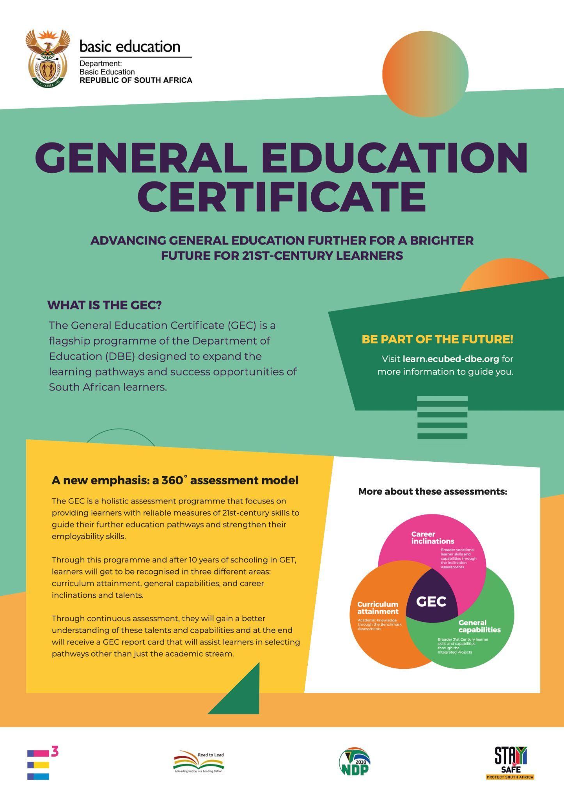
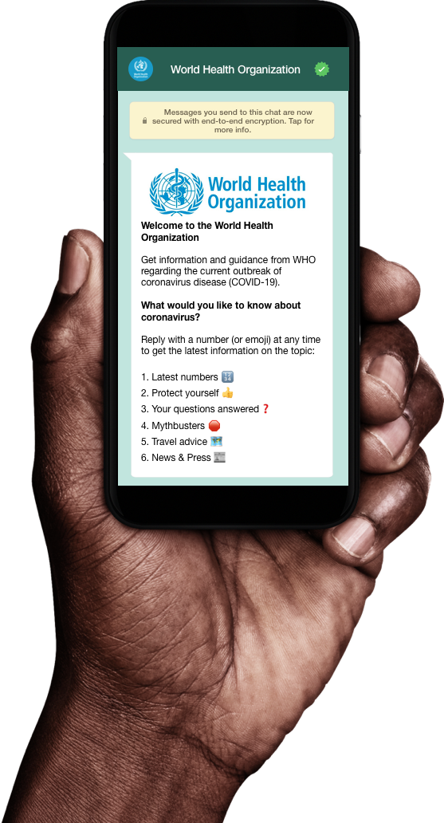
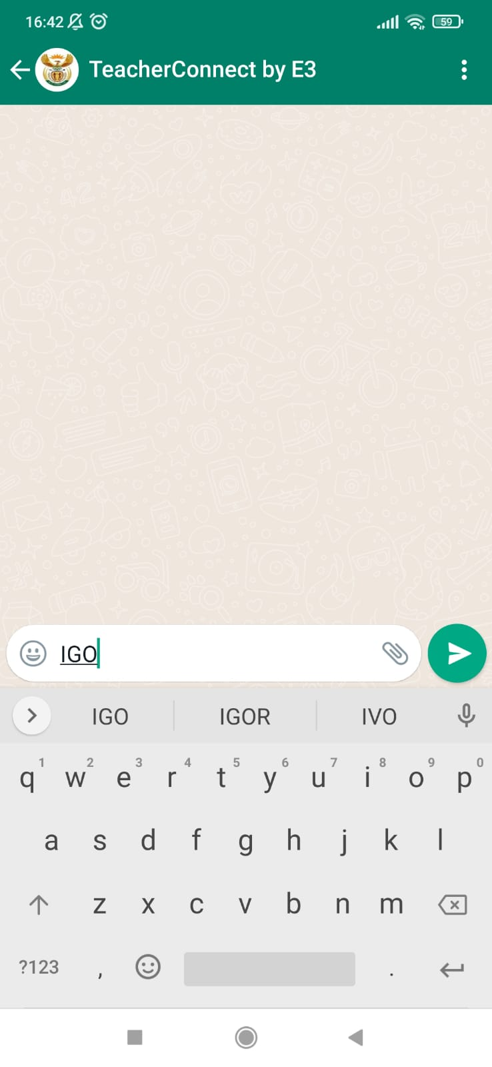
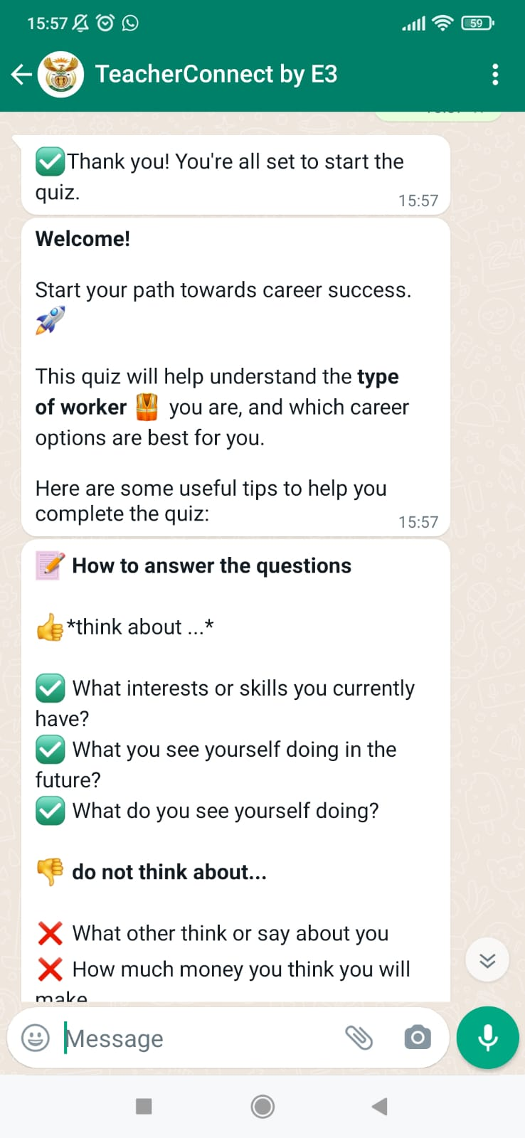
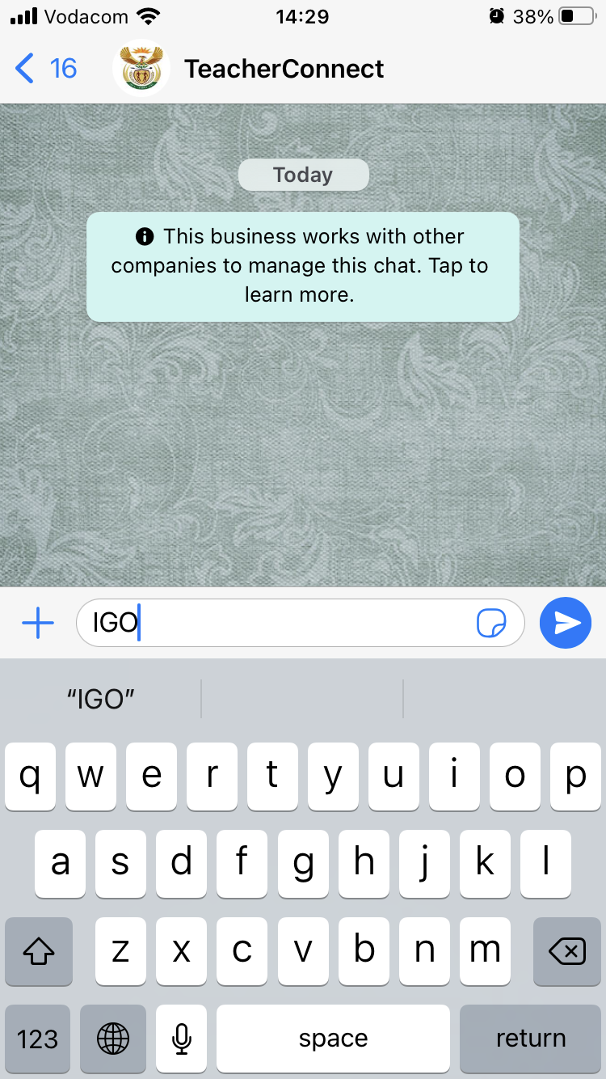
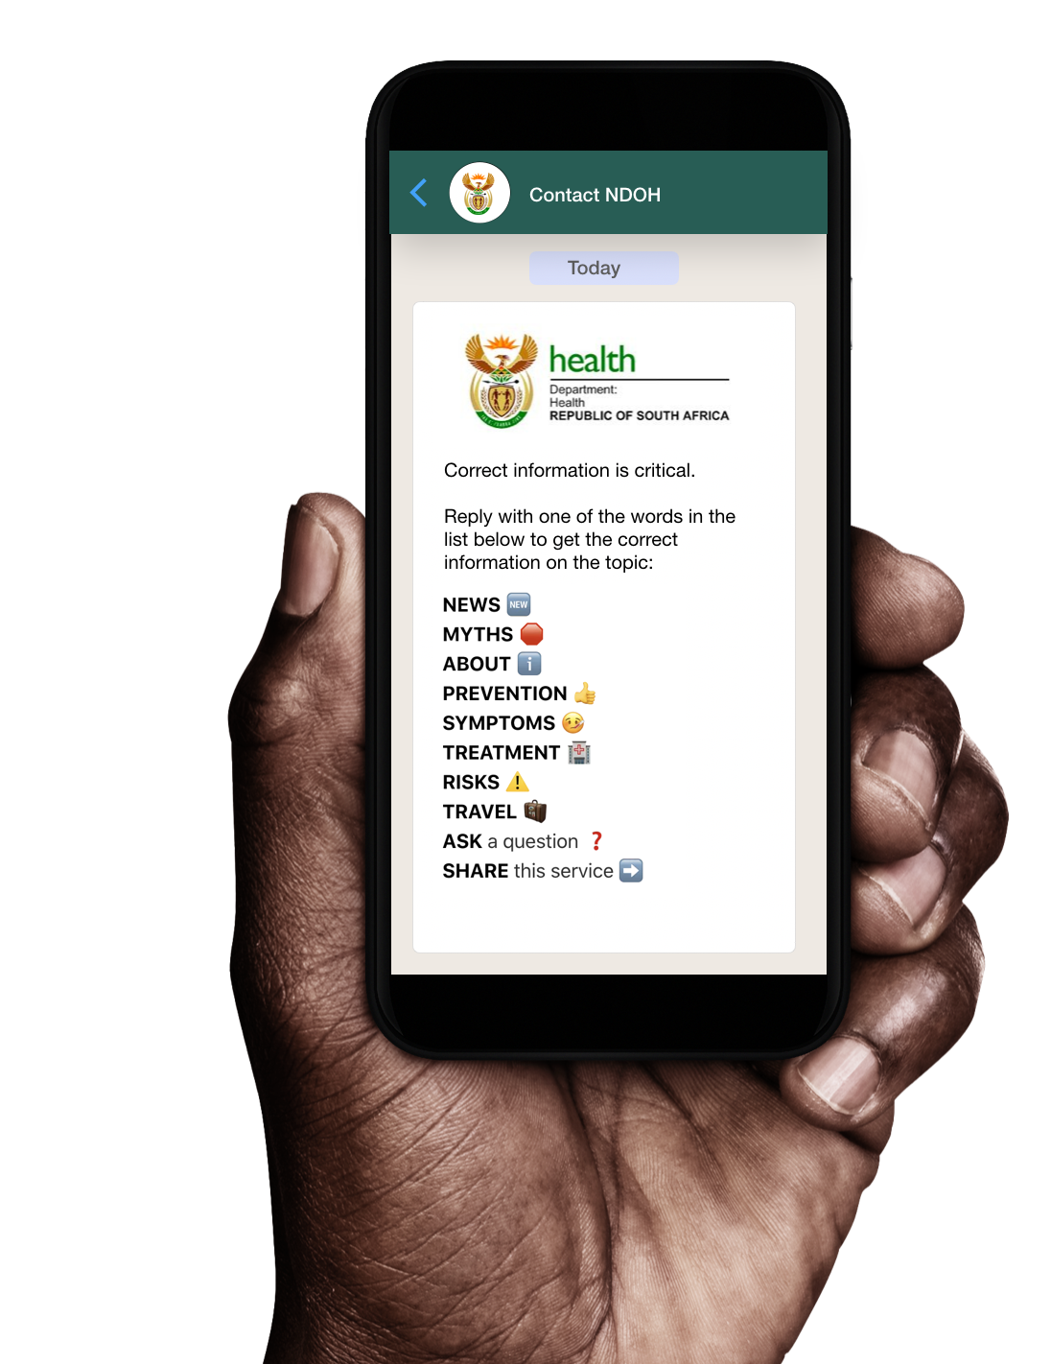

1, 2, 3… Yenza!
Accessing the GEC Trial’s Inclination Assessment on TeacherConnectchat
TeacherConnect
Infusing 21st-Century Skills into the GEC
WhatsApp
IGO
to 060 060 33 33

Slide 2



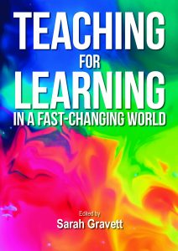

Agenda - curious questions
What are the key 21st-century skills our students need to thrive in today's changing world?
Why curious questions?
Curiosity is the driver of attention and engagement. Getting and keeping learners curious is one of the key factors of successful education.
S. Gravett 2022
Science of learning: Attention and engagement
Why do we need 21st century skills?
What can we learn from international education systems efforts to infuse 21st Century Skills?
What does this mean for the GEC? How do we infuse 21st-Century Skills into the GEC?
Meeting Overall Objective 2: to explore the integration of 21st Century skills in the teaching, learning, and assessment related to the GEC.
Notes:
Thank you Dr Chetty, Dr Poliah for your excellent presentations, I must say you are both hard acts to follow, and at the end of the day! I’ll do my best to keep you all engaged and interested in this fascinating topic. In the next 30 minutes I would like to take you on a journey, a journey that will take us outside the borders of South Africa, around the world before landing back in this room. On this journey we will explore 4 curious questions. I love my curious questions, because in the words of Professor Gravett curiosity is the driver of attention and engagement. Getting and keeping learners or in this case participants curiosity is one of the key factors of successful education.
We will explore
what are the key 21st century skills our learners need to thrive in today’s changing world?
Why do we need 21st century skills
What can we learn from international education systems efforts to infuse 21st-Century skills?
What does this mean for the GEC, how do we infuse 21st-Century skills into the GEC?

Slide 3


What are the 21st-Century Skills we need to thrive in changing world ?

Slide 4
21st Century Skills
21st-Century Skills refer to key abilities that learners need to grow in order to succeed and thrive in today's fast-paced world.
Known by many names such as transferable skills, soft skills, competencies, essential skills, life skills, future skills, higher-order thinking skills…

Slide 5

Ask the audience
What do you think are important 21st-Century Skills?
Science of learning: Assessing prior knowledge

Slide 6
Examples of 21st-Century Skills
Adaptability
Conflict resolution
Self-efficacy
Self-Efficacy
Communication
Empathy
Accountable
Intrinsic motivation
Systems thinking
Collaboration
Resilience
Self-directed
Emotional Intelligence
Computational thinking
Critical thinking
Problem solving
Information literacy
Adaptability
Growth Mindset
Compassion
Creativity
Metacognition
Agency/Autonomy
Curiosity
Digital literacy
Innovation
Leadership
Solution seeking
Decision making
Logical reasoning
Environmental awareness
Notes:
There are hundreds of different 21st Century skills and this word cloud is by no means complete.

Slide 7
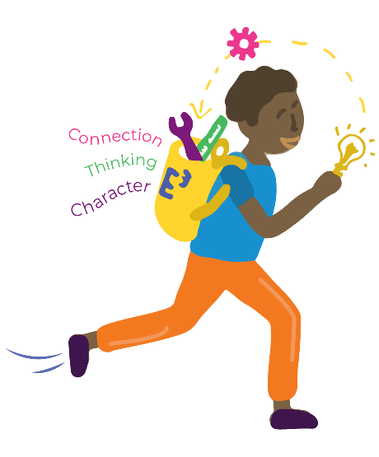

Summary 21st-century leaders and learners
21st-century learners, teachers, and leaders are people who employ skills such as critical thinking, collaboration, creativity to be
problem-finders and solution-seekers
who are self-directed as they look for opportunities
to solve problems and create value for everyone!

Slide 8
Why do we need 21st-Century Skills?

Slide 9
Ask the audience
Why do we need 21st-Century Skills?
Science of learning: opportunities for deep thinking

Slide 10
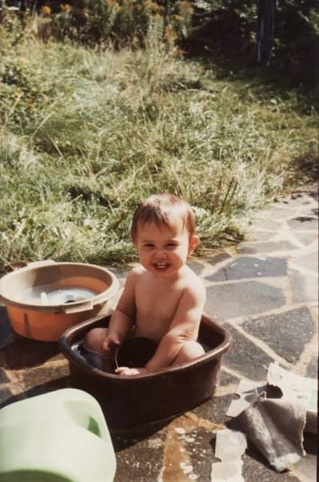
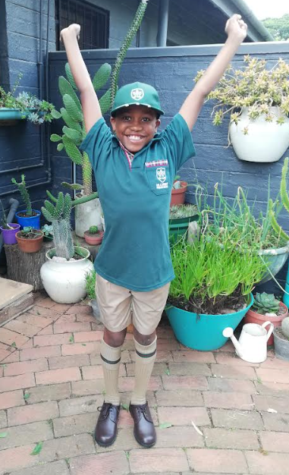


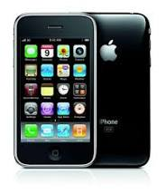
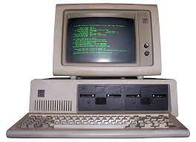
We live in a changing world…
Population: 4 billion
1980’s
Population: 7 billion
2010’s
Population: 4 billion
Notes:
We live in a rapidly changing world. When I was born, the population was 4 billion, telephones and computers looked like this?
This is Walter, on his first day of school. He certainly does not look like this each morning I take him to school. When he was born in 2011 this is what computers and cellphones looked like.

Slide 11
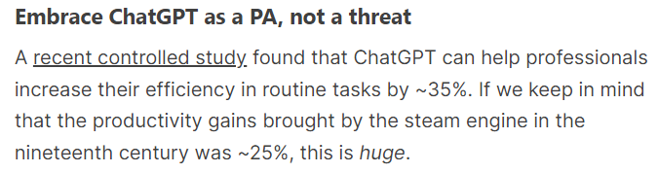
… where change is rapid
Quote from Dr. Philippa Hardman
Learning Research Digest
Moore’s law: computing power doubling every 18 months.
Notes:
So we live in a changing world, where change is rapid. How many of you have used some form of AI or even ChatGPT. Personally it has changed my life, for anyone interested, i'd be happy to do a quick master class one evening. Anyway, the study found that the productivity gains brought by ChatGPT and other AIS increased efficiency by 35%!!!! Bearing in mind that the productivity gains from the steam engine in the 19th century was 25%! We are living through a pivotal moment in history, where change is so rapid we cannot keep up.

Slide 12



… and the future is uncertain
Our future is
Volatile
Uncertain
Complex
Ambiguous
Images were taken from Pexels
Notes:
But the future is also very uncertain. In the last couple of years we experienced terrible droughts in the Cape as well as more recently floods. Last year a huge war broke out in Ukraine, which impacted us here in South Africa, do you remember the ridiculous costs of cooking oil. And of course who could forget corona virus.

Slide 13
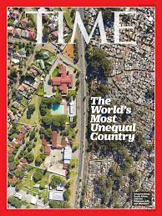
Can perpetuate inequality
…If we do not embrace these changes and prepare our young people with the skills they need for a rapidly changing world.
These skills are INTERCONNECTED. These 21st Century Skills also help the development of academic skills.
Notes:
If we do not embrace these changes and prepare our young people with the skills they need for a rapidly changing world, we will simply perpetuate the inequality that we find ourselves in. These skills are INTERCONNECTED. These 21st Century Skills also help the development of academic skills

Slide 14
What can we learn from international education systems’ efforts to infuse 21st Century Skills?

Slide 15
What can we learn from the learning sciences?
What is the science of learning?
What does it tell us about 21st-Century Skills?
What do the researchers say?
A multidisciplinary field combining cognitive science, educational psychology, neuroscience, and pedagogy. Its goal is to enhance our understanding of learning processes to improve educational methods and outcomes. (This is NOT new)
Collaboration
Communication
Critical thinking
Creativity
Cognition/Metacognition/
Confidence
AND
Content (CAPS)
Are key to learners' success
We’ve identified [through the learning sciences] the 6C’s that will help all young people to become thinkers… contributing members of their communities as they forge a fulfilling life.
(Hirsch-Pasek Golingkoff, 2016, p5.)
Notes:
The science of learning is a multidisciplinary field that encompasses various domains such as cognitive science, educational psychology, neuroscience, and pedagogy. It aims to understand how people learn and to apply this understanding to improve educational methods, strategies, and outcomes. In a recent book by Kathy Hirsh-Pasek and Roberta Golingkoff, they write, we’ve identified through the learning sciences the 6Cs that will help all young people to become thinkers, contributing members of their communities as they forge a fulfilling life.
Here they include CONTENT as in curriculum content as the 6’C, placing it firmly in the centre of their model.

Slide 16
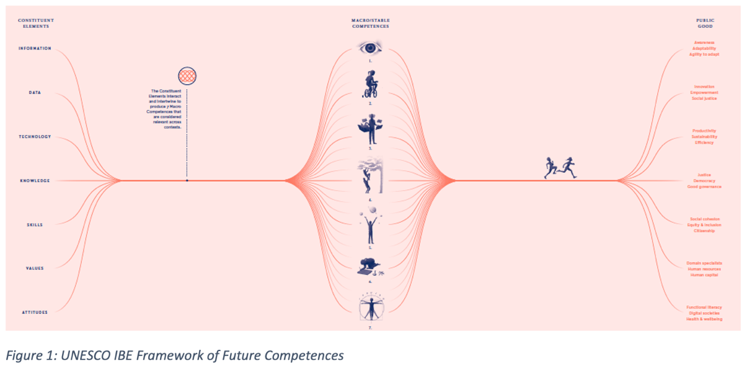
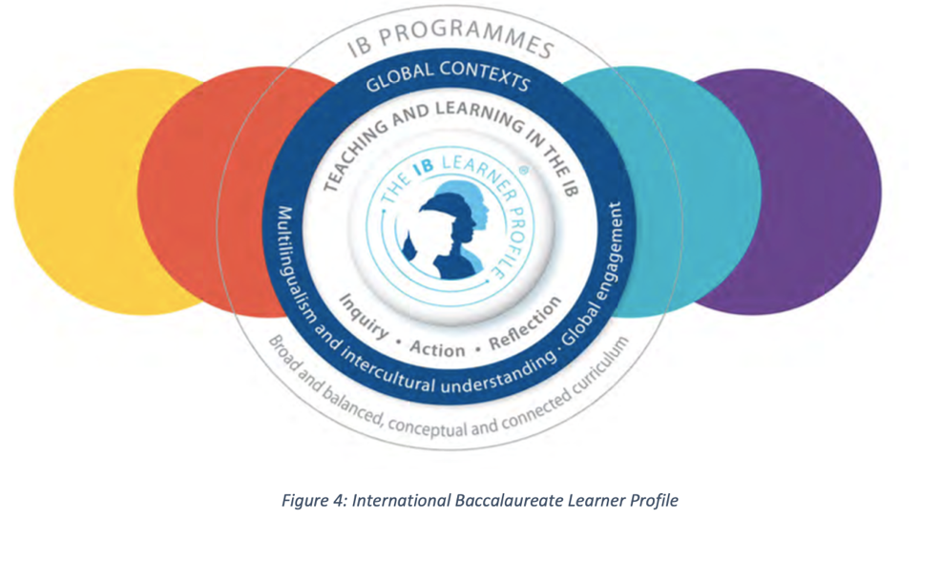
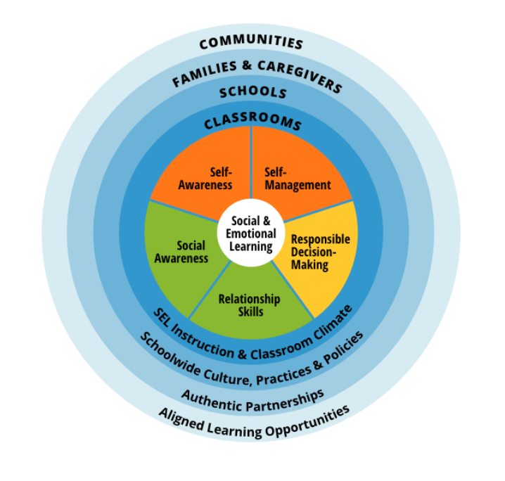
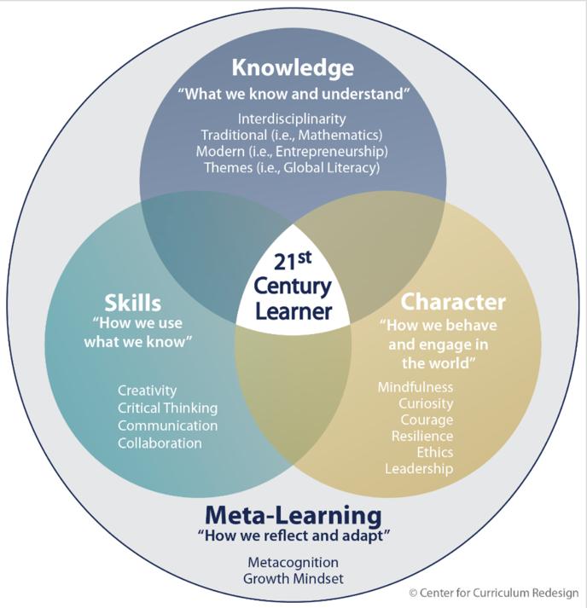
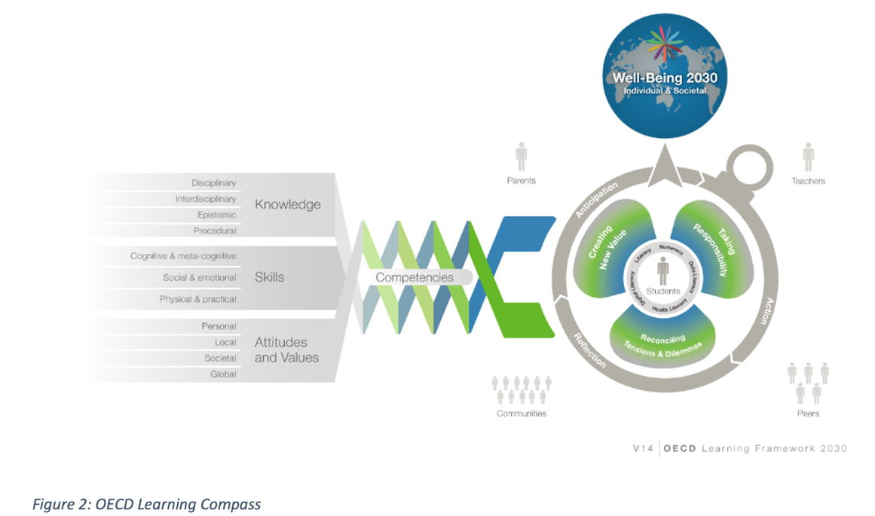
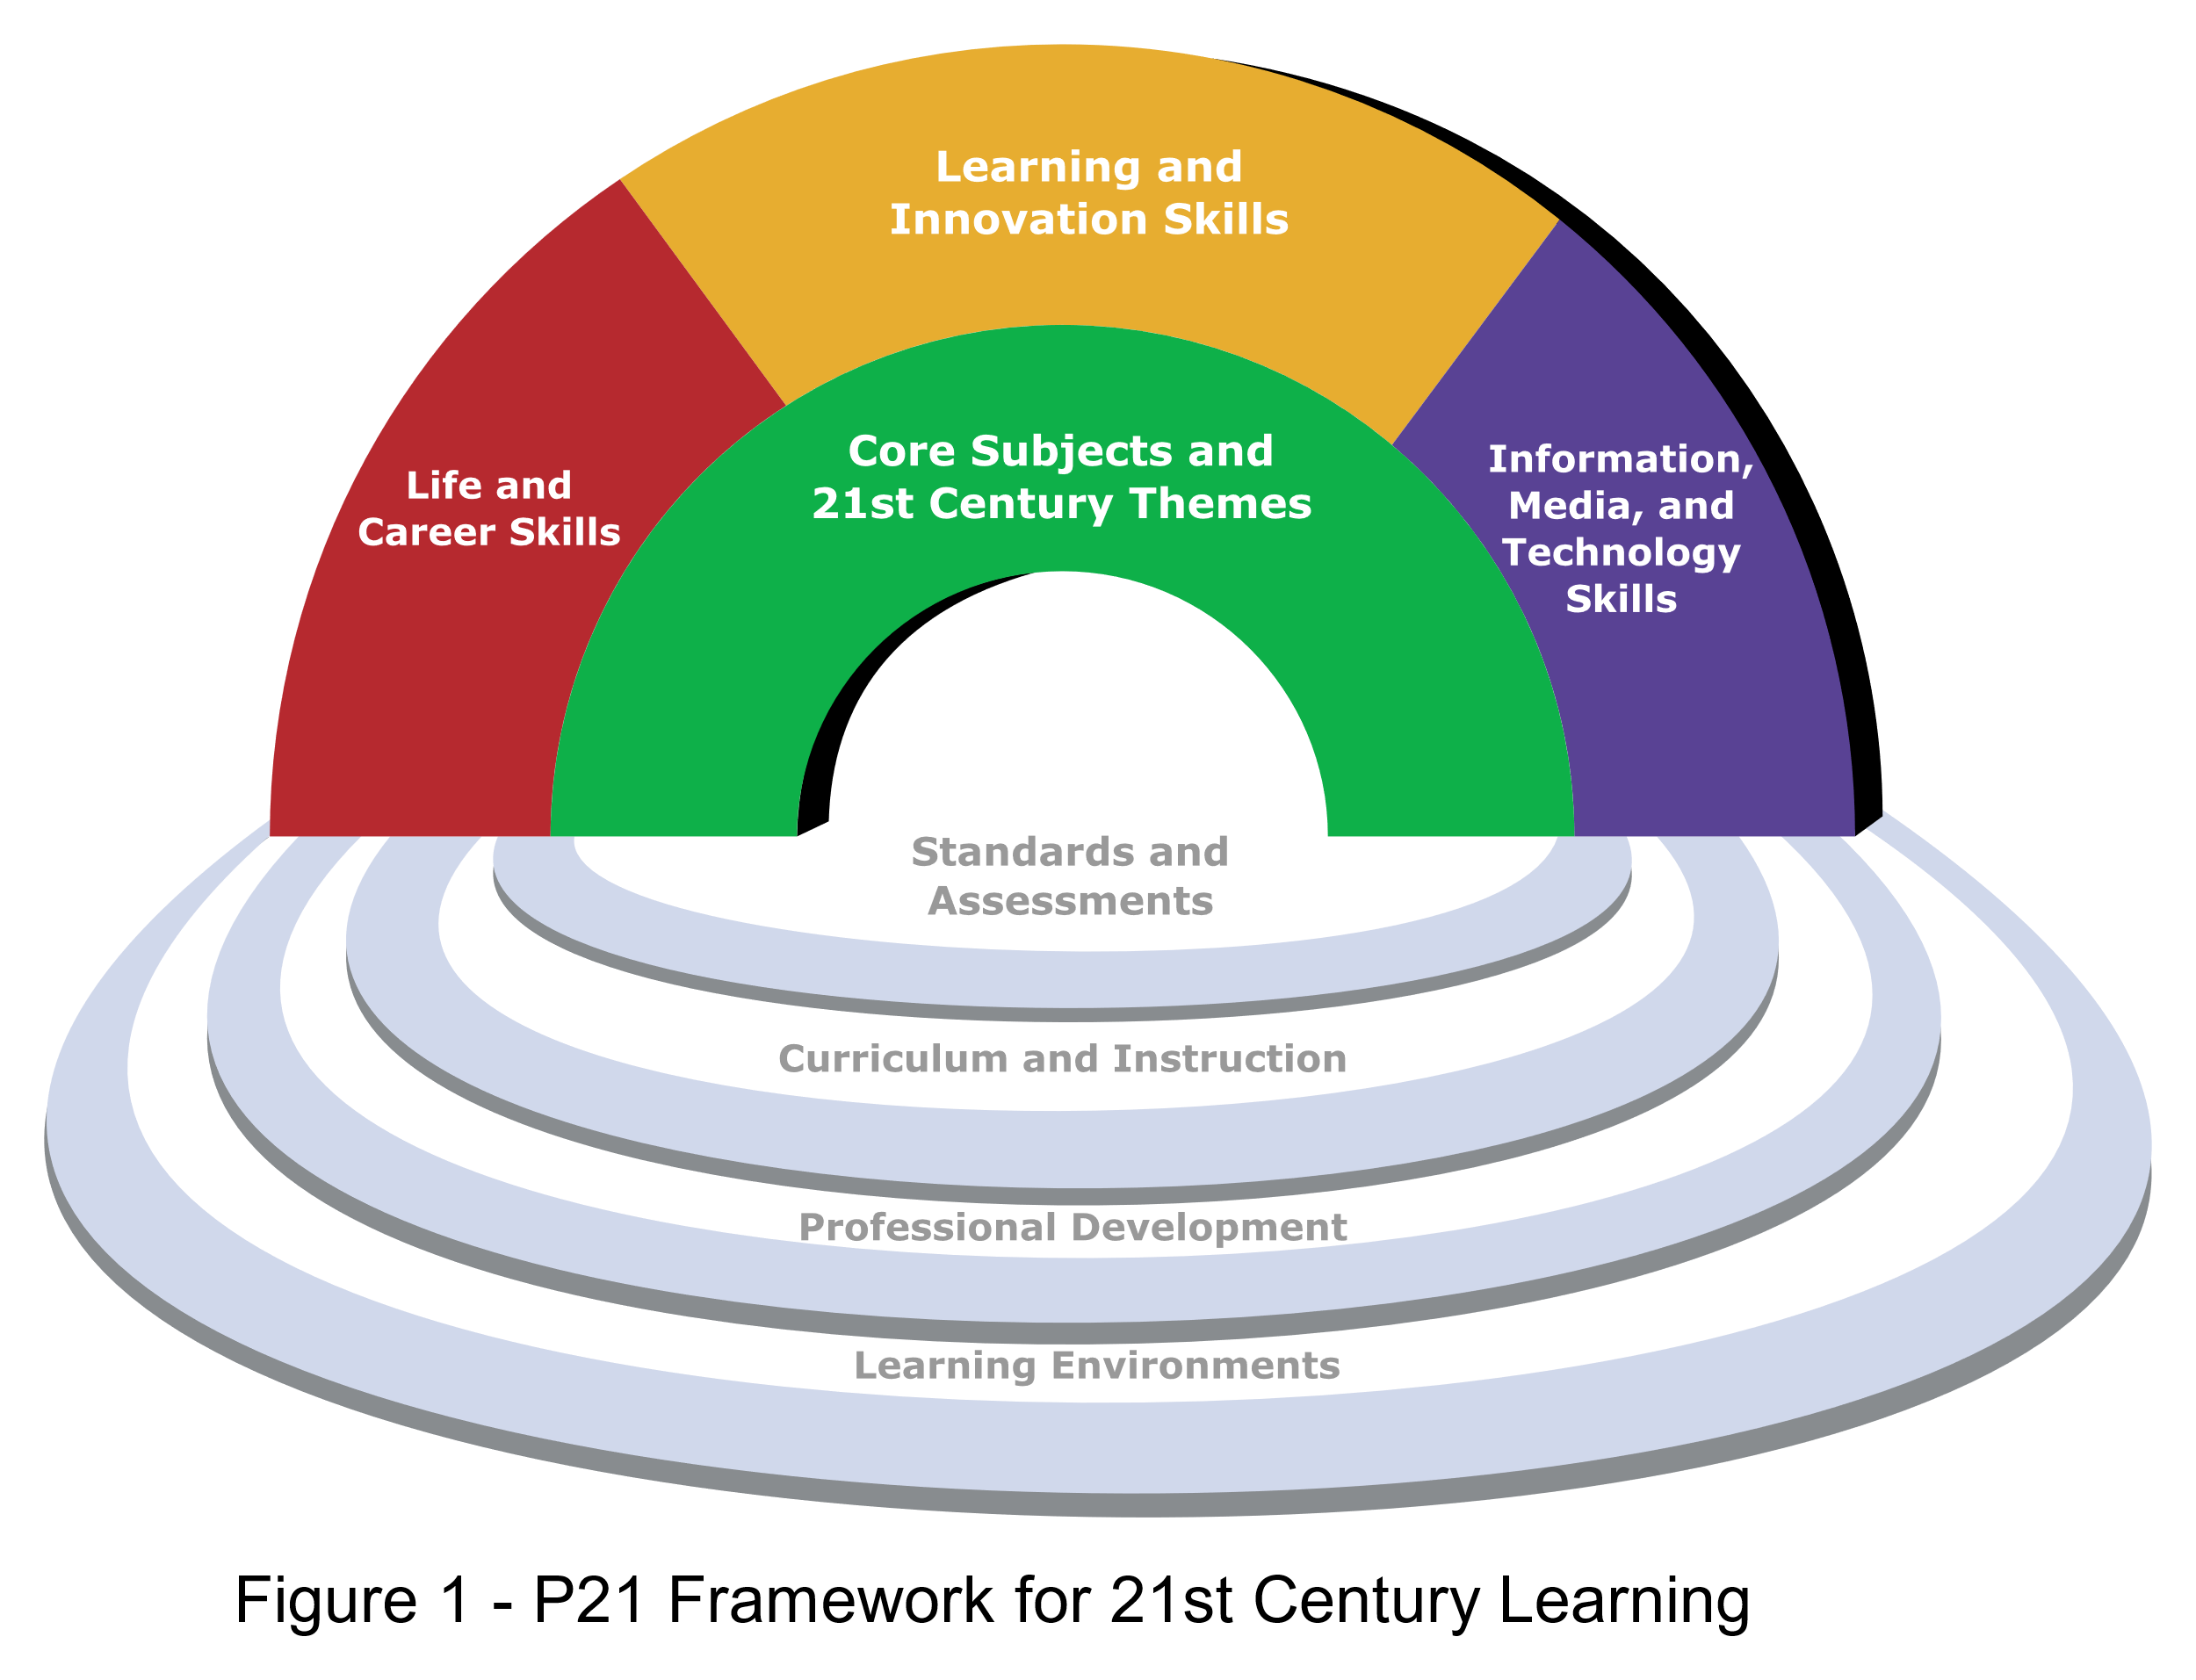
International frameworks
Notes:
Global political, economic, and social shifts, compounded by rapid technological changes, have caused many countries to rethink how their education systems are preparing young people to succeed in life beyond school, and to embark on reforms aimed at improving the quality and relevance of basic education. South Africa is no different – the theme for the 2023 DBE Lekgotla was Equipping Learners with Knowledge and Skills for a Changing World Post the COVID-19 Pandemic. There are literally hundreds of frameworks from around the world as countries try and grapple with how they can prepare their young people to succeed and thrive in a rapidly changing world.

Slide 17
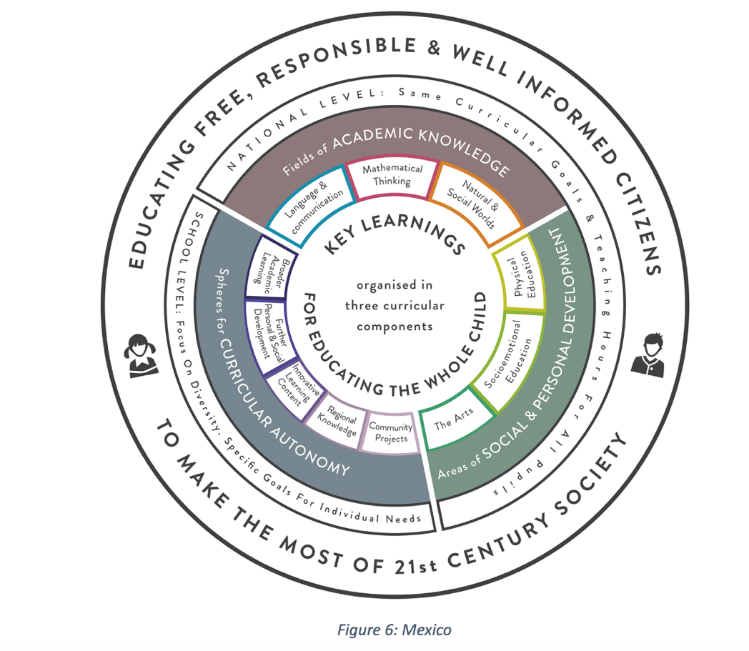
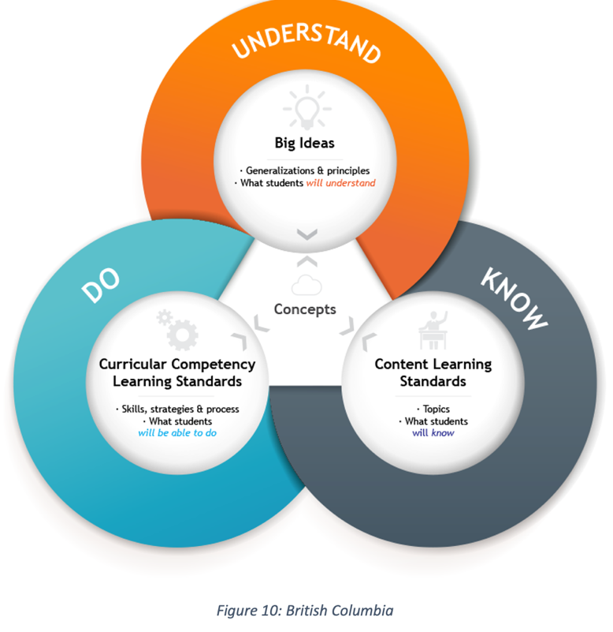
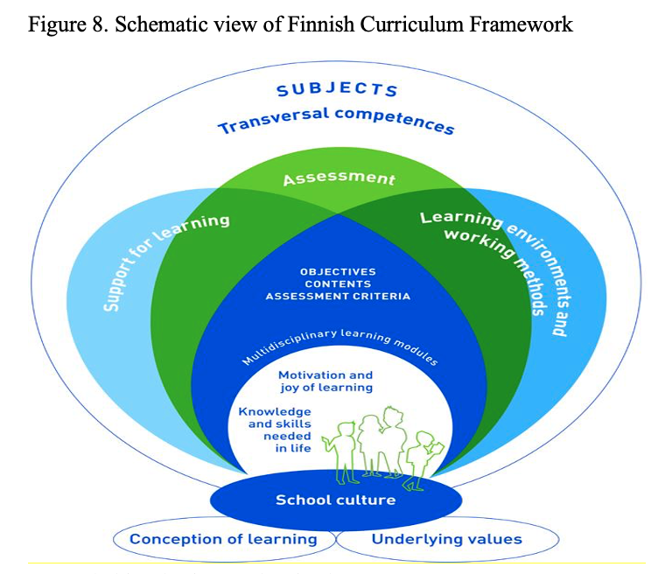
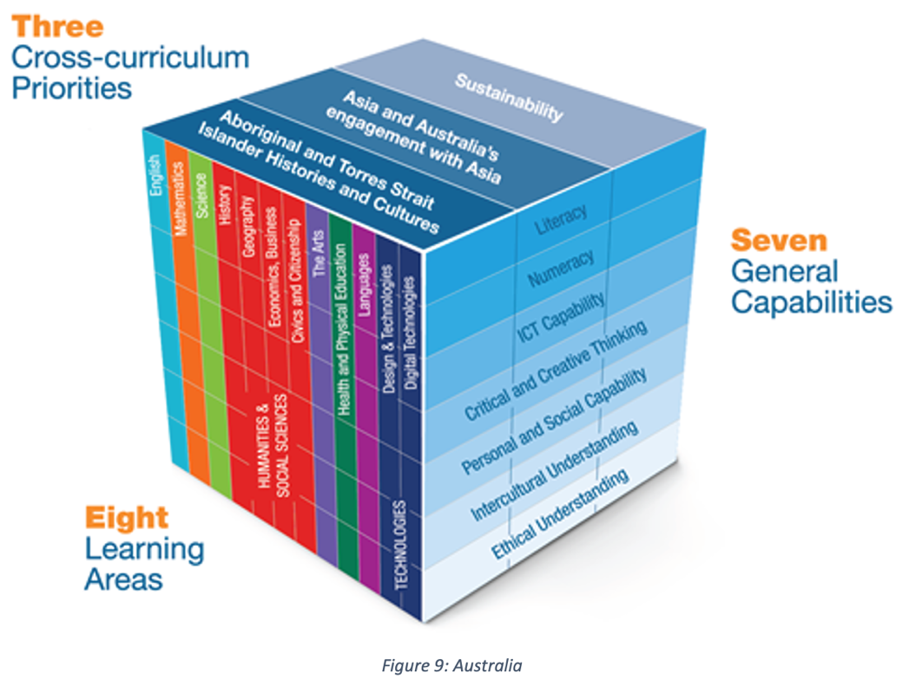
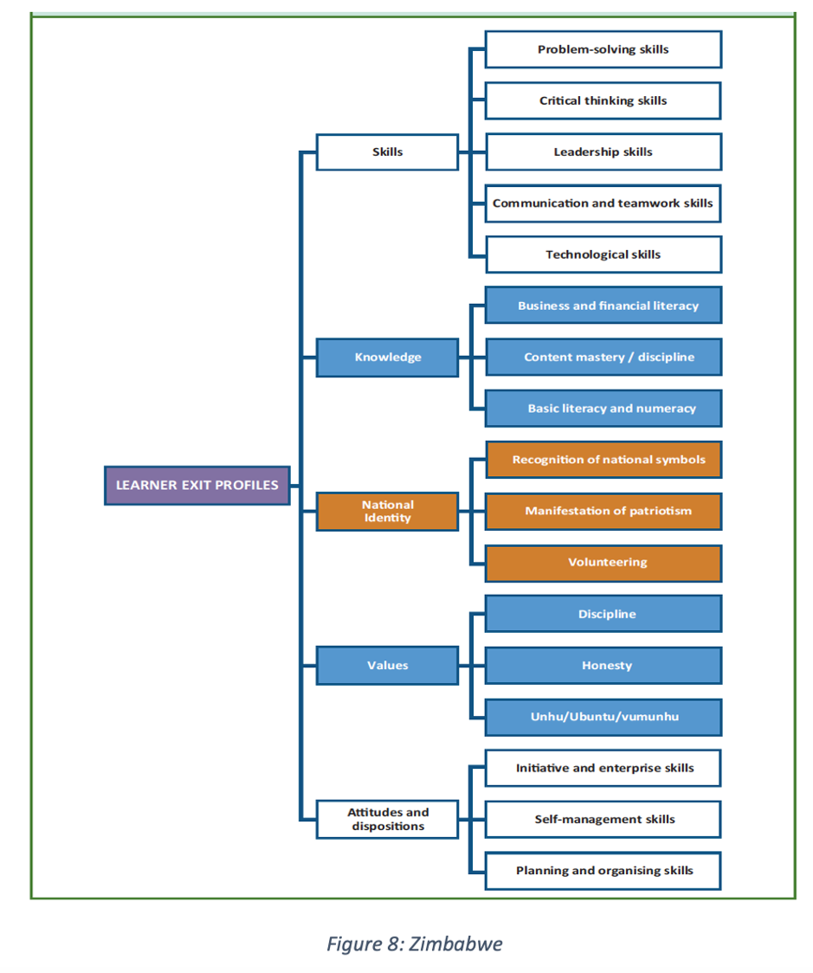
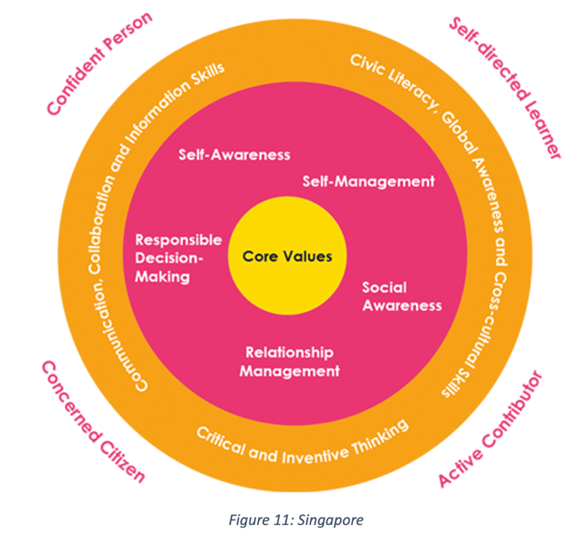
International frameworks

Slide 18


Learning from others
Notes:
In South Africa, the Curriculum Strenghtening team are leading a very thorough process that seeks to create a South African competency framework that will infuse these 21st-Century skills into the curriculum. They have compiled a collection of case studies and key insights that can be used to inform ongoing educational improvements in South Africa.

Slide 19
Learning from others
Different frameworks have different purposes for different settings.
Each framework adds to the conversation.
No single framework can be used to solve every problem and meet every need.
The is no ONE way to infuse competencies, different countries have done different things.
Teaching and developing 21^{st-}Century Skills requires alignment between assessment, curriculum and teacher development.
The measurement of 21st -Century Skills is still in its infancy and does not lend itself to summative methods of assessment. (Care et al 2018)
It is NOT a quick fix, it is a developmental process with a number of steps, taking place over time.
Notes:
What can we learn from all of these frameworks?
Different frameworks have different purposes for different settings.
Each framework adds to the conversation.
No single framework can be used to solve every problem and meet every need.
The is no ONE way to infuse competencies, different countries have done different things.
Teaching and developing 21st-Century Skills requires alignment between assessment, curriculum and teacher development.
It is NOT a quick fix, it is a developmental process with a number of steps, taking place over time.

Slide 20
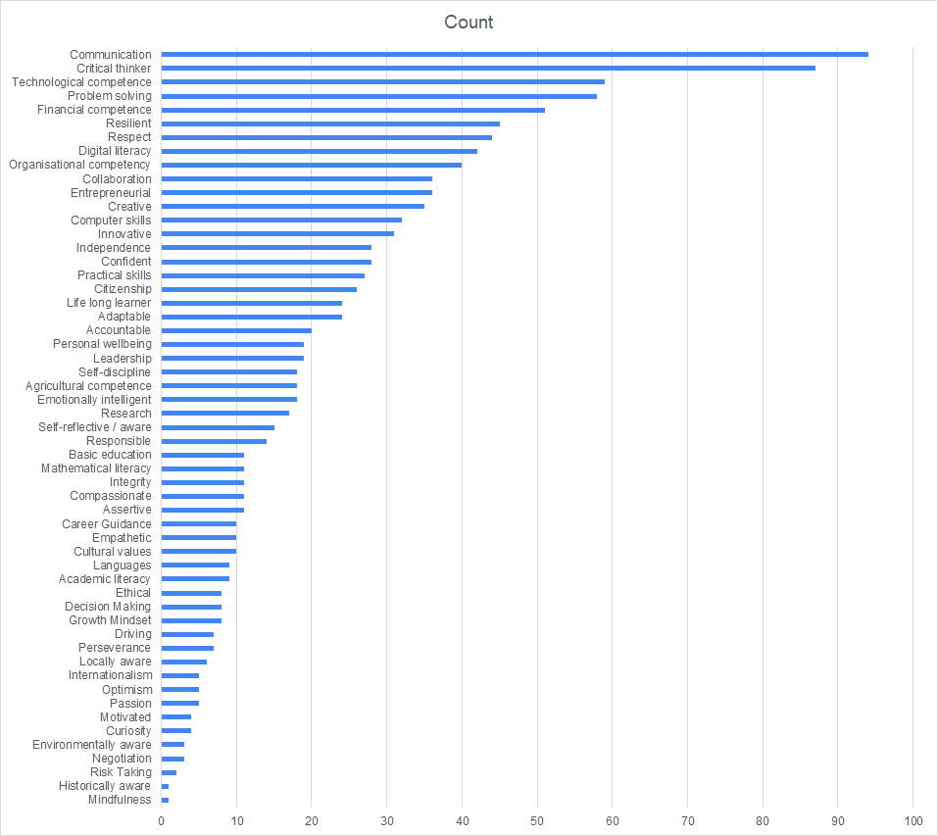
South African stakeholder engagement led by Curriculum Strengthening
Question: What ‘tools’ do learners need when they finish school?
Consulted with
- Adults(314)
- Learners(117)
- Virtual participants (60)
Workshops – across 9 provinces, 36 workshops [Sep to Nov 2022]
Communication, Critical thinking, Collaboration, and Creativity are among the most commonly referenced skills.
Notes:
Moving from the global to the local. In 2022 the team working on the South African competency framework led a stakeholder engagement process, consulting with 500 + people across the country. This is a list of all the 21st century skills that this group thought were important for young people to thrive in a changing world. You will notice that communication, critical thinking, collaboration and creativity are very high up on the list.

Slide 21
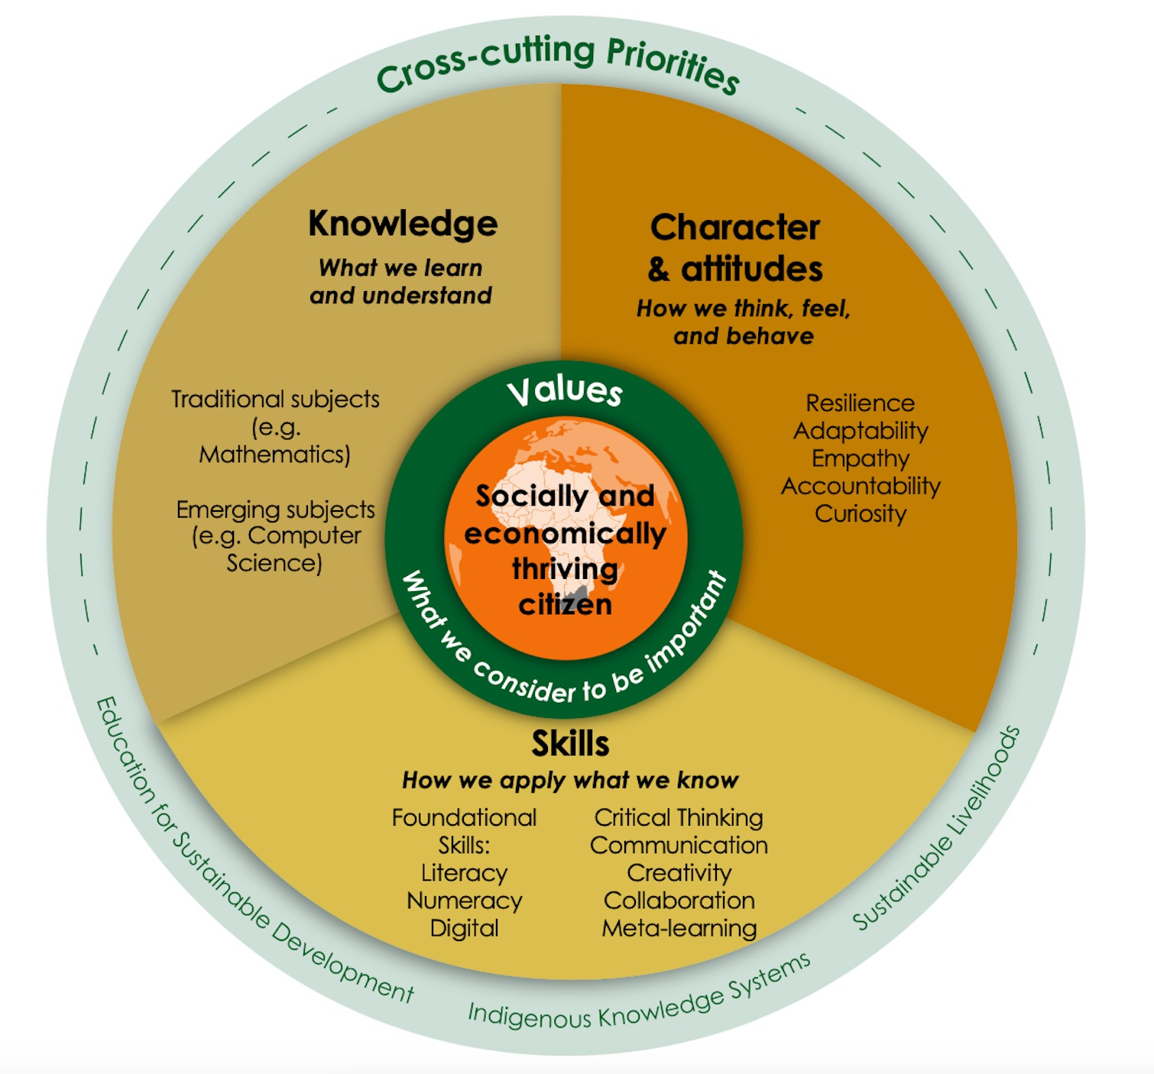
A possible South African Competency Framework
The five C’s are very prominent in this framework!
Notes:
Here you can see the very first draft of a South African competency framework, noting that our 5Cs are central to this framework.

Slide 22
What does this mean for the GEC? How do we infuse 21st-Century Skills into the GEC?

Slide 23
Process
Framework comparison
Analyzed two international frameworks, the CCR Rubric, and the ACER framework, to check for overlap and differences. Chosen for their deep research, coherence, and relevance
Skills mapping
Linked key elements from these frameworks to the learning process of integrated projects (13 steps). What types of activities support the practice of 21st–Century Skills, because these skills are cultivated through pedagogies that support deep learning
\\
Sub-skill selection
Selected a limited set of sub-skills from ACER and CCR to create a manageable framework, that are practically observable.
Rubric testing
Tested and updated the rubric based on findings.
Skill infusion
Purposefully embedded 21st-Century Skills into Integrated Projects (2023).
Notes:
What are the implications of these insights for the Global Education Coalition (GEC)? Our initial step involved carefully selecting two comprehensive and complementary frameworks, namely the Centre for Curriculum Redesign and the Australian Council for Educational Research. These were chosen for their rigor, ribusticity and evidence base. These informed the foundation for our GEC framework, prior to there being a South African framework.
We initiated a comparative analysis of these two frameworks, identifying areas of overlap and divergences. Following this mapping, we proceeded to a practical application, examining the projects in detail. Our aim was to pinpoint within the 13-step process of each project the prime opportunities for learners to actively engage with and develop the vital 21st-century skills.
Subsequently, to ensure our framework remains user-friendly, we distilled the skills and sub-skills down to a more compact number. This step was essential to creating a manageable framework conducive to effective learning and teaching.
In 2022, we tested the rubric. The invaluable feedback we received was instrumental in enabling us to refine and enhance our rubric, bringing us to the version we have today.
So what does this all mean for the GEC. Our first steps were to begin by selecting a couple of very well researched and aligned frameworks to inform our framework for the GEC. We used the Centre for Curriculum Redesign and the Australian Council for Educational research. We first mapped these two frameworks for check for overlap.
We then looked at the actual projects to map out which of the 13 steps of the project would provide the best opportunities for learners to practice thoes 21st century skills.
We then selected a smaller number of the skills and sub-skills to create a manageable framework.
We tested the framework in 2022 and based on the feedback iterated and updated the rubric.

Slide 24
Updates from 2022
Challenges | Mitigation
Limited training and additional support resources | ½ day training Teachers guide to 21st-Century Skills 21st-Century Skills toolkit
Too many criteria | Reducing measurement criteria from 25 - 15.
Lack of integration of 21st-Century Skills into the projects | Integrated 21st-Century Skills into projects
Vague reporting process | Refining the data collection process for 21st-Century Skills.
Notes:
Here is just a quick summary of the changes we made from 2022 to 2023.

Slide 25
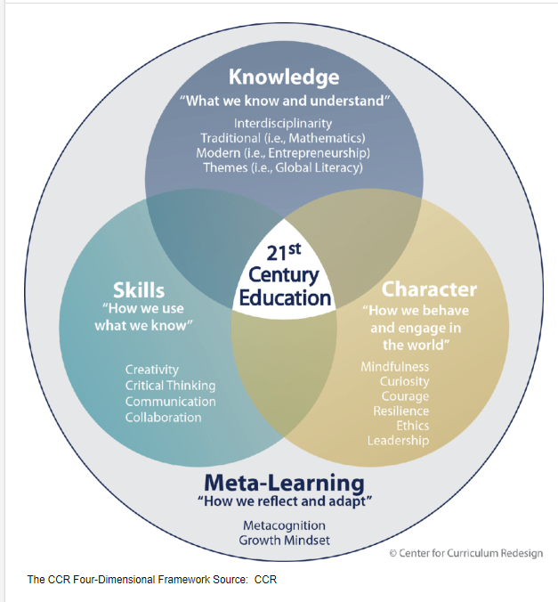


Testing and learning, from global to local
Drawing on a couple of well-researched evidenced based and relevant frameworks
Critical thinking
Collaboration
Creative thinking

Slide 26
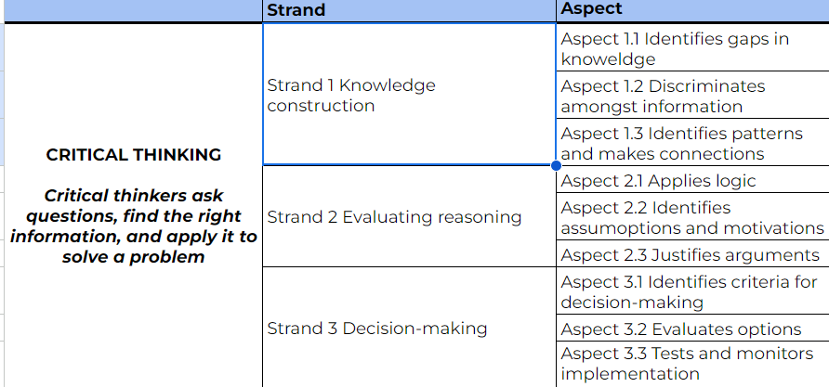
ACER Framework example Critical Thinking
Notes:
Here is an example of critical thinking from the ACER framework. In the interest of time, and I dont want to send you all to sleep, this is an example of critical thinking. Here you can see critical thinking is made up of 3 strands of which each has a further 3 aspects.

Slide 27
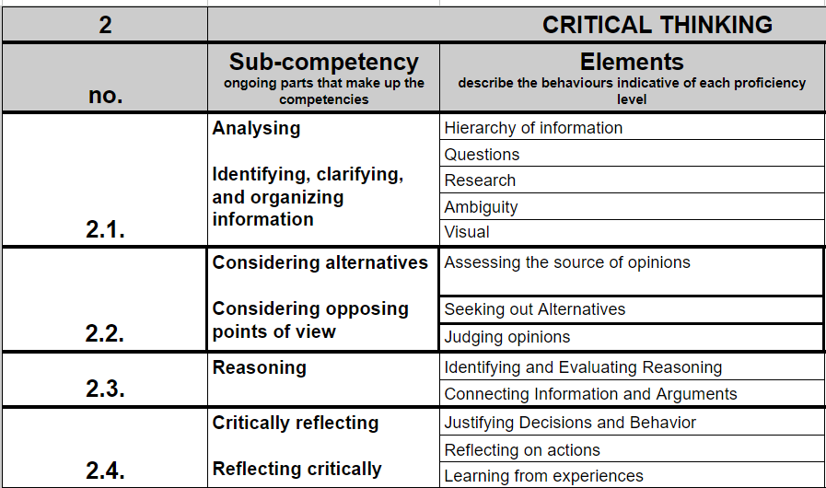
CCR Framework Example Critical Thinking
Notes:
Here with the CCR framework, comparing to critical thinking, again, there are sub-competencies and elements that make up these sub-competencies.
Alone there are many many elements that make up critical thinking, and so we had to think carefully which would be the most relevant to see in the projects AND which might be the easiest to see. So that we could create something that would be both tangible, relevant, and feasible to implement.

Slide 28
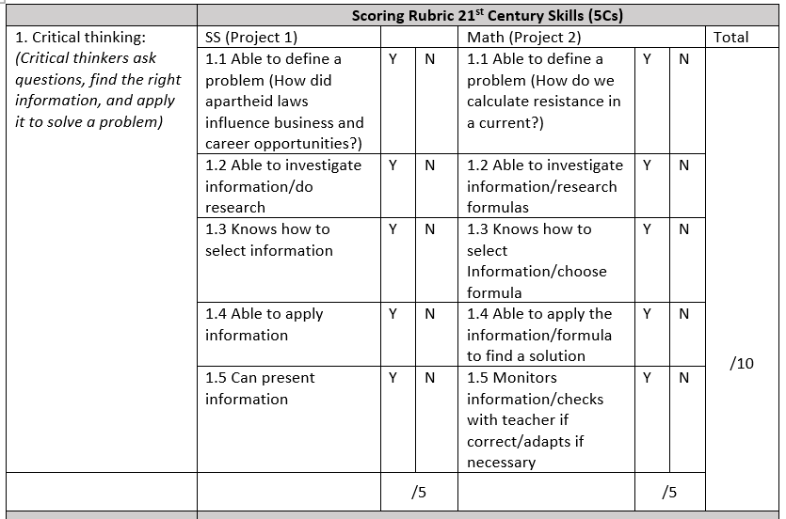
2022
Notes:
In this rubric, we found the in trying to make it simple and easy to use, we found that it was actually too simplistic and therefore became very vague.

Slide 29
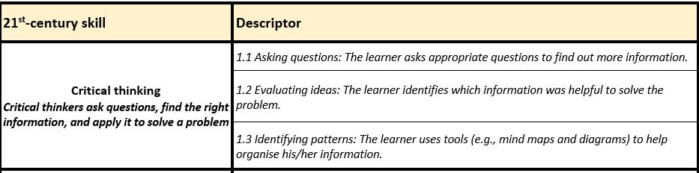
2023
Notes:
We used the research, feedback and learning from previous years to inform this version. Ensuring specificity and simplicity.

Slide 30
A journey to the ultimate goal
Finding the simplicity behind the complexity, while maintaining integrity, quality and impact [of the resources and tools].
Notes:
However this is a journey towards Finding the simplicity behind the complexity, while maintaining integrity, quality and impact [of the resources and tools].

Slide 31
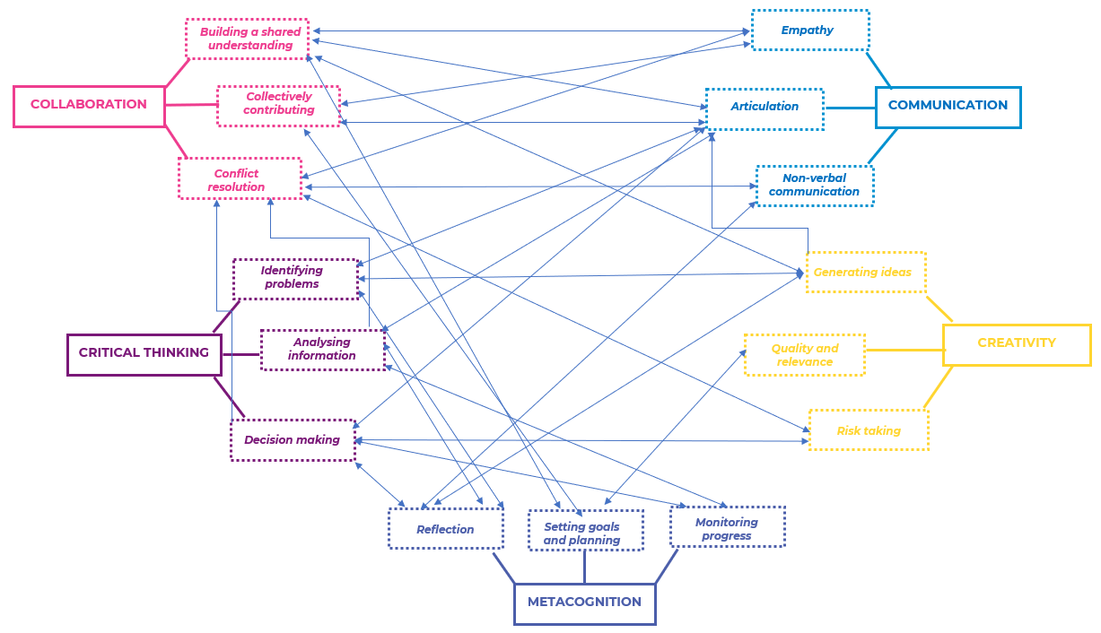
Interconnected

Slide 32
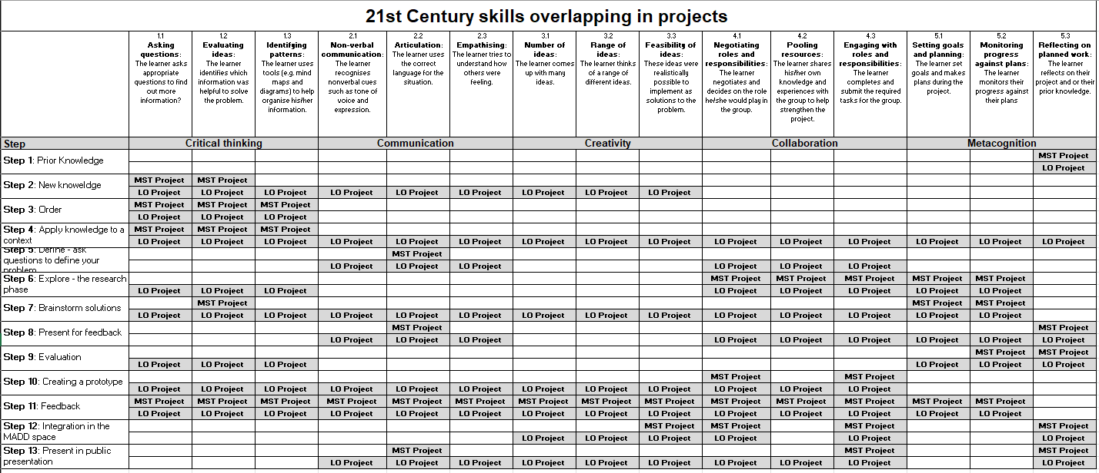
Mapping of 21st-Century Skills into the Integrated Projects
Notes:
Here is an example of how we mapped the 21st-Century Skills into the Integrated Projects.

Slide 33
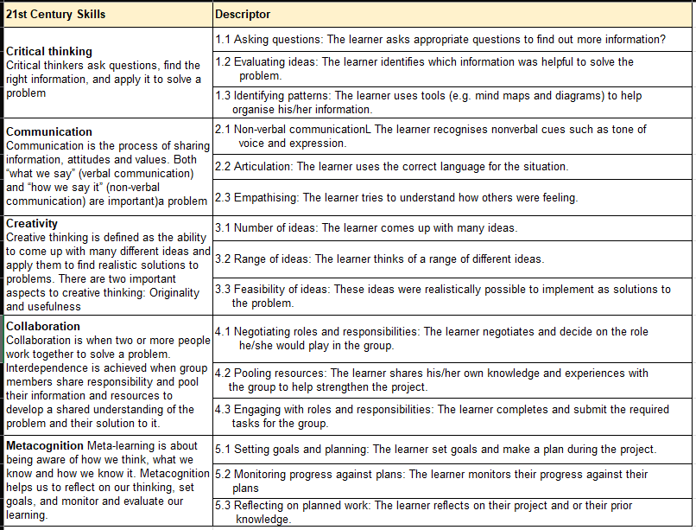
GEC 21st-Century Skills Rubric
Notes:
This is what the rubric looks like. In Tuesdays session we will have time to go through it properly and actually use it.

Slide 34
GEC 21st-Century Skills Rubric
CRITICAL THINKING
COMMUNICATION
CREATIVITY
COLLABORATION
METACOGNITION
Critical thinkers ask questions, find the right information, and apply it to solve a problem
Communication is the process of sharing information, attitudes and values. Both “what we say” (verbal communication) and “how we say it” (non-verbal communication) are important
Creative thinking is defined as the ability to come up with many different ideas and apply them to find realistic solutions to problems. There are two important aspects to creative thinking: Originality and usefulness
Collaboration is when two or more people work together to solve a problem. Interdependence is achieved when group members share responsibility and pool their information and resources to develop a shared understanding of the problem and their solution to it.
Meta-learning is about being aware of how we think, what we know and how we know it. Metacognition helps us to reflect on our thinking, set goals, and monitor and evaluate our learning.

Slide 35
GEC 21st-Century Skills Rubric
CRITICAL THINKING
COMMUNICATION
CREATIVITY
COLLABORATION
METACOGNITION
1.1 Asking Questions
1.2 Evaluating ideas
1.3 Identifying patterns
2.1 Non-verbal communication
2.2 Articulation (how we say things)
2.3 Empathising
3.1 Number of ideas
3.2 Range of ideas
3.3 Feasibility of ideas
4.1 Negotiating roles and responsibilities
4.2 Pooling resources
4.3 Engaging with roles and responsibilities
5.1 Setting goals and planning
5.2 Monitoring progress against plans
5.3 Reflecting on work
Making the intangible, tangible!

Slide 36

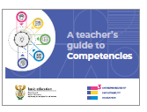
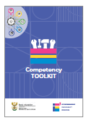
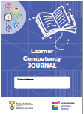
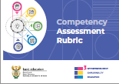
A journey towards complexity
Growth in
Development of competencies and complexity of the measurement tools.
Developmental process
Identifying competencies
Testing systems not assessing the impact of the curriculum on developing competencies
Tools and resources to support scaffolding
Starting from the know, moving to the unknown
Scaffolding and building capacity of both teachers and learners in the process
TIME
Notes:
Finally just to say that this is a journey, it will take time, the first step is to define and identify these skills.

Slide 37
Research to inform practice
Looking at questions such as:
How effective do teachers find the rubric in observing 21st century skills among learners?
What challenges do teachers encounter when implementing the rubric in their classrooms?
How easily can teachers incorporate this rubric into their existing teaching practices?
How do teachers interpret the rubric? Is it too granular, or too simplistic?
Do current teaching practices give teachers enough opportunities to see learners practice their 21st-Century skills?
What teacher training is needed?
What changes to the curriculum need to take place to support this, if any?
Informing the Curriculum Strengthening process of developing a South African Competency Framework

Slide 38
What next?
A journey towards the development of
Ensuring clear definitions and descriptions of 21st-Century Skills
Clear developmental trajectories for 21st-Century Skills
Focus on formative assessment methods
Implementation of a teaching-for-learning approach that support the development of 21st Century Skills
Prioritising learner reflection

Slide 39
1, 2, 3… Yenza!
Accessing the GEC Trial’s Inclination Assessment on TeacherConnectchat
TeacherConnect
Infusing 21st-Century Skills into the GEC
WhatsApp
IGO
to 060 060 33 33

Slide 40
My curious questions
What are the key 21st-century skills our students need to thrive in today's changing world?
Why curious questions?
Curiosity is the driver of attention and engagement. Getting and keeping learners curious is one of the key factors of successful education.
S. Gravett 2022
Science of learning: Attention and engagement
Why do we need 21st century skills?
What can we learn from international education systems efforts to infuse 21st Century Skills?
What does this mean for the GEC? How do we infuse 21st-Century Skills into the GEC?
Meeting Overall Objective 2: to explore the integration of 21st Century skills in the teaching, learning, and assessment related to the GEC.
Notes:
Thank you Dr Chetty, Dr Poliah for your excellent presentations, I must say you are both hard acts to follow, and at the end of the day! I’ll do my best to keep you all engaged and interested in this fascinating topic. In the next 30 minutes I would like to take you on a journey, a journey that will take us outside the borders of South Africa, around the world before landing back in this room. On this journey we will explore 4 curious questions. I love my curious questions, because in the words of Professor Gravett curiosity is the driver of attention and engagement. Getting and keeping learners or in this case participants curiosity is one of the key factors of successful education.
We will explore
what are the key 21st century skills our learners need to thrive in today’s changing world?
Why do we need 21st century skills
What can we learn from international education systems efforts to infuse 21st-Century skills?
What does this mean for the GEC, how do we infuse 21st-Century skills into the GEC?

Slide 41
What are the 21st-Century Skills we need to thrive in changing world ?

Slide 42
21st Century Skills
21st-Century Skills refer to key abilities that learners need to grow in order to succeed and thrive in today's fast-paced world.
Known by many names such as transferable skills, soft skills, competencies, essential skills, life skills, future skills, higher-order thinking skills…

Slide 43
Ask the audience
What do you think are important 21st-Century Skills?
Science of learning: Assessing prior knowledge

Slide 44
Examples of 21st-Century Skills
Adaptability
Conflict resolution
Self-efficacy
Self-Efficacy
Communication
Empathy
Accountable
Intrinsic motivation
Systems thinking
Collaboration
Resilience
Self-directed
Emotional Intelligence
Computational thinking
Critical thinking
Problem solving
Information literacy
Adaptability
Growth Mindset
Compassion
Creativity
Metacognition
Agency/Autonomy
Curiosity
Digital literacy
Innovation
Leadership
Solution seeking
Decision making
Logical reasoning
Environmental awareness
Notes:
There are hundreds of different 21st Century skills and this word cloud is by no means complete.

Slide 45
Summary 21st-century leaders and learners
21st-century learners, teachers, and leaders are
problem-finders and solution-seekers
who are self-directed as they look for opportunities
to solve problems and create value for everyone!

Slide 46
Why do we need 21st-Century Skills

Slide 47
Ask the audience
Why do we need 21st-Century Skills?
Science of learning: opportunities for deep thinking

Slide 48
We live in a changing world…
Population: 4 billion
1980’s
Population: 7 billion
2010’s
Population: 4 billion
Notes:
We live in a rapidly changing world. When I was born, the population was 4 billion, telephones and computers looked like this?
This is Walter, on his first day of school. He certainly does not look like this each morning I take him to school. When he was born in 2011 this is what computers and cellphones looked like.

Slide 49
… where change is rapid
Quote from Dr. Philippa Hardman
Learning Research Digest
Notes:
So we live in a changing world, where change is rapid. How many of you have used some form of AI or even ChatGPT. Personally it has changed my life, for anyone interested, i'd be happy to do a quick master class one evening. Anyway, the study found that the productivity gains brought by ChatGPT and other AIS increased efficiency by 35%!!!! Bearing in mind that the productivity gains from the steam engine in the 19th century was 25%! We are living through a pivotal moment in history, where change is so rapid we cannot keep up.

Slide 50
… and the future is uncertain
Our future is
Volatile
Uncertain
Complex
Ambiguous
Images were taken from Pexels
Notes:
But the future is also very uncertain. In the last couple of years we experienced terrible droughts in the Cape as well as more recently floods. Last year a huge war broke out in Ukraine, which impacted us here in South Africa, do you remember the ridiculous costs of cooking oil. And of course who could forget corona virus.

Slide 51
Can perpetuate inequality
…If we do not embrace these changes and prepare our young people with the skills they need for a rapidly changing world.
Notes:
If we do not embrace these changes and prepare our young people with the skills they need for a rapidly changing world, we will simply perpetuate the inequality that we find ourselves in.

Slide 52
What can we learn from international education systems’ efforts to infuse 21st Century Skills?

Slide 53
What can we learn from the learning sciences?
What is the science of learning?
What does it tell us about 21st-Century Skills?
What do the researchers say?
A multidisciplinary field combining cognitive science, educational psychology, neuroscience, and pedagogy. Its goal is to enhance our understanding of learning processes to improve educational methods and outcomes.
Collaboration
Communication
Critical thinking
Creativity
Cognition/Metacognition/
Confidence
AND
Content (CAPS)
Are key to learners' success
We’ve identified [through the learning sciences] the 6C’s that will help all young people to become thinkers… contributing members of their communities as they forge a fulfilling life.
(Hirsch-Pasek Golingkoff, 2016, p5.)
Notes:
The science of learning is a multidisciplinary field that encompasses various domains such as cognitive science, educational psychology, neuroscience, and pedagogy. It aims to understand how people learn and to apply this understanding to improve educational methods, strategies, and outcomes. In a recent book by Kathy Hirsh-Pasek and Roberta Golingkoff, they write, we’ve identified through the learning sciences the 6Cs that will help all young people to become thinkers, contributing members of their communities as they forge a fulfilling life.
Here they include CONTENT as in curriculum content as the 6’C, placing it firmly in the centre of their model.

Slide 54
International frameworks
Notes:
Global political, economic, and social shifts, compounded by rapid technological changes, have caused many countries to rethink how their education systems are preparing young people to succeed in life beyond school, and to embark on reforms aimed at improving the quality and relevance of basic education. South Africa is no different – the theme for the 2023 DBE Lekgotla was Equipping Learners with Knowledge and Skills for a Changing World Post the COVID-19 Pandemic. There are literally hundreds of frameworks from around the world as countries try and grapple with how they can prepare their young people to succeed and thrive in a rapidly changing world.

Slide 55
International frameworks

Slide 56
Learning from others
Notes:
In South Africa, the Curriculum Strenghtening team are leading a very thorough process that seeks to create a South African competency framework that will infuse these 21st-Century skills into the curriculum. They have compiled a collection of case studies and key insights that can be used to inform ongoing educational improvements in South Africa.

Slide 57
Learning from others
Different frameworks have different purposes for different settings.
Each framework adds to the conversation.
No single framework can be used to solve every problem and meet every need.
The is no ONE way to infuse competencies, different countries have done different things.
Teaching and developing 21^{st-}Century Skills requires alignment between assessment, curriculum and teacher development.
It is NOT a quick fix, it is a developmental process with a number of steps, taking place over time.
Notes:
What can we learn from all of these frameworks?
Different frameworks have different purposes for different settings.
Each framework adds to the conversation.
No single framework can be used to solve every problem and meet every need.
The is no ONE way to infuse competencies, different countries have done different things.
Teaching and developing 21st-Century Skills requires alignment between assessment, curriculum and teacher development.
It is NOT a quick fix, it is a developmental process with a number of steps, taking place over time.

Slide 58
South African stakeholder engagement led by Curriculum Strengthening
Question: What ‘tools’ do learners need when they finish school?
Consulted with
- Adults(314)
- Learners(117)
- Virtual participants (60)
Workshops – across 9 provinces, 36 workshops [Sep to Nov 2022]
Communication, Critical thinking, Collaboration, and Creativity are among the most commonly referenced skills.
Notes:
Moving from the global to the local. In 2022 the team working on the South African competency framework led a stakeholder engagement process, consulting with 500 + people across the country. This is a list of all the 21st century skills that this group thought were important for young people to thrive in a changing world. You will notice that communication, critical thinking, collaboration and creativity are very high up on the list.

Slide 59
A possible South African Competency Framework
The five C’s are very prominent in this framework!
Notes:
Here you can see the very first draft of a South African competency framework, noting that our 5Cs are central to this framework.

Slide 60
What does this mean for the GEC? How do we infuse 21st-Century Skills into the GEC

Slide 61
Process
Framework comparison
Analyzed two international frameworks, the CCR Rubric, and the ACER framework, to check for overlap and differences. Chosen for their deep research, coherence, and relevance
Skills mapping
Linked key elements from these frameworks to the learning process of integrated projects (13 steps). What types of activities support the practice of 21st–Century Skills?
Sub-skill selection
Selected a limited set of sub-skills from ACER and CCR to create a manageable framework, so as not to overwhelm.
Rubric testing
Tested and updated the rubric based on findings.
Skill infusion
Purposefully embedded 21st-Century Skills into Integrated Projects (2023).
Notes:
What are the implications of these insights for the Global Education Coalition (GEC)? Our initial step involved carefully selecting two comprehensive and complementary frameworks, namely the Centre for Curriculum Redesign and the Australian Council for Educational Research. These were chosen for their rigor, ribusticity and evidence base. These informed the foundation for our GEC framework, prior to there being a South African framework.
We initiated a comparative analysis of these two frameworks, identifying areas of overlap and divergences. Following this mapping, we proceeded to a practical application, examining the projects in detail. Our aim was to pinpoint within the 13-step process of each project the prime opportunities for learners to actively engage with and develop the vital 21st-century skills.
Subsequently, to ensure our framework remains user-friendly, we distilled the skills and sub-skills down to a more compact number. This step was essential to creating a manageable framework conducive to effective learning and teaching.
In 2022, we tested the rubric. The invaluable feedback we received was instrumental in enabling us to refine and enhance our rubric, bringing us to the version we have today.
So what does this all mean for the GEC. Our first steps were to begin by selecting a couple of very well researched and aligned frameworks to inform our framework for the GEC. We used the Centre for Curriculum Redesign and the Australian Council for Educational research. We first mapped these two frameworks for check for overlap.
We then looked at the actual projects to map out which of the 13 steps of the project would provide the best opportunities for learners to practice thoes 21st century skills.
We then selected a smaller number of the skills and sub-skills to create a manageable framework.
We tested the framework in 2022 and based on the feedback iterated and updated the rubric.

Slide 62
Testing and learning, from global to local
Drawing on a couple of well-researched evidenced based and relevant frameworks
Critical thinking
Collaboration
Creative thinking

Slide 63
ACER Framework example Critical Thinking
Notes:
Here is an example of critical thinking from the ACER framework. In the interest of time, and I dont want to send you all to sleep, this is an example of critical thinking. Here you can see critical thinking is made up of 3 strands of which each has a further 3 aspects.

Slide 64
CCR Framework Example Critical Thinking
Notes:
Here with the CCR framework, comparing to critical thinking, again, there are sub-competencies and elements that make up these sub-competencies.
Alone there are many many elements that make up critical thinking, and so we had to think carefully which would be the most relevant to see in the projects AND which might be the easiest to see. So that we could create something that would be both tangible, relevant, and feasible to implement.

Slide 65
2022
Notes:
In this rubric, we found the in trying to make it simple and easy to use, we found that it was actually too simplistic and therefore became very vague.

Slide 66
2023
Notes:
We used the research, feedback and learning from previous years to inform this version. Ensuring specificity and simplicity.

Slide 67
A journey to the ultimate goal
Finding the simplicity behind the complexity, while maintaining integrity, quality and impact [of the resources and tools].
Notes:
However this is a journey towards Finding the simplicity behind the complexity, while maintaining integrity, quality and impact [of the resources and tools].

Slide 68
Updates from 2022
Challenges | Mitigation
Limited training and additional support resources | ½ day training Teachers guide to 21st-Century Skills 21st-Century Skills toolkit
Too many criteria | Reducing measurement criteria from 25 - 15.
Lack of integration of 21st-Century Skills into the projects | Integrated 21st-Century Skills into projects
Vague reporting process | Refining the data collection process for 21st-Century Skills.
Notes:
Here is just a quick summary of the changes we made from 2022 to 2023.

Slide 69
Interconnected

Slide 70
Mapping of 21st-Century Skills into the Integrated Projects
Notes:
Here is an example of how we mapped the 21st-Century Skills into the Integrated Projects.

Slide 71
GEC 21st-Century Skills Rubric
Notes:
This is what the rubric looks like. In Tuesdays session we will have time to go through it properly and actually use it.

Slide 72
GEC 21st-Century Skills Rubric
CRITICAL THINKING
COMMUNICATION
CREATIVITY
COLLABORATION
METACOGNITION
Critical thinkers ask questions, find the right information, and apply it to solve a problem
Communication is the process of sharing information, attitudes and values. Both “what we say” (verbal communication) and “how we say it” (non-verbal communication) are important
Creative thinking is defined as the ability to come up with many different ideas and apply them to find realistic solutions to problems. There are two important aspects to creative thinking: Originality and usefulness
Collaboration is when two or more people work together to solve a problem. Interdependence is achieved when group members share responsibility and pool their information and resources to develop a shared understanding of the problem and their solution to it.
Meta-learning is about being aware of how we think, what we know and how we know it. Metacognition helps us to reflect on our thinking, set goals, and monitor and evaluate our learning.

Slide 73
GEC 21st-Century Skills Rubric
CRITICAL THINKING
COMMUNICATION
CREATIVITY
COLLABORATION
METACOGNITION
1.1 Asking Questions
1.2 Evaluating ideas
1.3 Identifying patterns
2.1 Non-verbal communication
2.2 Articulation (how we say things)
2.3 Empathising
3.1 Number of ideas
3.2 Range of ideas
3.3 Feasibility of ideas
4.1 Negotiating roles and responsibilities
4.2 Pooling resources
4.3 Engaging with roles and responsibilities
5.1 Setting goals and planning
5.2 Monitoring progress against plans
5.3 Reflecting on work
Making the intangible, tangible!

Slide 74
A journey towards complexity
Growth in
Development of competencies and complexity of the measurement tools.
Developmental process
Identifying competencies
Testing systems not assessing the impact of the curriculum on developing competencies
Tools and resources to support scaffolding
Starting from the know, moving to the unknown
Scaffolding and building capacity of both teachers and learners in the process
TIME
Notes:
Finally just to say that this is a journey, it will take time, the first step is to define and identify these skills.

Slide 75
Research to inform practice
Looking at questions such as:
How effective do teachers find the rubric in observing 21st century skills among learners?
What challenges do teachers encounter when implementing the rubric in their classrooms?
How easily can teachers incorporate this rubric into their existing teaching practices?
How do teachers interpret the rubric? Is it too granular, or too simplistic?
Do current teaching practices give teachers enough opportunities to see learners practice their 21st-Century skills?
What teacher training is needed?
What changes to the curriculum need to take place to support this, if any?
Informing the Curriculum Strengthening process of developing a South African Competency Framework

