Slide 1
PLAYFUL PROJECT-BASED LEARNING SUPPORTING E3 AND PPBL IMPLEMENTATION – Topic 6

Slide 2
Programme
TIME | Min | ITEM
E.g. Time | TIME NEEDED | Item
08h00 – 08h20 | 20 | Registration, Welcome and Introductions
08h20 – 08h35 | 15 | Ice Breaker
08h35 – 09h05 | 30 | Supporting E³ and PPBL Implementation
09h05 – 09h20 | 15 | Open Discussion
09h20 – 09h35 | 15 | Q&A
Notes:
Good Morning Colleagues. And Welcome to day 3 of the E3 training. I am really so pleased to be with you this morning and really hope that when we are done today, you would have come away with some valuable information about Playful Project Based Learning.
We have divided this workshop into four parts.
Although we are not here together in person, we want this to be as interactive as possible so please use the chat function to share your questions and thoughts with us and we will read out your comments throughout the session. I foyu are not able to access the chat function then feel free to raise your hand to add to the conversation and discussions.

Slide 3
Ice-Breaker
Choose your favourite picture on your phone and explain why it is so special to you.
When you share, switch on your camera to show the rest.

Slide 4
SUPPORTING E³ AND PPBL IMPLEMENTATION
In this section we will cover the following
Coaching and Mentoring
Mobilising the district and the DTDCs
PLCs and the power of PLCs
Why are PLCs important to E³?
We will highlight the support systems that E³ has mobilised and created to ensure that teachers are empowered, supported and enabled to teach optimally, so they can truly be the frontline heroes who are developing prepared and engaged 21st century learners.
What can you expect from the E³ team?
Celebrate and support visits
Supporting schools: The Partnership and Stakeholder Relationship workstream
Parent involvement is part of the success
Notes:
Explain what this session will cover

Slide 5
Coaching and Mentoring
Planning
Observation
Support
Reporting
Reflection
To meet DCESs and be assigned co-training sites with the DCESs
To observe every teacher in their mentee group
To ensure SMT support
Set expectations for what reports are required
To conduct a reflection process at the end of Term 3
Notes:
Click:
At the end of 2019, the E³ monitoring and evaluation team analysed the results of their data. The found there was an outcry for more teacher support toward helping children become more actively engaged in the classroom and better prepared for the 21st century and the challenges of the fourth industrial revolution. As a result, the team decided to appoint co facilitators and coaches who could assist provincial master trainers to train teachers as well as to visit and support schools during the implementation of the third term active learning projects. The role of the coaches includes five areas.
Click: Planning,
To meet the DCESs and be assigned co-training sites with the DCESs
Provide coaches with a letter of introduction to schools from the DG. Facilitate their meetings with the DCESs in order to establish the protocols per province.
To engage with Principals and SMTs to set expectations. Ascertain with the DCESs as to how the coaches should liaise in terms of the best strategy to engage with principals
To create a space for dialogue with the teachers to plan how to implement the PBL project in the classroom in terms of logistics and mindset. Provide the Project Planner as a guide to PBL in the classroom
Click: observation,
To observe every teacher in their mentee group. Provide a reflection and feedback template with space for additional insights from coaches
Click: support,
To ensure SMT support (informing, information gathering, etc). Provide a list probing questions. To identify challenges and brainstorm solutions with teachers after observation visits. Provide an observation template with space for additional insights from coaches. To listen to, acknowledge and document learner stories in terms of the overall goals. On the observation template, there will be a space for feedback on learner engagement, competency development and stories. (Verbally, voice notes, reports, etc.) To utilise WhatsApp group communication with their teachers as part of the support process (once a week). Remind coaches to get phone numbers and create a WhatsApp group and “meet” them on a group once-a-week to track project progress, facilitation issues, challenges, etc. To initiate PLCs and create a sustainable plan for PLCs (also in order to achieve SACE points). VVOB to assist in training of coaches. Assist the coaches to plan for meetings, ensure 4 solid interventions which are action research based which deliver results and documented as specified by SACE so that they can upload 10 points. To train how to facilitate a PLC. Included in VVOB training
Click: reporting
To E³ (verbal, videos, voice notes, written reports).Set the expectations for what reports are required in a document in the training. To provide Website uploads Orientate them to the E³ website and show them the protocols as to how to upload their stories, feedback, etc. To participate in Coaches’ WhatsApp group. E³ to set up a Coaches' WhatsApp group.
Click: and reflection.
To conduct a reflection process at the end of term 3 with their teachers during the last PLC.Provide a framework for reflection guided by input from the M&E team.To attend an E³ reflection session with E³.Provide a framework for reflection guided by input from the M&E team.

Slide 6
Mobilising the district and the DTDCs
Mobilisation
Importance
Advocacy Campaign to ensure the E³ message reaches everyone
To provide oversight and support
Funding
Roles of DTDC
Provided through the ETDP SETA and 1% levy
Capturing and submitting SACE Points.
Notes:
Click:
Mobilising the districts
Mobilising the districts will involve an advocacy campaign to make sure that the E³ message reaches everyone. It began with the Minister’s Meeting with District Directors, in early December of 2019 and the DBE MaLekgotla. E³ participated in the Director General’s Provincial Engagement in all Provinces and nearly 33 000 concept and other documents were circulated. Finally, E³ is included as a standing agenda item on all reporting structures.
Click:
Why it is important for districts to be mobilised?
Firstly, the districts work directly with circuits and schools and their main function is the implementation and management of the National Curriculum Statement. They are there to provide support to Deputy Chief Education Specialists, and to provide oversight and support to school. They implement and oversee school competitions, advocate E³ during engagements with structured meetings with Principals, engage with Teacher Unions at the local level and they include E³ in the District Management Plans and Annual Performance Plans.
Click:
The role of the District Teacher Development Centres
The DTDC start by doing the skills audit and then plan and implement teacher training programmes. They are responsible for capturing and submitting SACE points and they are the liaison between relevant stakeholders, such as teacher unions and other entities. They also coordinate the National Teacher awards and attend the Provincial Teachers Training Committee Meetings
The DTDC will take charge once the annual teacher training plans are approved and budgets are provided, and then training planning sessions will take place during September and -October for the following year
Click:
Other Important information
You might want to know that the funding for the DTDC is provided through the ETDP SETA and the 1% Levy, as well as that the training is demand-driven, which makes it fit for
purpose

Slide 7
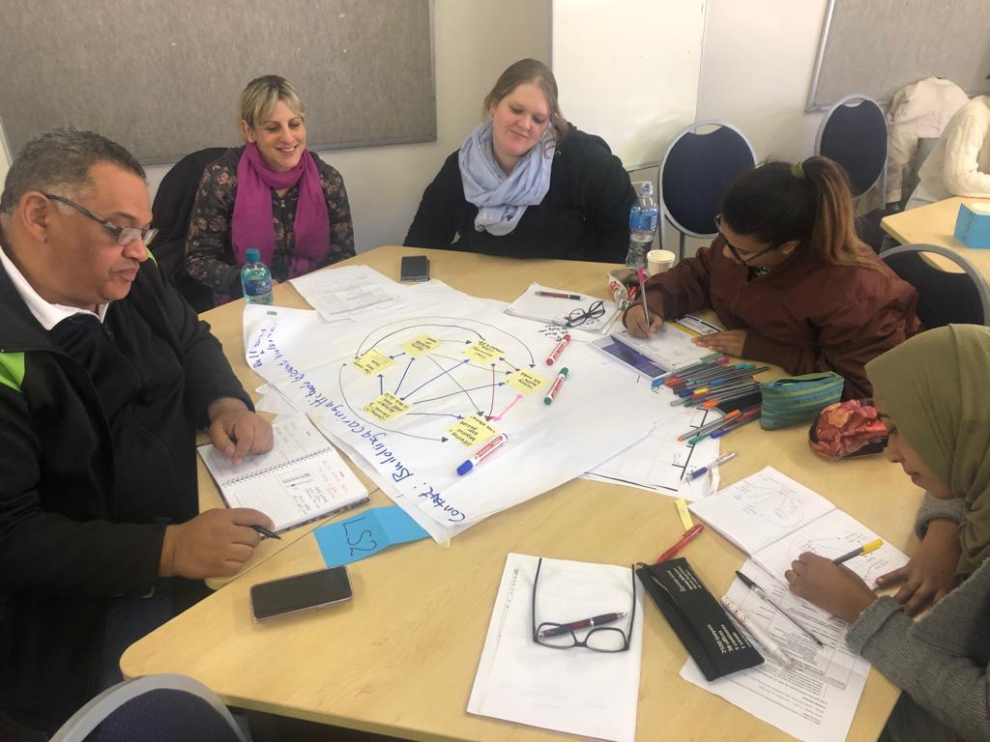
PLCs and the power of PLCs
Group of professionals
Learn from each other
Provide support
Embedded in South African Policy
Notes:
Click:
What are Professional Learning Communities?
Professional Learning Communities are groups of professionals in our present context, teachers, who decide to come together to learn with and from each other on needs they themselves have identified. PLCs are communities that provide the setting and the necessary support for groups of classroom teachers, school managers and subject advisors to participate collectively in determining their own developmental trajectories and to set up activities that will drive their development. PLCs are fully imbedded in South African policy as cited in the integrated strategic planning framework for teacher education development.

Slide 8
Why are PLCs important to E³?
Reflective Practitioners
Lifelong professional development
Action research
Implement Project-Based learning in classrooms
PLCs are appreciated by teachers
Allows teachers to take charge of own professional development
Allows for sharing of ideas and collaboration
Creates a platform for expert support
Provide opportunities for feedback and reflection
Perfect model to support the change we want to bring
Notes:
Why are PLCs important to E³?
E³ teachers will be at the forefront of changing teaching and learning in South Africa. In order to be the trailblazers and tone setters of change, E³ teachers need to become reflective practitioners who engage in lifelong professional development and action research. This includes engaging with likeminded teachers on the implementation of playful project-based learning in classrooms. PLCs offer the platform for this engagement and E³ has chosen PLCs as one of the key mechanisms to support teachers. Global research confirms that exchanging experiences and learning from each other directly is a form of support most appreciated by teachers. The very nature of PLCs allows teachers to direct and take charge of their own professional development. The following characteristics of PLCs confirm this. PLCs are driven by the needs of teachers and focus on content and real classroom issues. They allow for the sharing of materials and teaching strategies and support innovation by infusing new ideas into teaching practice. PLCs support collaboration and create a safe space for teachers to share ideas and collaborate in their learning. They allow teachers to profile models of best practice to provide guidance to fellow teachers and create a platform for coaching and expert support. They provide opportunity for feedback and reflection and create the opportunity for teachers to meet regularly to discuss teaching and learning.
PLCs are the perfect professional model to support the change we want to bring. E³ hopes to encourage and support teachers to establish PLCs to plan and reflect on the implementation of playful project-based learning and the activation of 21st-century competencies in learners. When establishing your own PLC, consider the following essential ingredients of effective PLCs:
• There must be mutual trust and respect amongst members, in other words, a safe environment to openly share.
• Members, in this case teachers, must set the agenda. Members must be motivated by a sense of collective responsibility for student learning.
• PLCs need to be supported by the school management and successful PLCs need to be skilfully facilitated. When necessary, input from external experts must be sourced.

Slide 9
What can you expect from the E³ team?
Support to establish PLCs
OPEN DISCUSSION
Explain why each of the 10 characteristics is crucial for a successful PLC:
Mutual trust and respect
Support challenge and constructive critique
Shared vision and focus on learning for all learners
Collaborative and reflective enquiry
Inclusive membership
Leadership
Collective responsibility for student learning
Coherent, responsive change in practice
Regularity
Systematic, rigorous enquiry into practice
Some Facilitation using Technology
Some PLCs will be face-to-face
Notes:
The E³ team will support teachers to establish PLCs. The E³ coaches will play an ongoing supportive role to the PLCs. Some PLCs will be facilitated using technology where teachers will connect with other teachers at a distance while other PLCs will rely on more direct forms of face-to-face dialogue. In conclusion, peer learning and collaboration among teachers is amongst the highest indicators of effectiveness in teacher development. It allows teachers to learn from colleagues, transfer that knowledge to their classroom practice and be reflective about what they have learned.
Have an open discussion om why the 10 Characteristics above are crucial for a successful PLC – Discussion can take about 10 – 15 minutes

Slide 10
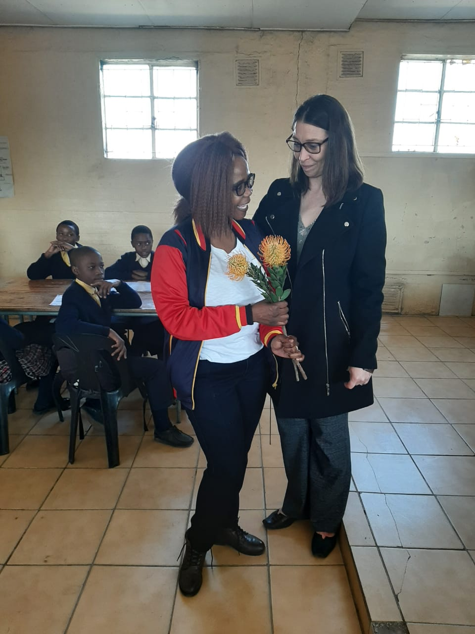
Celebrate and support visits
Notes:
School visits
There are two types of visits to school – ‘Celebrate and Support’ visits and Monitoring and Evaluation (M&E) visits. The visits are very different in terms of function. Annual school visits are planned to a sample of E³ schools with the purpose of celebrating success and offering developmental support.
The impact of the pilot is being measured by a professional monitoring and evaluation team. Their processes measure the mindset and competency of teachers and learners, as well as the development of schools and surrounding stakeholder communities towards the goals of E³.
This formal monitoring and evaluation process rigorously engages with key stakeholders and conducts classroom observations to inform the teacher development model.

Slide 11
Supporting schools: The Partnership and Stakeholder Relationship workstream
Engage with partners to:
Introduce learners to a range of possibilities
Enrich teachers understanding of ALP
Bring curriculum alive
Create authentic learning experiences
Will link learners to real life problems
Notes:
Teachers need to extend teaching beyond the walls of their classrooms by collaborating with partners to create innovative learning environments. Teachers are encouraged to actively engage with civil society and business to create expanded learning opportunities around their classrooms to support the building of 21st century skills and competencies in their learners.
How do we go about rethinking teaching and learning in 21st century classrooms by activating partnerships and networks?
Teachers need to engage with partners to introduce learners to a range of possibilities and resources in the classroom. Engagement with partners will, enrich the teacher’s understanding of active learning pedagogy, bring the curriculum alive, create authentic learning experiences for the learners. Central to authentic teaching, are realistic real-life problems which are interesting because they are more relevant, complex and challenging than more simplified educational ones. Engagement will link learners to real-life problems and hands-on experiences as well as linking them to socially relatable role models. Global research has confirmed the value of this approach to improve teaching and learning. Hargreaves and Fullan tell us teachers
who aim to create innovate learning environments should build and maintain the capital they need as organizations. This includes social capital, intellectual capital and professional capital. This can be done through forging alliances, partnerships and networks. Partnerships are not only about enriching learning environments within but extending their boundaries outwards creating networks in the process.
What are the implications for teachers?
Teachers need to understand their role. The role of the teacher is to design and facilitate authentic learning experiences by bringing the outside world into the classroom. Teachers need to establish and build relationships with business and civic society in order to facilitate these real-life experiences. Teachers need to actively use learning experiences to link learners with the outside world and build networks and opportunities Teachers need to rethink the role extra and co-curricular programmes play and how to facilitate the process effectively for optimum learning. These present learning opportunities for both learners and teachers.
The E³ team will provide support to this process by setting up a national platform. The E³ program envisions creating a platform for all education initiatives working with DBE schools who are striving to bring 21st century skills into the pedagogy both in the class and out. E³ will establish partnerships with a number of role players such as civil society organizations, volunteers, businesses and government departments to create ecosystems around schools. These ecosystems will support and add value to the efforts by the teachers in the classroom so that learners are integrated into a broader ecosystem of support and opportunity. Teachers are encouraged to visit our website to meet our signed-up ecosystem partners and see what they are up to in E³ schools around the country using this information to build their own ecosystems of support around their schools and classrooms.

Slide 12
Parent involvement is part of the success
Parent Involvement
+
PPBL Implementation
=
21st Century Competencies
Notes:
Parent involvement is part of the success
The E³ programme has the vision of mobilising parents so that they are aware of, know about and enthusiastically support their children, the teacher and the school to implement the E³ model and Playful project-based learning to activate 21st century skills and competencies.
Click:
This involves making parents active partners in the learning journey by forming strong partnerships between parents, teachers and schools to create a learning community.
Click:
This partnership is more than parental involvement in social events fundraising efforts or the traditional involvement in the PTA. Rather, it’s about ongoing collaboration focussed on supporting the goals of activating these 21st century competencies.
Click:
An active and thought through mechanism needs to be put in place to support parent involvement in activating 21st century competencies. Research has proved that bridging the gap between home and school improves learner functioning and performance. An integral part of the process is to acknowledge the worth of parent involvement in the process. The school management team is a key custodian of establishing relationships between school, community and parents and must play the role of mobilising the parent partnership component. The South African school act cites the importance of school-driven, capacity building programmes for parents which should include strategies to motivate parents to engage in learner’s education.
Teachers in turn, need to give parents an active role in the innovation in the classroom starting with the shared vision. They need to build shared values and responsibility for the outcomes. This should include the building of understanding of the new approach and creating excitement to build support. By sharing the new approach and building a common vision, parents become equal active partners on the journey. They feel empowered and capable with the knowledge about the learning process. Parents become real partners in changing teaching and learning.
Advice to teachers: make the parents a real part of the learning journey. Efforts must be collaborative and genuine. There should be meaningful roles for each party to play and these must be clearly communicated. Foster interaction around the curriculum and project-based learning, including public events to celebrate each project after completion. Profile lifelong learning as important for both parent and learner. At school level, teachers should lead change in the school, advocate for active learning pedagogies at school meetings.
What can be done to activate this vision?
Schools can start parent empowerment programmes to develop the understanding commitment to the common goal and to develop an understanding of their role. These parent programmes should be needs-driven, focus on building an understanding of 21st century skills and competencies and they should include the vision of support to out of school learning.

Slide 13
How important is parental involvement in the success of learning and teaching?
Open Discussion
Notes:
This open discussion should be guided by the facilitators and team. Give this discussion about 10 to 15 minutes

Slide 14
Questions and Answers
Raise your hand to ask questions
Or put your questions in the chat box
Or ask your coach after this training session.

Slide 15
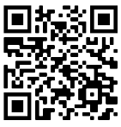
Get connected
Find out what you need for this journey by adding TeacherConnect as a contact on WhatsApp with the number 060 060 33 33 and send the world BELT to start with training on our zero-rated platform, or use the TeacherConnect QR code below:
The Teachers’ Lounge
https://www.teacherconnect.co.za/share/49Q5oaJa85GQmb9C?utm_source=manual
Notes:
Before we end, please feel free to link up with the E³ journey on TeacherConnect and in the Teachers’ Lounge.

Slide 16
Thank you – see you soon www.ecubed-dbe.org

