Slide 1
PLAYFUL PROJECT-BASED LEARNING THE PBL LEARNER AND THE PBL TEACHER – Topic 4

Slide 2
Programme
TIME | Min | ITEM
E.g. Time | TIME NEEDED | Item
08h00 – 08h20 | 20 | Registration, Welcome and Introductions
08h20 – 08h35 | 15 | Ice Breaker
08h35 – 08h50 | 15 | Open Discussion
08h50 - 09h30 | 40 | Part One – The PPBL Learner and Gen Z
09h30 – 09h45 | 15 | Q&A
09h45 – 10h00 | 15 | Open Discussion
10h00 – 10h30 | 30 | Part two – The 21st Century Teacher
10h30 – 10h45 | 15 | Q & A
Notes:
Good Morning Colleagues. And Welcome to day 3 of the E3 training. I am really so pleased to be with you this morning and really hope that when we are done today, you would have come away with some valuable information about Playful Project Based Learning.
We have divided this workshop into four parts.
Although we are not here together in person, we want this to be as interactive as possible so please use the chat function to share your questions and thoughts with us and we will read out your comments throughout the session. I foyu are not able to access the chat function then feel free to raise your hand to add to the conversation and discussions.

Slide 3
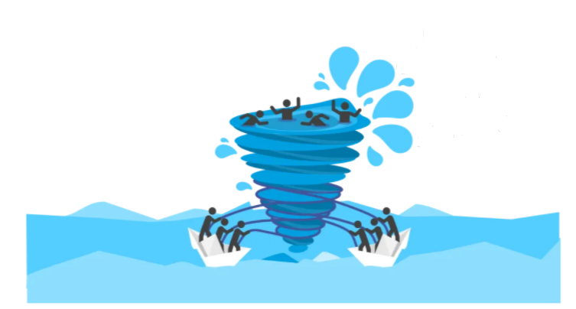
VUCA
V
OLATILE
U
NCERTAIN
C
OMPLEX
A
MBIGUOUS
Notes:
Has anyone heard of the term VUCA?
Can you write in the text box what you think it might mean?
Read out the comments and thank people for their input.
Right so as you mentioned, VUCA stands for
click:
Volatility,
Click:
Uncertainty,
Click:
Ambiguity and
Click:
Complexity.
This is the world we are living in, It is volatile, uncertain, ambiguous and complex. In this workshop we are looking at what it means to be a Generation Z and the types of skills learners need in order to succeed in this VUCA landscape. And in order to prepare learners for a success in the VUCA world, they need a different sort of education, so what does this mean for teachers…..
Teachers need at least five skills that are vital to be able to lead successfully in a VUCA world.
Developing a shared purpose
The ability to build teams where colleagues have a shared purpose and vision is key. Teachers need to help their learners to understand the bigger picture and how they personally fit into it.
2. Learning agility
Tomorrow’s leaders need to be willing to stretch themselves out of their comfort zone and be open-minded enough to rapidly embrace new concepts.
3. Self-awareness
Leaders need an understanding of their own strengths and areas for development and the impact their communication and working style has on others. The ability to be authentic and show your true self at work is key to building trust.
4. Leading through collaboration and influence
Success often depends on working with people over whom you have no official authority. Tomorrow’s leaders need high-level influencing skills and the ability to collaborate with a wide range of stakeholders.
5. Confidence to lead through uncertainty
The ability to assess acceptable levels of risk and make decisions based on incomplete or even conflicting information is key. Managers also need the ability to learn from mistakes and to allow others to do the same.
Lets take a look at the objectives for this session…..

Slide 4
PART ONE
THE PPBL LEARNER and GEN Z
In this section we will cover the following
A learner-centred approach- What kind of learner is envisaged
Generation Z (Gen Z)
What are the characteristics of Gen Zs?
What they do should matter
The learners in our classrooms are mainly Generation Z (people born from the mid-1990s
to the early 2000s). Their mindsets are very different from our own. In a sense, both young
teachers (Generation Y) and their learners (Generation Z) are already "entreprenerials".
Work and play – in the same day
Generation “Why not?”
A world in pictures
Why PPBL is perfect for GenZ learners
Notes:
Note: Read what is planned in this session.

Slide 5
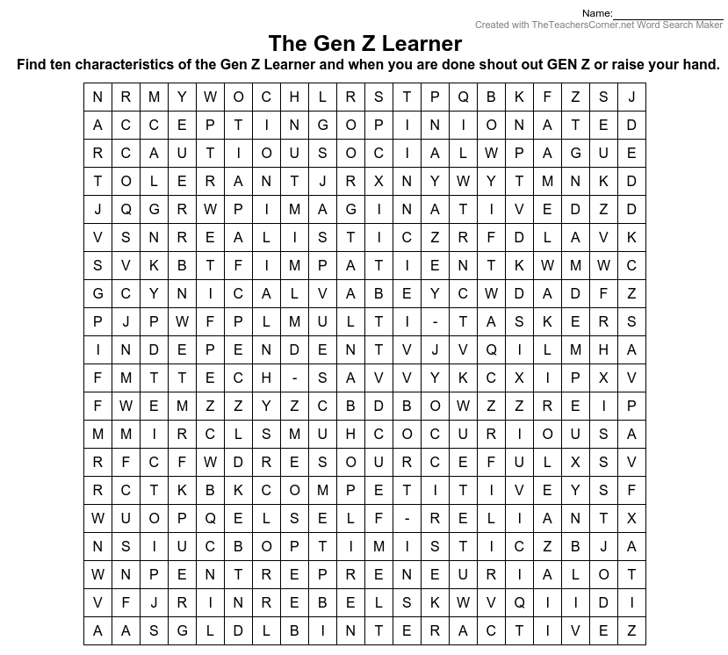
Ice breaker
Here is a crossword. Try and find the ten characteristics of the Gen Z Learner. We will wait for the first person to call out GEN Z to give us the words.
Notes:
This is the ice-breaker for the participants. This may take anything from 5 to 10 minutes. You can ask the participants to raise their hands when they are done or shout out GEN Z. They will then give you their list of characteristics. This is generally the list, but they may have a different perception of the GEN Z Characteristics.
Accepting
Opinionated
Cautious
Social
Tolerant
Imaginative
Realistic
Impatient
Cynical
Multi-Taskers
Independent
Tech Savvy
Curious
Resourceful
Competitive
Self-reliant
Optimistic
Entrepreneurial
Rebels
interactive

Slide 6
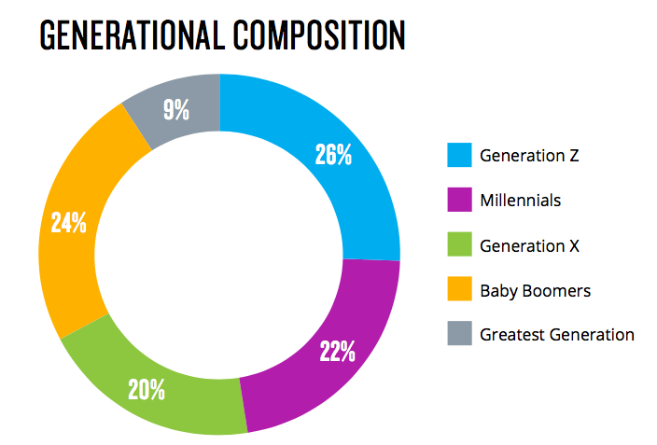
Open Discussion
Who do you think the Gen Z Learner is?
What has your experience working with Gen Z learners?
What techniques have worked well when working with Gen Z learners?
How are the characteristics of Gen Z influencing the way we teach?
Put your comments in the chat box or raise your hand to discuss.
Notes:
This is an open discussion for participants to engage in. Let it become a conversation.

Slide 7
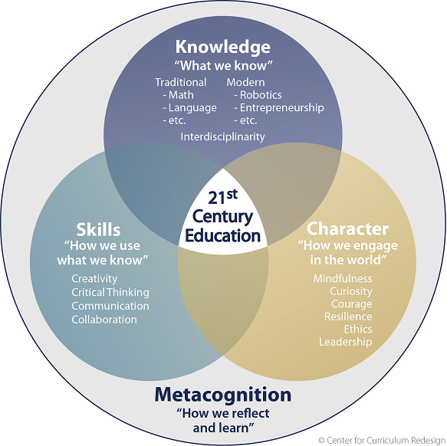
A learner-centred approach- What kind of learner is envisaged?
Self efficacy
Intrinsic motivation
Growth mindset
E³ Mindset:
Internal locus of control
Resilience
Notes:
We have discussed the entrepreneurial, search and discovery and solution-seeking mindset that is critical for success in our changing world. Although not all learners will become entrepreneurs, we should think of them all as ‘’entrepreneurials’’, a generation of young people with an opportunity-seeking mindset that drives their abilities, actions and purpose in helping others. In order for an education system (starting at school) to develop these learners, every element of the E³ approach must be unlocked.
Click:
This includes the E³ mindset
Click for each of these:
(self-efficacy, a growth mindset, resilience, an internal locus of control and intrinsic motivation)
Click:
and 21st century skills (foundational literacies, competencies and character qualities, rooted in life-long learning).
The diagram above, designed by Fadl of the CCR, unpacks the unique qualities needed by 21st century learners in order to thrive in a changing world. E³ has synthesised all of the attributes of Fadl’s model above, as well as other key features identified as success factors in the 21st century in a learning model which includes the process towards achieving the E³ competences, which is, character, thinking and connection. Our learners are different which means it’s time for a major overhaul of the way in which we teach. Knowledge transmitted from a textbook to a passive learner can no longer deliver good results – our learners are millennials, who need to be actively engaged to thrive, and we owe them all the strategies we can offer them to flourish in a vastly different world.

Slide 8
Generation Z (Gen Z)
Born mid 1990 to early 2000s
Already “entrepreneurials”
Social Learning Environments
More Career Focused
Refuse to be passive learners
Thrive in immersive lessons
Learn best by doing
Notes:
The learners in our classrooms are mainly Generation Z (people born from the mid-1990s to the early 2000s). Their mindsets are very different from our own.
In a sense, both young teachers (Generation Y) and their learners (Generation Z) are already "entreprenerials". Even though they will not necessarily start their own businesses, they share a common mindset. Let us focus on the needs of this generation so we can understand their learning preferences. Our learners are Generation Z and we need to find a language that communicates the best with them. Generation Z is leading the change in how learning takes place. They are a driving force in the innovation of new learning tools, teaching styles, and unlimited access to resources.
According to Forbes Magazine, Gen Zs tend to embrace social learning environments, where they can be hands-on and directly involved in the learning process. They expect on-demand services that are available at any time and with low barriers to access. And they tend to be more career-focused earlier on in their college careers.
A study done by Barnes and Noble College shows that today’s students refuse to be passive learners. They aren’t interested in simply showing up for class, sitting through a lecture, and taking notes that they’ll memorize for an exam later on. Instead, they expect to be fully engaged and to be a part of the learning process themselves.
In fact, Gen Z students tend to thrive when they are given the opportunity to have a fully immersive educational experience and they even enjoy the challenges of being a part of it. For instance, 51% of surveyed students said they learn best by doing while only 12% said they learn through listening. These same students also mentioned they tend to enjoy class discussions and interactive classroom environments over the traditional dissemination teaching method.

Slide 9
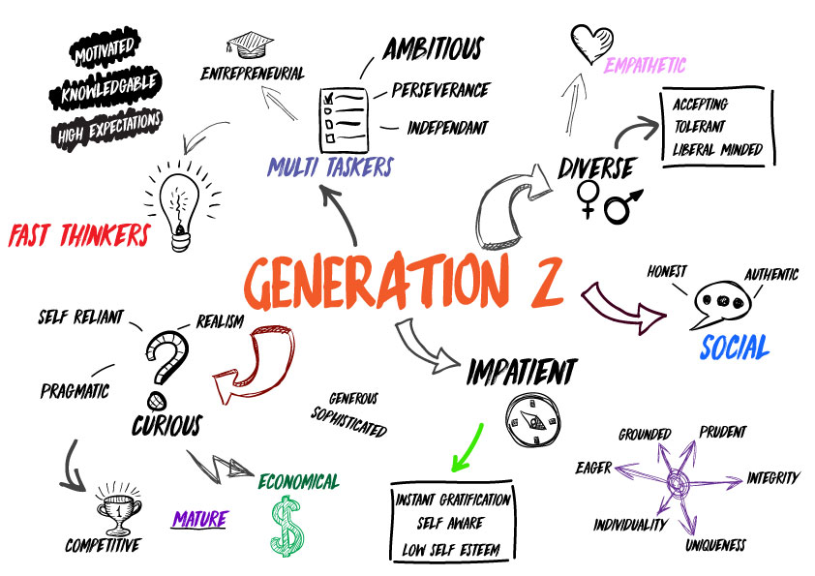
What are the characteristics of Gen Zs?
Social
Multi Taskers
Entrepreneurs
Digital Natives
Interactive
Tech Savvy
Less Focussed
Notes:
Teachers often complain about the lack of discipline in their classes and their learners’ fascination with their cell phones and subsequent loss of interest in the lesson. Younger teachers have greater tolerance for their learners’ attitudes and learning styles, but without a definite plan to engage their GenZ learners, classroom time will not be productive. By focusing on the needs of Generation Z, it will become clear that a whole new approach and a break from chalk and talk teaching is the most efficient way to engage the learners in our classrooms. The learners of today have certain characteristics that make them unique and there are things that excite them.
Technology
Of course they are technologically inclined! Gen Zs are known as neo-digital natives. The rest of us are technology immigrants! They cannot imagine a world without technology – and are not awestruck or intimidated by it. Gen Zs don’t use technology for the sake of using it. For them it is simply a way to get what they want, be it information, entertainment or connection. Technology immigrant (BBTs – Born Before Technology) found friends on the playground; Gen Zs find them on social media sites. BBTs used libraries; GenZs use google. BBTs went shopping; GenZs shop online. There are many, many differences between the generations that all highlight the facts that there is a poor fit between GenZs and traditional teaching. It is not possible or fair to reshape GEnZs to fit an outdated educational system. What we do need is to shift education so it ‘fits’ and meets the needs of these young people.
And as a digital generation, Generation Z expects digital learning tools such as these to be deeply integrated into their education. For them, technology has always been a fully integrated experience into every part of their lives. And they don’t think education should be any different.
They believe they should be able to seamlessly connect academic experiences to personal experiences through these same tools.
Additionally, they expect that these learning tools be available on-demand and with low barriers to access. For them, learning isn’t limited to just the classroom; it’s something that can take place at any time, anywhere.
And finally, access to unlimited new information has created a more self-reliant and career driven generation. In fact, 13% of Gen Zs already have their own business. And many are even taking this entrepreneurial spirit to drive changes in college curriculum, as they show a strong interest in designing their own classroom path in college. For those who haven’t started a business quite yet, early preparation is still key.
Part of this change is due to the fact that, they have more access to more information than the generations before them. By the time they’ve reached higher education, they are already well versed in current events, music popular culture, and global trends. They are well-aware of the world around them and are already beginning to think through what their place in it will be.
Multi-tasking
GenZs know no other way. On the day that they were born, they were probably filmed, and pictures and announcement sent around the world at the press of the ‘Send’ button. This is how they were welcomed into the world. Whether multi-tasking is productive, which is another topic altogether, the point is, this is how they operate: watching TV with headphones, jamming their favourite songs, texting a friend, and telling you how their day went - all at the same time. Life happens quickly.
Gen z is naturally social and spend 7,6 hours per day socializing with friends and family. They prefer to work on multiple tasks at the same time. They desire independent work environments. 72% of teens want to start their own business someday. They are the first true natives to the digital era. This generation spend approximately 15, hours per week on their smartphones. They like to interact with people. 66% of them will say that technology makes them feel like anything is possible. Gen Z need continuous updates and stimulation.

Slide 10
What they do should matter – they really CARE about their world
Cultural environment does play a role
Our environment is VUCA
Learners need to be prepared
Notes:
CLICK - Cultural environment does play a role, however, the characteristics that we have mentioned may not all be present in all learners across South Africa. Learners in rural areas for example may not have the same access to technology as learner in urban areas. (we do recognise this is a huge generalization)
CLICK - However, this doesn't change the fact that the world we live in is VUCA and
CLICK - therefore we do need to prepare ALL learners to succeed in a volatile, uncertain, complex and ambiguous world.

Slide 11
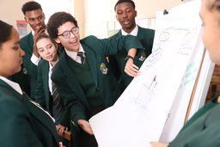
Work and play – in the same day
Work and Play connected
Rebelling against working your life away
Cautious and cynical
Accepting of diversity
South African Gen Zs a bit more serious
Notes:
Click: Work and play is inseparable for the modern learner. Learners learn through play, and it is critical that we structure our teaching around this fact.
Click: Also, they may have watched their parents slaving away (to give them everything they want …) and they are silently rebelling against the institution of working your life away. They have tasted a fun-loving life, and they want to live it. GenY are known for having big dreams and aspirations and making them happen - provided they are passionate about them, they are meaningful, and they can accomplish them in a playful way. Gen Zs want to be deeply invested in their work and know their time and effort has real meaning. But they will be entering a workforce where there already are serious issues when it comes to employees understanding their role in the organization. For instance, only six in 10 people agree they know what’s expected of them at work, according to Gallup’s State of the American Workforce study. Also, only four in 10 people feel like their job is important, have a manager who cares about them, or the opportunity to do their best each day. And just three in 10 agree that they have someone at work who encourages their development.
Click: Generation Z, however, is a little more cynical, and more cautious. They were born during a time of financial recession, a boom in violence and terrorism, and they live in a world that has never felt safe.
Click: Unlike previous generations, who have strong opinions about issues like sexuality and diversity, Gen Zs are more accepting of people who are different. Since they were born, multitudes of people have migrated from their home countries and there is no country that remains homogeneous. The result is multi-cultural classrooms where learners are exposed to - Quote,Unquote - ‘foreignness’ daily.
Click: Please note In South Africa, Gen Zs are a little more serious as they are often the first generation to go on to tertiary education and the sacrifices of their parents and the extended family can be heavy burdens to carry.

Slide 12
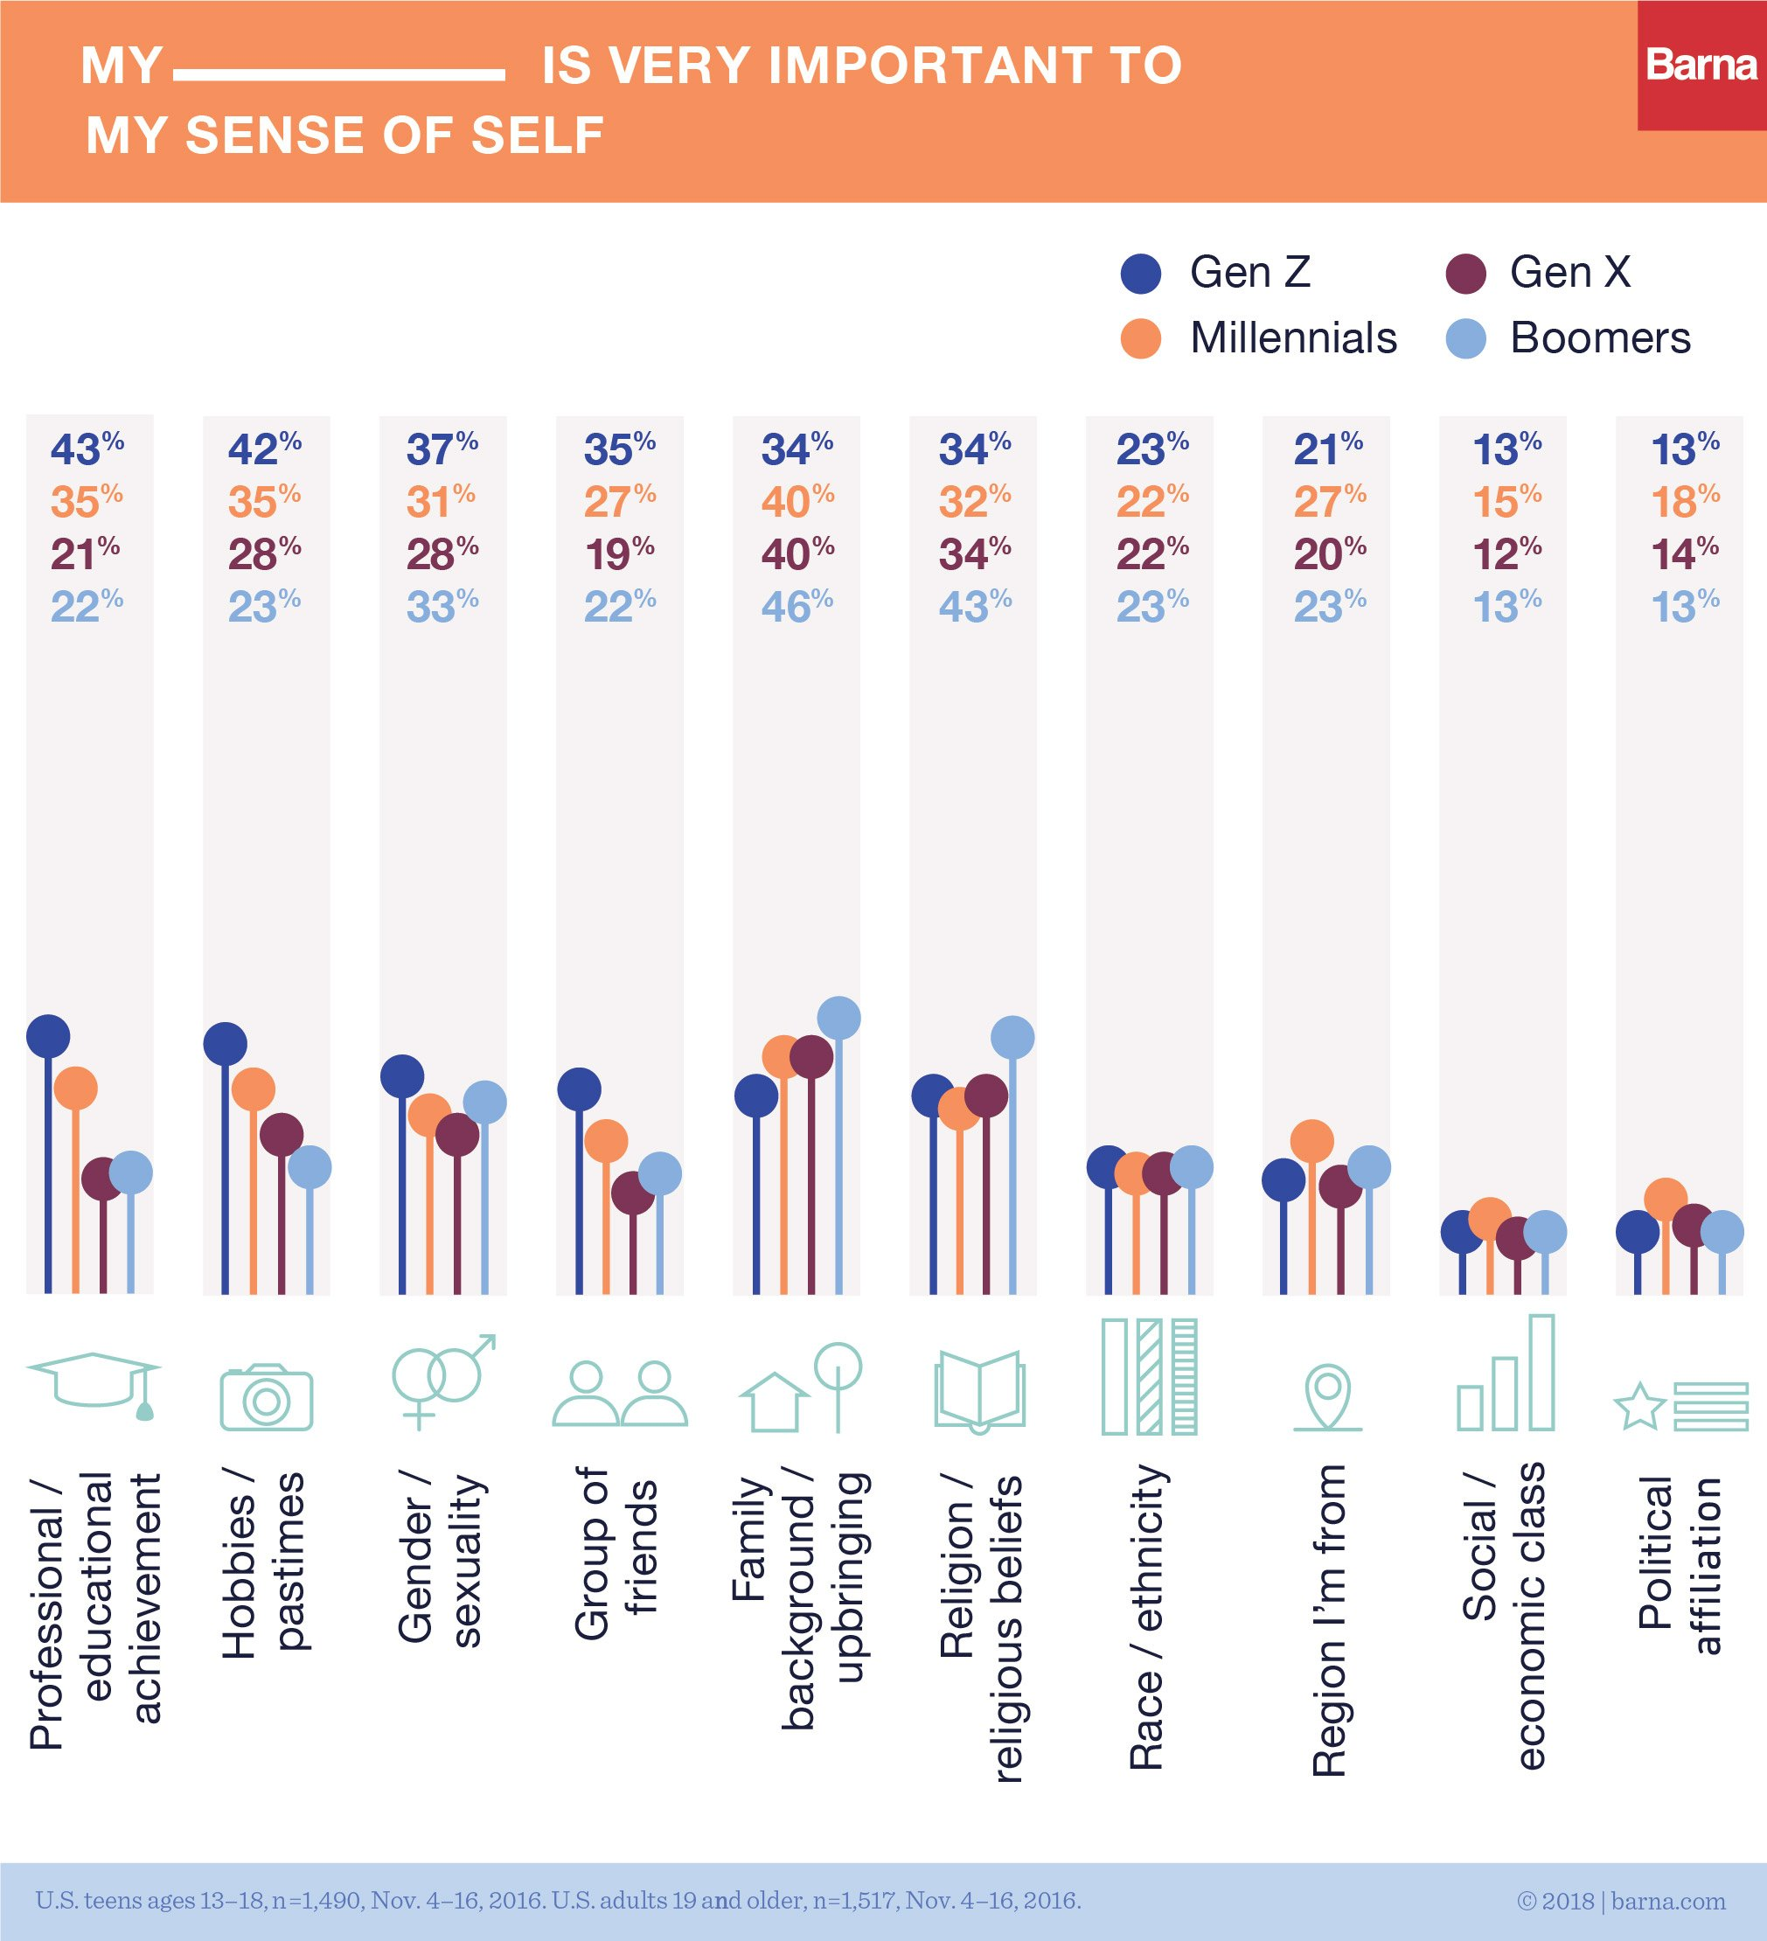
Generation “Why not?”
Critical Thinkers
Always questions
Up tempo
Online social life
Structure and Instruction
Only need to pitch up
Notes:
Generation “Why not?”
By no fault of their own, Gen Z is not used to the word “no”, simply because they have not heard it that much growing up. This is the ‘why not?’ generation.
Click: The modern learner thinks critically and always questions.
Click: They want to negotiate and are willing to compromise. Their parents were unlikely to deprive them in the same way they were denied. And whenever “no” was imperative, it was softened with an alternative. They could not have ice-cream, but what about frozen yoghurt? These were also the children who got spared punishment and served time-out instead – somewhere on a designated chair or in their rooms. Punishment does not serve them well.
Click:
Up tempo – quick, quick, quick!
Gen Y are racing cars, so to speak. They are used to instant-everything. The on-line world spared them from ever waiting in any type of queue. And, of course, the Boomers would never let their GenY gems wait for anything… can you imagine the neglect that would make them feel! Never. Rather than letting Gen Y wait after school, or soccer, or a playdate, the Boomers ensured that their Car was parked as close as possible to the gate, at least 15 minutes before the bell rang, or the whistle blew, or the party became a drag.
Click: Interestingly, Gen Z again are less likely to even go to parties – they have online friends and an online social life. This means Gen Z learners with computers and data, are less likely to start smoking or consuming alcohol. They do not really use Facebook, preferring social media where they can communicate with their closest friends. They are also more likely to have created a personal brand to use social media communication
Click:
Structure and instruction
This may seem like a contradiction – coming from a generation which seems to break all the rules known by the generations before them, but keep in mind that they were raised by “helicopter parents”. They had detailed navigation all the time. Someone else monitored what needed to be done, where, and how.
Click: In most cases, Gen Z only need to pitch up. So don’t expect them to simply be able to figure something out, unless it is the latest smartphone. Then again, using technology rarely requires intuitive problem-solving skills. It is actually user-friendly … or so we are told! Therefore, Gen Z needs structures and guidelines:

Slide 13
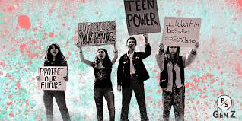
A world in pictures
Notes:
ASK THE GROUP - What characteristics of the Gen Z can you see in these pictures? Type your answers in the text box or raise your hand to speak.
Note, GEN Z might be different in different areas, but these are the some of the common characteristics of the Gen Z.
Some of the things that I am seeing are
These “screenagers” as Gen Zs are sometimes called, are naturally more comfortable in image rich environments. They love pictures, whether posting selfies on the ‘gram or learning through pictures, the visual aspect of learning is imperative for this generation.
Just do it! – Gen Z is the ‘just do it’ generation. The modern learner is hands-on, they want to participate and not just observe. They prefer to try stuff by themselves – to explore the world and their environment on their own. They are actively involved in whatever happens on the screen in front of them. This is why play-/activity-based learning engages them.
Social connection and team players Last but by no means least, is social connection. Generation Z needs to collaborate. They do not alienate themselves with technology, but it is actually how they connect. It is not uncommon for two friends sitting next to each other to communicate via texting. That is simply another way they connect. Gen Zs seamlessly move between physical and virtual interaction and are much more positive about being team players than operating in isolation. They are also much more inclusive than generations before them, and comfortable and more accepting of diversity. This is the generation for whom gay culture and xenophobia are almost not an issue. They are very tolerant of “different-ness”. Their interaction, if data is available, is likely to be mostly virtual and their social circle smaller and more cohesive (“tighter”). They have a strong sense of identity and will even create a virtual image or personal brand to use in virtual communication. How do we equip ourselves for these learners in our classrooms? We have to do things differently – chalk and talk is no longer relevant as the only way

Slide 14
Why PPBL is perfect for GenZ learners
Technology
Multi-Tasking
Learning should matter
Work and Play
Up Tempo
Structure and Instruction
A world in Pictures
Notes:
Playful Project-based learning is the pedagogy driving the E³ programme. Gen Z s respond very well to Playful project-based learning because it ticks many of their satisfaction boxes. In the last section we discussed the characteristics that are unique to the modern, Gen Z learner, and in this section you will find out how seamlessly playful project-based learning links with these characteristics.
Click: Technology: They are ready for the fourth industrial revolution, and they are already semi-geared for the new world of work which means that they will be more likely to find work. Playful Project-based learning is a natural learning space for research and 21st century research is linked to technology.
Click: Multi-tasking: The ability to move from one discipline to another and to integrate tasks is key if learners want to flourish in the modern economy. Because playful project-based learning is a series of integrated activities, learners practice multi-tasking in an authentic way.
Click: The learning should matter: A playful project-based learning activity is driven by a challenging problem or an important community question, one that has meaning to the learner. Their opinion matters: This is the ‘why not’ generation. One of the key outcomes of playful project-based learning is the promotion of critical thinking. Gen Zs fit into the playful project-based learning base naturally.
Click: Work and play all in the same day: Playful Project-based learning is activity based. Learners are involved in purposeful play as they learn, and this is exactly what this generation wants.
Click: Up tempo: Playful Project-based learning moves at a pace that is directed by the learners. They determine their own tempo to their own satisfaction.
Click: Structure and instruction: Despite being an organic process, good playful project-based learning is highly structured which is exactly what Gen Zs need - structured creativity.
Click: A world in pictures: Playful Project-based learning introduces various learning styles as groups try to solve a real-life problem. Visual learning, especially via YouTube and using Google, is a key tool.
This is the ‘just do it’ generation: Playful Project-based learning expects intuitive action as solutions to challenging problems are being found. Often instinctive trial and error are the beginnings of solutions to complex problems.
Social connection and team players: Group work and collaboration is integral to playful project-based learning and for developing 21st century skills. This is exactly how Gen Zs thrive, by communicating and connecting - and this is not necessarily done face-to-face.
Playful Project-based learning is the approach driving the E³ programme. Playful Project-based learning allows Gen Zs to thrive and learn in a way that not only challenges them but allows them to develop the skills needed for the changing world of work.

Slide 15
Tea Time
Please be back in 15 minutes

Slide 16
PLAYFUL PROJECT-BASED LEARNING The 21ts Century Teacher

Slide 17
The 21st-Century Teacher
PART TWO
In this section we will cover the following
The 21st Century Teacher Competencies
The PPBL Facilitator – reimagining traditional teaching
What will work in the 21st century?
21st -century teachers are able to look at their practice and adapt based on the needs of their students. They must be able to adapt their teaching style to include different modes of learning, adapt when a lesson fails, and adapt to new technology.
Notes:
Explain what this session will cover

Slide 18
Imagine If…… Open Discussion
Considering the advances of technology, what do think the role of the teacher could be?
Notes:
Allow for an open discussion on the above topic. This discussion should include as many participants as possible and time allocated is about 15 minutes

Slide 19
The 21st Century Teacher Competencies
Citizenship
01
CHARACTER
Curiosity
Resilience
Mindset
CONNECTION
Collaboration
02
Communication
Empathy
03
THINKING
Creativity
Critical Thinking
Reasoning
Notes:
Many teachers are readier than ever to move to more authentic results-driven active learning approaches because they know their learners will benefit. As teachers we need to reflect on what our purpose is as educators. Are we ready for the roller coaster ride? What competencies do we already have, and which competencies do we need to develop so we can offer our learners the best education possible, an education that will ensure they play an active part in the South African economy when they leave school. What do we need to model to help them, in turn, develop purpose as learners? The E³ competencies, which you are already familiar with, reflect what both learners and the teachers need to flourish in a changing world and to maximize the benefits of playful project-based learning. 21st-century teachers should focus on the three competencies to start the journey of self-development: character, connection and thinking.
ON CLICK
Character
Character embraces citizenship, curiosity, resilience and mindset - four attributes of the strong character underlying exceptional 21st-century teachers. Let's unpack each.
• Citizenship: 21st-century teachers care about their learners, about their country, and what competencies their learners need to find their place in society. As citizens of our nation, learners have the right to live here, to work here, start enterprises and continue to develop themselves and we as teachers should protect these rights at all costs. We are part of the team of nation builders.
• Curiosity: Successful teachers of the 21st century are curious and think, “What can I learn to make my teaching more relevant?” Because learners are tech savvy, teachers need to hone their tech skills too. Computers have taken the place of pens and pencils. Coding, robotics, the use of smartphones in the classroom and digital communication strategies, AI and blockchain have all become part of the teaching repetoire. Start increasing your vocabulary. And if you don't know enough find out because you are curious. But; also be curious about your own emotional development. Who are you as a person? Are you afraid of change? Are you a worrier or a warrior? Do you have the courage to embark into the unknown? Do you fear failure? Are you mindful? Do you stop for a moment to think about your professional purpose?
• Resilience: 21st-century teachers can adapt to almost any circumstances to satisfy the needs of their learners. They are resilient. When things go wrong, they bounce back. They reflect and then change the plan until they are satisfied that what they are offering is what the learners need. They have the mental ability to recover when things do not go according to plan.
• Mindset is critical: Keep learning. One of E³’s driving goals is the promotion of life-long learning. As new tools and new technologies keep emerging, learning and adapting is essential. Develop your growth mindset and believe you can and stop worrying about things beyond your control. Focus on what you can do, and you CAN do anything! An effective 21st-century teacher knows that learning about the latest gadget can truly transform students’ education. So, stay up-to-date on new trends because you know what your learners need to flourish.
ON CLICK
Connection is the second most important competency group. 21st-century teachers need to connect with technology but also with warm bodies - other people. They are thus collaborators, communicators and show empathy as they connect.
• Collaborator: Today's tech tools allow us to connect with anyone, anywhere, anytime. Do you have a question for an expert or a colleague? Simply connect via social media, follow, join ask or tell. Collaborate as a professional. Start or join a PLC. Learning is more effective when you can share ideas and knowledge with others. Sharing your expertise and experience and communicating and learning from others is an important part of the teaching and learning process, and especially relevant in the 21st-century.
• Communicator: 21st-century teachers are often great communicators. Recent technological advances have affected many areas of our lives including the way we communicate, collaborate, learn and of course teach. These types of tech advances are important but the really challenging skill, ironically called a soft skill, is communicating for personal and professional development, face to face. Develop your confidence; speak up in meetings. Show kindness when dealing with learners one-on-one; show empathy when sharing learner problems with parents. Renew your effort to become a great interpersonal communicator in a century in which the tendency is to hide behind technology. 21st-century teacher show empathy. They are aware of their learners’ future and know that good opportunities arise from great education. They strive to ensure that no child gets left behind. So, they focus on preparing today's learner for what's to come in the future. They lobby for their learners. Today's classrooms are filled with children who need somebody to look out for them, to give them advice, to encourage them and to listen to them. Empathy is the ability to understand and share the feelings of others. This is not a far step from the entrepreneurial mindset that understands and sees the problems that others are experiencing and then wants to find a solution to help them.
ON CLICK
Thinking, the third E³ competency, covers creativity, critical thinking and reasoning.
• Creativity: out-of-the-box solutions, fit for purpose groupings, custom-designed activities designed to address specific learner issues and then linking all of this to the CAPS - this requires teachers to move out of their comfort zones and away from mere tick boxes. We invite you to grow your teaching toolbox and explore creative new strategies you have not tried before. Teach with WhatsApp, have learners start blogs or have them move about their communities, gathering information to share in class. Only then go back to your textbook.
• Critical thinking: if you have ever wondered about the true value of group work and particularly active learning consider this: active learning helps promote higher order thinking such as the application of knowledge, analysis and synthesis. Clearly this is where critical thinking is developed. As a teacher, start engaging in deep rather than superficial learning and know how to apply and then transfer what you’ve learnt to the real world. Stay relevant by developing your own critical and problem-solving skills. PLCs are the group work of professionals. Join or start one today!
• Reasoning. Reason is defined as a cause or an explanation or justification for an action or event. Thus, the competency of reason is the ability of the mind to think, understand and form judgments logically. Interestingly there's a close connection between reason and emotion. As a teacher, you should be asking “Why?” - looking for reasons for learner behavior as opposed to making assumptions. No learner is the same so judgment of the learner should be well considered before creating a label that a learner may have to carry for the rest of his life.
To conclude, 21st-century teachers are different from traditional teachers in one huge way: they care - about their learners, themselves, their environments and their nation. They have a compelling purpose to make their classrooms places of discovery and joy and they are prepared to learn and do almost anything in the service of their learners.

Slide 20
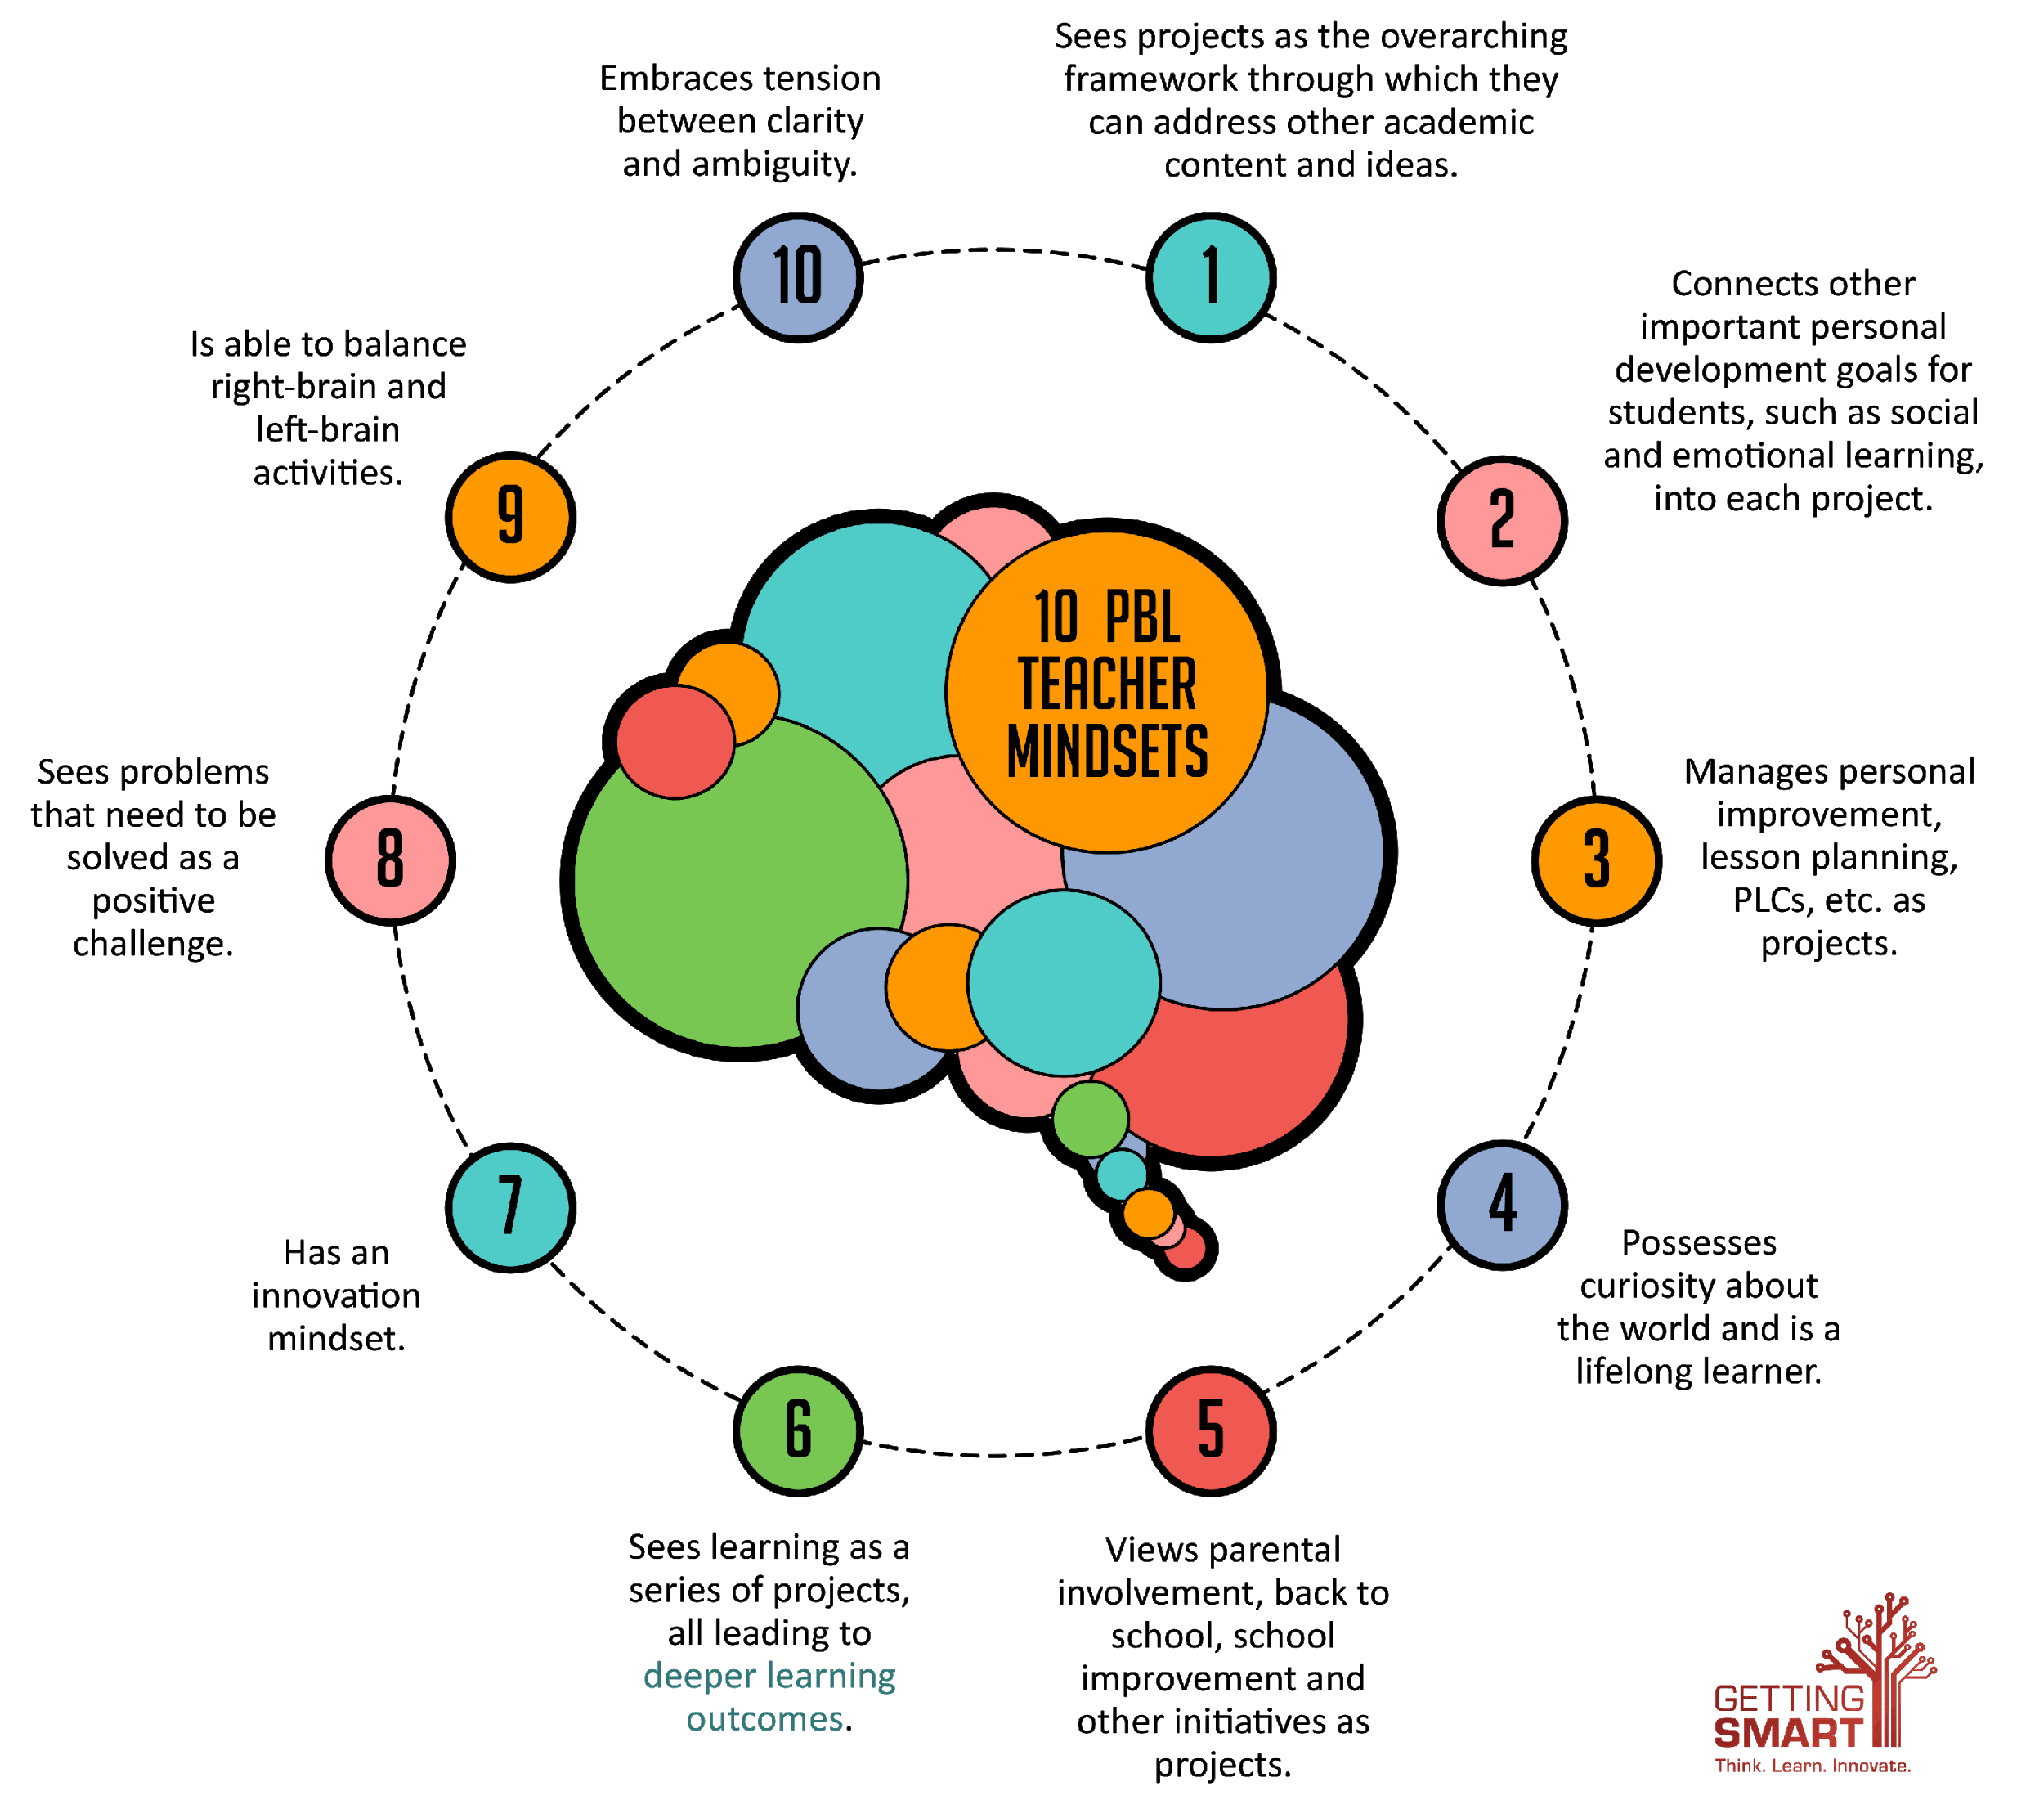
The PPBL facilitator – re-imagining traditional teaching
Notes:
What used to work
Successful teachers in the not too distant past were those who were 100% prepared. They took time to study the lessons from the textbook and even made notes so they would be able to answer all questions. They were strict, but fair and allowed no noise in class. Everyone worked quietly and studiously. They were truly organised and a master at their trade. They also suited learners from that generation and equipped them with the skills needed for that time. Why is this style of teaching no longer successful today?
These are some characteristics of teacher-centered instruction
The teacher is the center of knowledge and in charge of learning.
Students are usually passively receiving information.
The instructor’s role is to be primary information giver and primary evaluator.
Students are viewed as “empty vessels” who passively receive knowledge from their teachers.
Teachers and professors act as the sole supplier of knowledge, and under the direct instruction model, teachers often utilize systematic, scripted lesson plans.
Teacher Centered Instruction is fairly low-tech, often relying on the use of textbooks and workbooks instead of computers
Assessments are in many cases only carried out as summative and not formative evaluations and they rarely address qualitative issues of the learner’s progress.
8. The classroom remains orderly.
9.Students are quiet as the teacher presents new information and lead the activities
10.Teachers retain full control of the classroom and its activities.
What we need to do is reimagine traditional teaching. (Speak to slide)

Slide 21
• Can a teacher today ever be 100% prepared? Why? Why not?
Is the word Teacher still relevant?
1
4
STEP
STEP
01
04
Is the textbook the best driver of a lesson? Why? Why not?
5
2
• Is a teacher who allows no noise in the classroom fair?
STEP
STEP
02
05
• Can teachers prepare well enough to answer all learner questions? Should they be there to answer their questions? What is their role?
3
• Is a silent classroom an educationally sound learning space?
STEP
6
STEP
03
06
Notes:
In the above scenario there are glaring problems which lead to very important questions:
Click
• Can a teacher today ever be 100% prepared? Why? Why not?
Click
• Is the textbook the best driver of a lesson? Why? Why not?
Click
• Can teachers prepare well enough to answer all learner questions? Should they be there to answer their questions? What is their role?
Click
• Is the word ‘teacher’ still relevant?
Click
• Is a teacher who allows no noise in the classroom fair?
Click
• Is a silent classroom an educationally sound learning space?
Have an open discussion on these questions and see what comes from it.

Slide 22
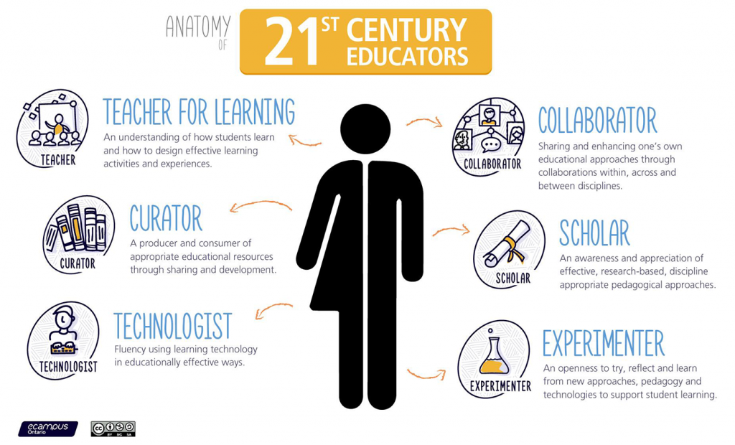
What does the 21st Century teacher look like?
Tech Savvy
Advocates
Lifelong Learners
Collaborators
Forward Thinkers
Adaptive
stay up-to-date with current educational trends and technology
21st-century teacher is right along for the ride
must be able to collaborate and work well within a team
advocate not only for their students but their profession
They are able to adapt to whatever comes their way.
thinks about their students' future
Notes:
Click:
What does a 21st-century teacher look like to you? You may have heard this popular buzzword thrown around your school or on the news, but do you know what a modern-day educator really looks like? Beyond the obvious of being up-to-date on the latest in technology, they can have the characteristics of a facilitator, a contributor, or even an integrator. Here are six more key characteristics of a 21st-century educator.
Click:
They're Adaptive
They are able to adapt to whatever comes their way. Being a teacher in today's world means that you have to adapt to the ever-changing tools and changes that are being implemented in the schools. Smartboards are replacing chalkboards and tablets are replacing textbooks and a 21st-century teacher needs to be okay with that.
Click:
Lifelong Learners
These educators don't just expect their students to be a lifelong learner, but they are as well. They stay up-to-date with current educational trends and technology and know how to tweak their old lesson plans from years before to make them more current.
Click:
Are Tech Savvy
Technology is changing at a rapid pace and that means that a 21st-century teacher is right along for the ride. The latest technology, whether it's for lessons or grading, will allow the teacher and student to be able to learn better and faster. An effective teacher knows that learning about the latest gadget can truly transform their students' education, so they are not just current on the new trends, but really know how to master them.
Click:
Know How to Collaborate
An effective 21st-century educator must be able to collaborate and work well within a team. Over the past decade, this important skill has grown quite rapidly in schools. Learning is deemed to be more effective when you can share your ideas and knowledge with others. Sharing your expertise and experience and communicating and learning from others is an important part of the learning and teaching process.
Click:
Are Forward Thinking
An effective 21st-century educator thinks about their students' future and is aware of the career opportunities that may arise from them. They are always planning to ensure that no child gets left behind. So they focus on preparing today's children for what's to come in the future.
Click:
Are Advocates for the Profession
They are an advocate not only for their students but their profession. Today's teachers are being watched with a close eye because of all of the changes in curriculum and the Common Core. Instead of sitting back, a 21st-century teacher takes a stand for themselves and their profession. They pay close attention to what is going on in education and they address these issues head-on.
They also advocate for their students. Today's classrooms are filled with children who need someone to look out for them, give them advice, encouragement, and a listening ear. Effective teachers share their knowledge and expertise and act as a role model for their students.
21st-century teaching means teaching as you have always taught but with today's tools and technology. It means utilizing everything that is important in today's world so that students will be able to live and prosper in today's economy, as well as having the ability to guide students and to prepare them for the future.

Slide 23
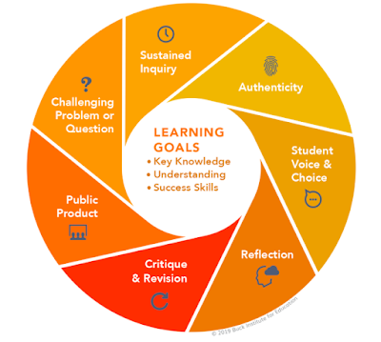
What will work in the 21st century
Notes:
The Buck Institute of Education has listed a number of standards to describe the successful Playful Project-based Learning facilitator:
PPBL facilitator
Designs and plans
A learner problem arises and a lesson is created around it. She knows her curriculum and this will help her to link the problem to relevant CAPS information/ knowledge transfer.
Traditional teacher
Selects a textbook and writes a lesson plan for that lesson. Sometimes uses scripted lesson plans.
PPBL facilitator
Aligns to standards
Knows the CAPS and links lessons to outcomes and expectations from the CAPS.
Traditional teacher
The textbooks are already CAPS-aligned so teacher does not need to take out her CAPS document at all.
PPBL facilitator
Builds the culture
Understands that school culture plays a huge role in modelling appropriate and meaningful relationships.
Traditional teacher
Classroom culture is not her concern. Who learners are and what they think is not her concern – as long as they do their work and keep quiet. She demands respect. Being kind leads to undisciplined learners.
PPBL facilitator
Manages activities
The project is designed around practical real-life solutions. There is very little transmission teaching. Learners are given a task with clear instructions and the teacher observes learners and helps them when needed. She is a class and activity manager.
Traditional teacher
There are no classroom activities. She presents the lesson, and asks learners to summarise that lesson or even do a creative summary on a poster as a project.
PPBL facilitator
Scaffolds student learning
She understands that all learners are different and learn in a variety of ways. She sees her role as that of supporter as each individual learner is helped to climb to the next level because of her one-on-one coaching.
Traditional teacher
She never allows group work and seldom has a private one-on-one with any of her learners. Once she has taught her lesson, she gives learners work, usually the questions at the end of the chapter and she goes back to her marking. She has so many exercises to mark.
PPBL facilitator
Assesses student learning
In her classroom, there are 3 types of assessment and each is treated differently and has a different purpose: Baseline – Where should we start? Where are the gaps? Formative – How are we doing, every little step of the way? Summative – How did we do when tested on a chunk of work?
Traditional teacher
The marks that she allocates are used to decide whether a learner is successful or not. Paper and pen tests, she believes, are a solid gauge of learner progress, and knowledge and information are assessed because statistics give the best results.
PPBL facilitator
Engages and coaches
Her role is to pay attention to the needs of every learner and to offer them support, not via formal teaching, but by one-on-one coaching especially as they work in groups.
Traditional teacher
No activities or homework are done in class. Classroom time is for her lesson, so she has no opportunity to coach learners or observe their progress.
Teachers need to reassess their roles. The time for good lecturing has passed. The time has come to put learner needs and their problems at the centre of lesson and to do everything in our power to make school useful for life after school, to help learners know and believe in themselves and to give them space to become problem solvers themselves…and, of course, to have fun! Learners go to school not to WORK, but to LEARN!

Slide 24
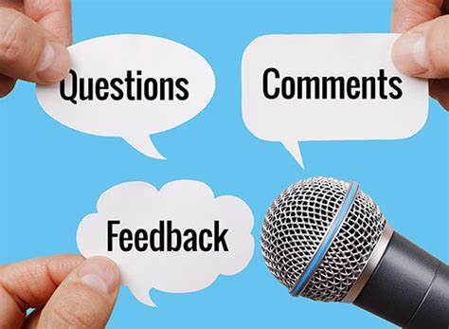
Questions and answers
Notes:
Open the floor up to any questions or discussion for the section. You may allow 10 – 15 minutes.

Slide 25
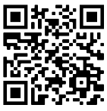
Get connected
Find out what you need for this journey by adding TeacherConnect as a contact on WhatsApp with the number 060 060 33 33 and send the world BELT to start with training on our zero-rated platform, or use the TeacherConnect QR code below:
The Teachers’ Lounge
https://www.teacherconnect.co.za/share/49Q5oaJa85GQmb9C?utm_source=manual
Notes:
Before we end, please feel free to link up with the E³ journey on TeacherConnect and in the Teachers’ Lounge.

Slide 26
Thank you – see you soon www.ecubed-dbe.org

