Slide 1
PLAYFUL PROJECT BASED LEARNING LET’S GET STARTED – TOPIC 3

Slide 2
Programme
TIME | Min | ITEM
E.g. Time | TIME NEEDED | Item
08h00 – 08h20 | 20 | Registration, Welcome, Introductions and Ice Breaker .
08h20 - 09h45 | 30 | PART ONE: Introduction to Project-based Learning, PBL Quiz and Q&A
09h45 - 10h00 | 15 | BREAK
10h00 - 10h55 | 55 | PART TWO: Case Study from Brebner Primary by Michelle Van den Nieuwenhoff PBL Game Break out rooms Q&A
10h55 - 11h00 | 5 | BREAK
11H00 - 11H55 | 55 | PART THREE: The role of assessment Q&A
Notes:
Good Morning Colleagues. And Welcome to day 2 of the E3 training. I am really so pleased to be with you this morning and really hope that when we are done today, you would have come away with some valuable information about Playful Project Based Learning. My name is Patula Dagee and I am the implementation coordinator for E3 and joining me to today is Susannah Morcowitz. I am going to hand over to Susannah to introduce herself.
We have divided this workshop into three parts.
In part one we will introduce you to Project Based Learning, pay attention because we will have an interactive quiz! There will be an opportunity to ask questions in our Q&A at the end of this part.
We’ll break for tea at 9.45 for 15 minutes - we so wish we could all be in person enjoying some tasty treats!
Part two is really exciting, we have invited Michelle van den Nieuwenhoff from Brebner primary school to present a Project Based learning project that she carried out in 2019. We’ll then play a game based on what we heard from Michelle and there will be an opportunity for you to ask her any questions.
We’ll then have a 5 minute comfort break
Followed by part three where we look at the role of assessment.
Although we are not here together in person, we want this to be as interactive as possible so please use the chat function to share your questions and thoughts with us and we will read out your comments throughout the session.

Slide 3
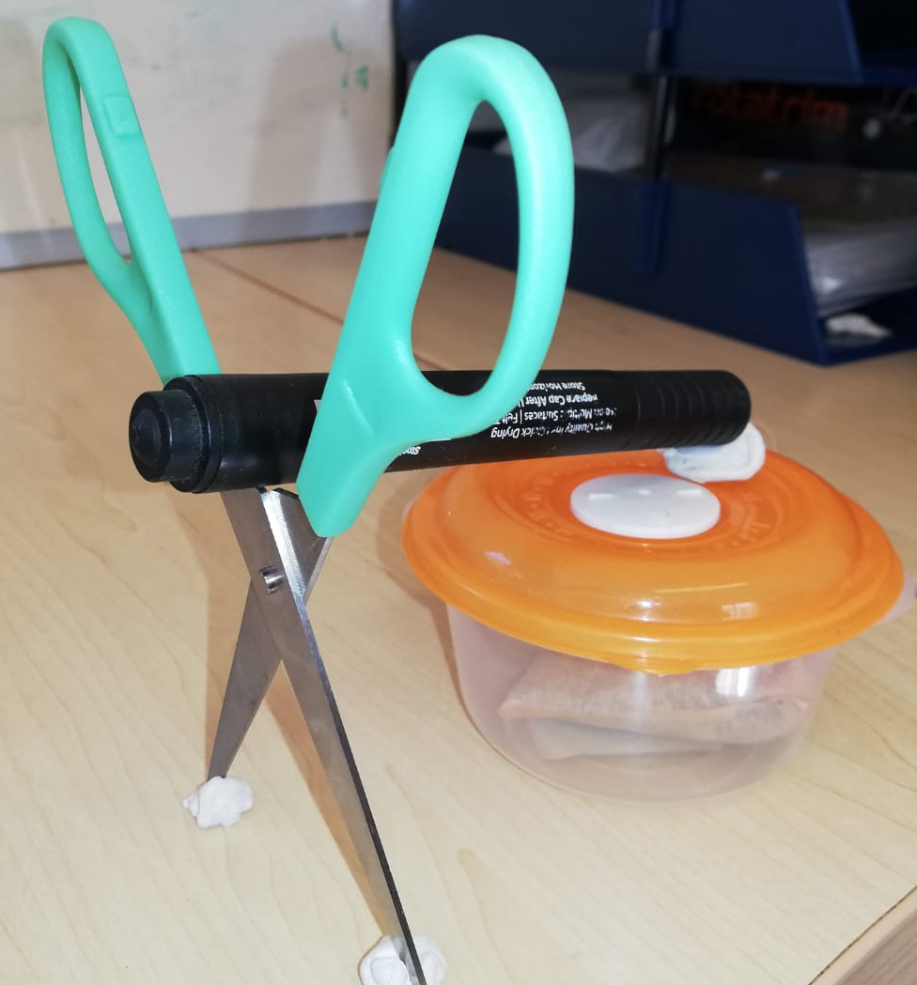
Ice breaker
Make your own pet!
1. You have 30 seconds to find 6 random objects that are close to you
2. Using these 6 objects you now have 1 minute to make any animal that you would have liked to have had a pet when you were a child.
Here is my example. Can you guess what it is, put your answers in the chat box and then I’ll tell you ☺

Slide 4
PART ONE
ABOUT Project-based learning
In this section we will cover the following
What is Project Based Learning
How is Project Based Learning different from Projects
How does Project Based Learning work in the classroom
E3 essential project design elements
A uniquely South African approach
The South African Playful project based learning process
Project-based learning is a learner centered teaching method where learners learn by actively engaging in real-world and personally meaningful projects.
Example of a South African Playful Project based learning project
SPECIAL
It's Quiz time

Slide 5
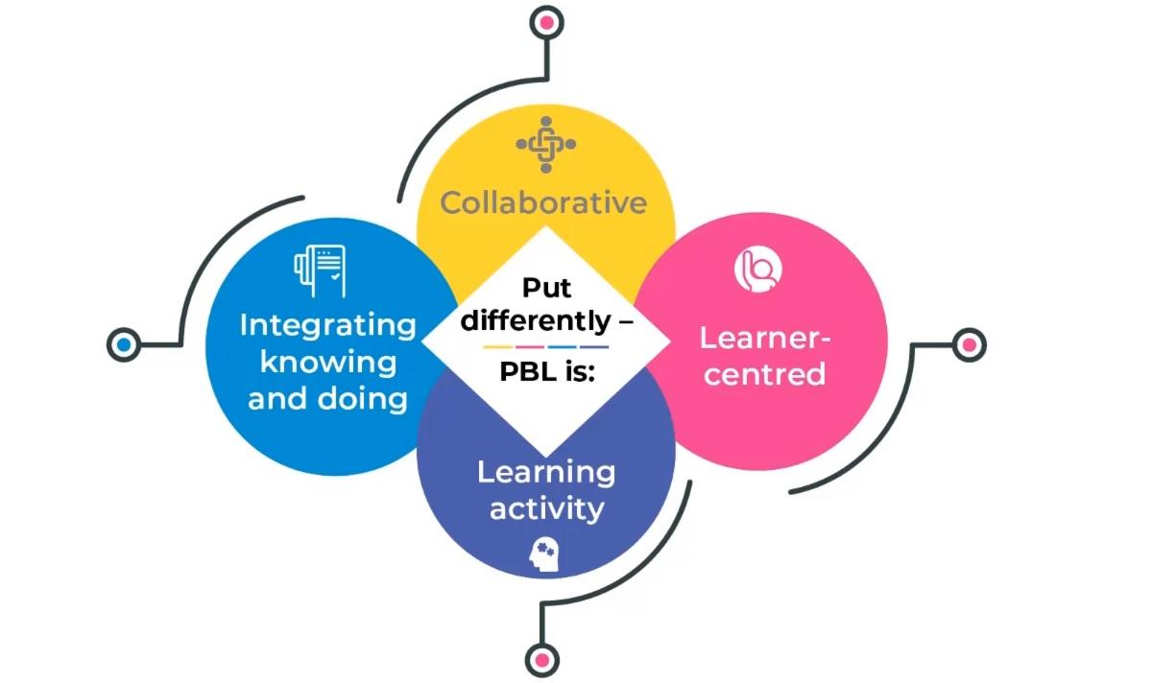
What is Playful Project-Based Learning?
1. 21 Century Skills
7. Research shows a decline in absenteeism and increase in co-operative learning skills
2. Learning becomes more relevant
6. Supports Group work and Collaboration
3. More meaningful assessment
5. More opportunity for speaking
4. Accommodates Diversity in Classroom
Notes:
Playful Project-based learning, or PPBL, is a learner-centered, activity-based pedagogy which promotes individual and small group learner involvement in solving real-life problems by developing basic research skills. It's learning by doing and focuses on developing specific curriculum knowledge and skills. Put differently, playful project-based learning is a collaborative, learner-centered, learning activity in which learners integrate knowing and doing.
Playful Project-based learning is useful for various reasons.
•Playful Project-based Learning equips learners with 21st century skills. Solving highly complex problems requires that learners have essential skills - reading, writing and maths -and 21st century skills - teamwork, problem solving, research gathering, time management, analysis and the ability to use high-tech tools.
• Learning becomes more relevant and meaningful in PPBL. Bringing the real world into the classroom provides a very powerful learning experience.
• Assessment is more meaningful in PPBL as it is authentic. The assessment in PPBL is more diverse and includes almost all forms of assessment - from the traditional test to observation of research practices. Authentic assessment also involves assessing learners’ development while they work in pairs, groups or individually. This is less stressful for the learner and allows for repetition and another chance if the learner was not on point on a specific day.
• Playful Project-based Learning accommodates diversity in the classroom. Globally classrooms are becoming more diverse and teachers are faced with the challenge of trying to ensure that learners are all treated equitably. Group work ensures that teachers can customise tasks for individual learners and settle individual queries as they arise.
• Playful Project-based Learning ensures that learners struggling with English (and any other LOLT) are provided with more options for speaking if the leader is empathetic and well-briefed.
A limited ability to communicate, in English particularly, is a key obstacle to many learners’ academic success especially from grade 4 onwards. If teachers group learners purposefully, they can ensure that each group has a strong and empathetic lead speaker from whom they can model conversation. Of course, the assumption here is that English is the LOLT (the language of Learning and teaching – if another language is the LOLT, a language-strong leader will perform the same leadership task). Thus: learners not comfortable in speaking English (or their LOLT) can do so in the low-risk group environment with peers who can help them.
• PPBL supports group work and collaborative learning a 21st century skill. Much learning is social and learners acquire many new skills from their peers in well-structured group work especially if teachers organise groups intentionally for the outcome they wish to achieve.
• Research supports Playful Project-based Learning. A growing body of international research supports the use of PPBL. Schools where PPBL is practised show a drop in absenteeism, an increase in co-operative learning skills and improvement in learner achievement. The marks actually improve. When technology is used to promote critical thinking and communication these benefits are further strengthened.
• Projects are the formal assessment task in term 3 of the CAPS The projects are written to meet the CAPS requirements. Teachers can thus reach the curriculum outcome simply by changing their teaching method. The same information but packaged differently. Project-based learning is not about the ‘what’ but the ‘how’

Slide 6
What is the difference between a project and project-based learning?
Notes:
Traditionally projects were a once-off poster or a flip file consolidating knowledge or content at the end of a chapter or a section of the syllabus. Thus a project was a product. While playful project-based learning could also feature projects in the traditional sense, in PBL the focus is more on the process of learning and learner/peer/content interaction than the end product itself.

Slide 7
How does PPBL work in the classroom?
Notes:
How does PPBL work in the classroom?
According to the Buck Institute, learners engage in a project over an extended period of time - from a week up to a semester - that engages them in solving a real-world problem or answering a complex question. This is a simulation of reality - how long the task would take in real time. They demonstrate their knowledge and skills by developing a public product or a presentation for a real audience at the end of the project. Importantly, this pedagogy creates a myriad of opportunities for teachers to embed 21st century skills and for learners to pick them up in a real-life way. Because it is real it has purpose for the learner and subsequently for the teacher. This is the Buck Institute model, which is the model that we used previously.

Slide 8
The E³ essential project design elements
7. Launching the Project
1. Challenging Problem or Question
6. Public Performance
2. Sustained enquiry
5. Critique and Revision
3. Authenticity
4. Reflection
Notes:
2.1 Project design
Instead of teaching content, projects should be designed so that the activity allows learners to discover fundamental concepts and key learnings from school subjects and apply them to the real world. PPBL helps learners practise these key learnings by using them to solve problems, answer complex questions and create complex products. To help teachers implement good projects, the Buck Institute created a set of criteria to be used as a checklist in Playful Project-based Learning design. E³ began using the Buck Model in 2018 as it provided a good foundation to start from. Since 2018 E³ has been developing its own unique South African model of playful project-based learning.
The question is How do we create successful projects?
To ensure an excellent PPBL process, we need the following minimum requirements to be integrated in the project design (which we originally implemented as part of the Buck Design), but which has been adjusted for the South African teaching space:
• Challenging problem or question.
This is a concrete or abstract problem which is real to the learners, in other words, the PPBL is centred on a research-type cycle in which a problem is identified, research is undertaken, investigations are done and some or other solution is the result.
• Sustained enquiry.
PPBL is different from the projects we are accustomed to. Merely looking up information and summing it up is not enough. It is too shallow and does not demand active follow-up and testing which leads to deeper learning. Sustained enquiry takes time, is taken seriously and teachers ensure that the activity is iterative, i.e. repeated until learning has taken place. The updated model places more weighting on the iterative element.
• Authenticity.
Authenticity is critical if we are to keep learners involved. The project must be real and start with a genuine problem that the school or community needs to solve.
• Student voice and choice.
If learners have the say in the selection of the project’s problem, they work harder because they feel they own it. They also feel they are contributing to solving the world’s problems.
• Reflection.
Learners and teachers should be reflecting on various questions during the process. What is being learned? Why is this learning important and how is this learning being presented? We
do not learn from experience; we learn by reflecting on experience.
• Critique and revision.
The outcome of good PPBL is work of a very high standard, but this may not happen in the first cycle as teachers and learners grapple with typical challenges. How deep is a good
project? How do we integrate the anchor subjects with other subjects? What are we learning? What can we do better?
• Public performance.
The learners’ solutions or projects are presented to as wide a public as possible for a few reasons. The work is generally of a higher standard if presented to a larger audience. Public products and performances are a way for learners and the school to communicate with all role players.
• Launching the project at school level is important for buy-in.
Schools involved should announce the launch of all their projects at the start of term 3 or earlier and also the culmination of the projects in a specified project week towards the end of term 3.
Each grade will manage its own launch. Example: a school competition the winner of which is announced in a project week; an entrepreneurship quiz or an appropriate civvies day. Be creative during project culmination week. All the products and solutions delivered by each grade’s projects are up for public display. The broader the community involvement the better for the learners. Schools will be encouraged to send YouTube videos of the best launch and other celebratory moments to be published on the E³ website and on the WhatsApp group. Have fun, it’s great Fun

Slide 9
So what does this uniquely South African Approach look like?
Playful project-based learning
S
Social Interaction
Design- based Learning
P
Purpose
play
E
Enjoyment
through
Problem-based Learning
C
Curiosity
I
Learning
Iteration
Inquiry- based Learning
A
Active Engagement
L
Learner centred
PROCESS
Project Based Learning
EQUIPPED
With tools and pedagogy
ACTIVATED
Play
FACILIATATED
Teacher
Notes:
So we talked about creating a uniquely South African model – but what does this look like?
Playful Project-Based Learning is the process that teachers can use to design meaningful, authentic learning experiences that connects what learners learn in school to real-world issues, problems, and applications. If learning mirrors real-life contexts and equips learners with practical and useful skills, they are more likely to be interested in and motivated by what they are learning. This includes 21st century knowledge, work habits and character traits that are critically important to success in today’s world.
Click:
Playful Project-based Learning includes a number of different Active Learning Processes that can be used in different stages of the project enabling different approaches to learning. It is not the only method to achieve these aims, but one that E³ wanted to start with as it can be seen as a framework that includes other active learning processes. You can see here that our approach uses Inquiry based learning, Problem based learning and design based learning.
CLICK:
That is activated through PLAY -These are the observable outcomes learners will display when participating in a Playful Project-based Learning project that is activated and facilitated using a playful learning pedagogy. Teachers can use these observable outcomes as a checklist when designing learning experiences. Teachers do not need to use all 7 of these elements in each lesson, but ensure that through the course of a project that these elements are covered.
Playful Project-based Learning provides the structure through which these observable outcomes are made visible. If we see these outcomes, then we know that meaningful learning is happening and that the whole child is being developed (as per Lego research). These will need to be tested more thoroughly in our approach.
CLICK:
The whole process is designed and facilitated by a teacher who is equipped with tools, manipulatives, games and a pedagogical approach that supports diversity in the classroom.
Click:
I want to stress, this is ONE approach to developing the 21st century competencies, it is not the only approach, but it is where we want to start.

Slide 10
Our Playful Project-based Learning Process
Solution -seeking mindset
Reflect and Iterate
13
PRESENT
Hold a public exhibition and present to the public
12
The MADD Space – present your work using Music, Art, Drama, Dance
INTEGRATE
Design Based Learning
Play
11
FEEDBACK
Speak to experts or the community to get REAL feedback
10
PROTOTYPE
Make your own prototype of your best solution
9
The teacher facilitates this learning process using tools and resources and
learning through play
Reflect and Iterate
EVALUATE
Evaluate and select your best solutions
8
through
PRESENT
Present the point of view and options to an audience
7
Brainstorm as many solutions to your problem as you can
Problem Based Learning
BRAINSTORM
6
Consider the different points of view to understand more
EXPLORE
Tools and Resources
Reflect and Iterate
5
Ask lots of questions to help you define your problem
DEFINE
Learning
4
Multi literacy pedagogy
APPLY
Apply your knowledge to your environment
3
Order and categorise your existing knowledge
Experiencing
Conceptualising
Analysing
Applying
Inquiry Based Learning
ORDER
2
NEW KNOWLEDGE
Building on what you already know and add new knowledge
1
KNOWLEDGE
Think about what you already know
Notes:
As mentioned above E³ has begun work on creating a uniquely South African model of project-based learning. Being iterative is really important to E³ and so we will be testing and developing this model over time, to ensure that it is the best model for South Africa and makes the biggest impact on learner achievement.
Our model includes 3 important active learning approaches to develop learners 21st century competencies:
Click:
• Inquiry-based learning
Click:
• Problem-based learning
Click:
• Design-based learning
Inquiry-based Learning
In the Inquiry phase, learners focus on investigating an open question or problem by practising their problem-solving skills. In the process learners generate and answer their own more focused questions, and as a result develop their conceptual and procedural knowledge of a given topic. Teachers encourage learners to ask questions, scaffolding them through the investigation process and moving them beyond general curiosity into the realms of critical thinking and understanding.
Problem-based learning
Learners work in teams to formulate real-world problems and propose possible solutions. Following a learner-centred approach, teachers scaffold the development of learners’ ability to work collaboratively, be self-directed, and to think critically - promoting critical thinking skills, communication skills, and cooperation.
Design-based learning
In the design phase learners come up with solutions to complex problems by designing, building and testing prototypes that solve some of the problems they identified in the problem phase. The process requires learners to establish goals and constraints, generate ideas, and create prototypes through storyboarding or other practices.
Lets just break this down a bit more. In the Inquiry based learning phase….. take them through the model. Step by step.

Slide 11
An example of a project in Grade Four that incorporates the elements of Playful Project-based Learning
Inquiry Phase: Exploring the concept of Culture and the importance of having cultural pride and respect for other cultures
1
Think about what you already know
2
Building on what you already
know and add
new knowledge
4
Apply your knowledge to your environment
S
KNOWLEDGE
NEW KNOWLEDGE
3
Order and categorise your existing knowledge
ORDER
APPLY
Social Interaction
Inquiry -based Learning
Using a CIRCLE MAP learners document what they already know about CULTURE
Read a story that introduces new knowledge, followed by a class discussion about the main cultural questions raised in this story
Learners interview each other to find out more about the different cultures in their class. Learners categorise all the new information they learnt using a TREE MAP
Learners then apply what they have learnt to the driving question, by creating a poem, song or dance to the topic of ‘we are proud of our culture’.
Reflect and Iterate
P
Purpose
E
Problem Phase: Learners explore how they can improve the level of cultural pride in the school
5
Ask lots of questions to help you define your problem
6
Consider the different points of view to understand more
7
Brainstorm as many solutions to your problem as you can
8
Present the point of view and options to an audience
Enjoyment
DEFINE
EXPLORE
BRAINSTORM
PRESENT
C
Refer back to the TREE MAP and focus on the Traditional Food Category. Learners discuss how sharing recipes for traditional cultural foods could help improve the sense of cultural pride.
The recipe book is intended to improve cultural pride in the school. What ideas can the learners brainstorm for their recipe books/posters?
Problem- based Learning
Learners explore ways that recipes can be shared and what might be important to include if they were doing a poster/ recipe book.
Groups present their brainstorming ideas and gain feedback from their peers.
Curiosity
Reflect and Iterate
I
Iteration
Design Phase: Design the prototype, come up with an idea – redo /tweak product or service
A
9
Evaluate and select your best solutions
10
Make your own prototype of your best solution
11
Speak to experts or the community to get REAL feedback
12
The MADD Space – present your work using Music, Art, Drama, Dance
13
Hold a public exhibition and present to the public
EVALUATE
PROTOTYPE
FEEDBACK
INTEGRATE
PRESENT
Active Engagement
Design -based Learning
Using a FLAT PLAN learners can evaluate the content and design of the book.
Learners collaborate to create their recipe book using the flat plan.
Learners seek feedback on their books from friends and family and action appropriate feedback
Learners can think of ways of promoting their recipe book for example creating a TV advert that includes dance, drama and song.
Present – assembly/ grade 7 market day where the books could be published.
L
Learner centred
Notes:
If you wanted to see the entire project and what it looks like - we have included this in all the projects as well –
Take them through the entire project on the above flat plan.

Slide 12
What does play look like in South Africa?
The 7 Essential Characteristics of Playful Project-based Learning
S
P
E
C
I
A
L
Learning spaces that:
Enable Social Interaction
Create a sense of Purpose
Are
Enjoyable
Inspire
Curiosity
Encourage Iteration
Foster Active Engagement
Are Learner Centred
Group work, solving problems together, learning from each other, choice in working independently or in groups
Choice, learning through song, dance, movement, drama, inside and outside the classroom.
Choice,
authentic real-life problems.
Ongoing projects
Opportunities to explore, investigate, follow interests
Explore problems try, fail, reflect and try again, develop and grow. No ‘right’ answers
Learners at the core of the learning cycle.
ENABLE
Learner voice and choice in learning.
Connection competencies
Collaboration Communication Empathy
Ownership, agency and self-efficacy.
Intrinsic motivation
Thinking competencies
critical thinking, creativity reasoning
Intrinsic motivation
Curiosity
Character Competencies
Resilience
Agency
Intrinsic motivation
Self Efficacy
Character
Citizenship
Curiosity
Resilience
DEVELOP
Ensuring the whole child development
COGNITIVE
CREATIVE
SOCIAL
PHYSICAL
EMOTIONAL
Notes:
These seven characteristics can help teachers to ensure that the Projects that they facilitate encompass all of these characteristics, then the Solution Seeking Mindset will ensue. Think of these things as observable traits that you will see in your classroom, use this as a checklist when running a project. For example – can you see meaningful group work? Is the work/project purposeful, is it authentic? Are there opportunities for learners to ‘iterate’ to action any feedback they receive and develop their work? And so on……
Take them through the slide.

Slide 13
Its Quiz time
The questions will appear on the screen, there will be 3 questions.
The quiz will be multiple choice
Write your answers on a piece of paper (e.g. A, B or C)
The answers will then appear on the screen and you can mark yourself.
This is just a bit of fun ☺

Slide 14
1. Circle the correct three stages in our PBL model
1. Circle the correct three stages in our PBL model
A
Investigation based learning
Problem based learning
Design based learning
B
Inquiry based learning
Problem based learning
Design based learning
B
Inquiry based learning
Problem based learning
Design based learning
C
Inquiry based learning
Project based learning
Design based learning
Notes:
We have just talked about Playful Project Based Learning, and now its time to see if you have been listening ☺ there are three stages to our model, circle the CORRECT three stages in our PBL model.

Slide 15
2. Inquiry based learning is
2. Inquiry based learning is
A
Learners work in teams to formulate real-world problems and propose possible solutions. In the process learners develop their critical thinking and problem solving skills.
c
Learners focusing on investigating open ended questions, learners generate additional questions and develop their conceptual and procedural knowledge.
B
Learners come up with solutions to complex problems by designing, building and testing prototypes that solve some of the problems they identified in the problem phase.
c
Learners focusing on investigating open ended questions, learners generate additional questions and develop their conceptual and procedural knowledge.
Notes:
We have just talked about Playful Project Based Learning, and now its time to see if you have been listening ☺ there are three stages to our model, circle the CORRECT three stages in our PBL model.

Slide 16
3. The reason why Project based learning is so important is that it…..
3. The reason why Project based learning is so important is that it…..
C
Creates an environment where learners gain 21 century work readiness skills such as problem solving, teamwork, communication, critical thinking etc….
A
Teaches CAPS content
B
It is fun, it teaches learners how to follow orders and become good citizens
C
Creates an environment where learners gain 21 century work readiness skills such as problem solving, teamwork, communication, critical thinking etc….

Slide 17
Questions and Answers
Raise your hand to ask questions
Or put your questions in the chat box
Or ask your coach after this training session.

Slide 18
Tea Time
Please be back in 15 minutes

Slide 19
PART TWO
CASE STUDY
From Brebner Primary
In this section we will cover the following
Introducing Michelle from Brebner primary
Keeping learners motivated
Overcoming challenges
Seeing real excitement
Activity time
Here we see a REAL project-based learning maths project in action.

Slide 20
Getting started with my maths project – Michelle Van den Nieuwenhoff – Brebner Primary School
Notes:
In this session we hear from an E³ teacher who implemented PPBL in 2019 before the pandemic.
Getting started with my maths project
Michelle van den Nieuwenhof is a teacher at Brebner Primary School in Bloemfontein. She started experimenting with playful project-based learning after she was introduced to it at the 2019 E³ conference. She realised that she had to make maths more realistic and alive in her class as that was the only way the learners were going to start to achieve. Her first step was to find a real-life problem which was quite a challenge as he says. One day she was attending a sale of repossessed vehicles when the idea came to her. So many vehicles get repossessed in our country and she thought she should do a lesson on how to buy a car.
This was amazing because 1) it was a real-life problem and 2) She was having more problems in her class with the boys – and as you know cars and boys - well, they were hooked immediately, says Michelle.
Once she had the real-life problem she got permission from her principal and learning facilitator. They decided that they would just do it with her two classes and the other grade 6 classes would carry on with the normal CAPS. The only condition was that they all had to write the same assessments.

Slide 21
Lets hear from Michelle herself
https://drive.google.com/drive/u/1/folders/1MFB9wGMY7uGtzxC29ZngxXm85djfu2EV
T03S03 (WhatsApp MP4) - Google Drive
T03S03 (WhatsApp MP4) - Google Drive
T03S03 (WhatsApp MP4) - Google Drive
https://drive.google.com/drive/u/1/folders/1MFB9wGMY7uGtzxC29ZngxXm85djfu2EV
T03S03 (WhatsApp MP4) - Google Drive
T03S03 (WhatsApp MP4) - Google Drive
Notes:
In the next session we will look at how Michelle from Brebner Primary school took this approach and created her own project.
Teachers will now go and listen to the clips of Michelle Brebner.

Slide 22
Keeping learners motivated by using the E³ essential project design elements
7. Launching the Project
1. Challenging Problem or Question
Write down these elements
During the presentation
Make notes of examples of when you these elements.
You will the be split into groups to discuss one of the elements.
6. Public Performance
2. Sustained enquiry
5. Critique and Revision
3. Authenticity
4. Reflection
Notes:
Keeping learners motivated throughout
The next step was to make sure she covered all the design elements.
So she used the design element logo that E³ supplied during the training, which was the Buck Institute Model. She also had to make sure that she covered the design elements.
So the first thing she did was pose a challenging problem or a question.
Then she had to work out how to sustain inquiry. She then decided to introduce a new aspect to buying a car regularly. The first thing she did was visit a car dealer with learners. There the learners got prices and they were all excited. As soon as their interest waned and they weren't quite as inquiring anymore she introduced insurance and then she introduced building a garage and then she introduced fuel consumption. So to sustain inquiry she kept on introducing new things or new points about buying a car.
For authenticity it wasn't too difficult because she chose a real-life problem and buying a car is a reality to most people and none of her learners had ever been to car dealership or gone with their parents. So the fact that they visited a car dealership and the the fact that the bank visited them as well just made it more authentic. The next thing I had to look at was the students’ voice and the students’ choice. Well here they had a voice because they could ask questions. Part of the project was to design questions to ask the car dealers or to ask the insurance or to ask the bank. Her final part of the project gave them a lot of voice and a lot of choice. With buying the car they also had to make a decision, She actually gave them pay slips and then they had to choose which car would suit their budget.
Reflection initially was a problem for her because She wasn't quite sure how she would get the learners to reflect on everything. She worked with the English teacher and we used English reports as part of the reflection for the project.
For critique and revision they had to give a report back.
The public product – well here the one thing was that they had to report back on. They had a final evening where they invited the parents, the school governing body, the learning facilitator, the car dealership who helped them and then the banks. So in the report back there was a lot of public product involved and the learners could thank the companies A lot of their creativity was exposed in the report back right at the end of the project. For public product you need to use businesses around you. She used a local car dealer and a local bank. The local car dealer was really open to everything and made it very, very easy. The bank was happy to come and speak to the learners and also give them information about the insurance section of the project. Once she had gone through the whole design element circle she saw that I had everything covered and she then just linked this to the CAPS.

Slide 23
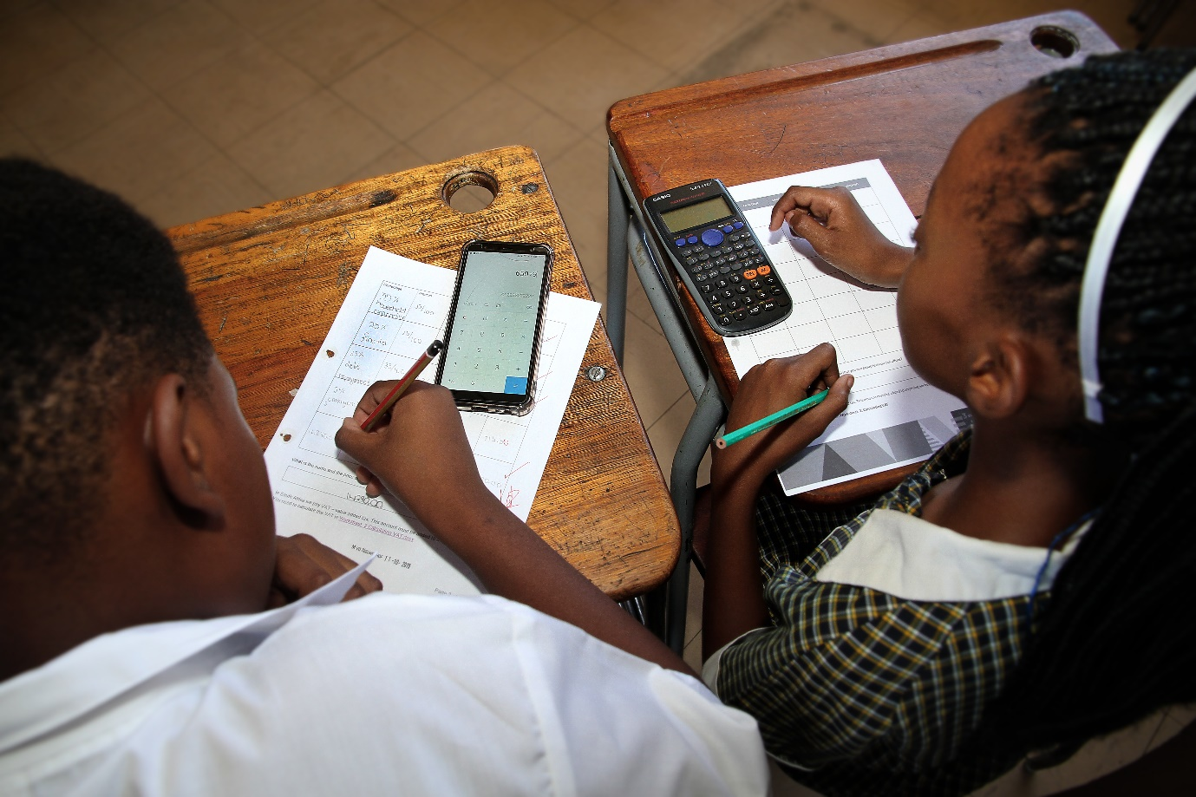
Overcoming challenges
Lone Wolf
PBL Noisy and Messy
Move from Chalk and Talk
Late for other classes
Started enjoying Maths
Marks Improved
Deeper understanding of Math
Parent involvement
Notes:
Michelle says that Like with all new things a person does experience various challenges and she really experienced quite a few. The biggest challenge for her was that she was the “lone wolf” on the staff. People thought she was really weird because she had these crazy ideas and it was difficult for her to keep her energy going because she didn't have much support initially. Later on it got better as she had a principal who backed her. The other challenge was that PPBL is noisy and it is messy. Her class is always relatively neat and the desks are all in a row. BUT suddenly her class was transformed into group work and suddenly there were a lot more papers because they were cutting out things and it was noisy because they were discussing things. The other challenge was to start getting the learners to move from traditional talk and chalk and traditional teaching to a more dedicated or a more disciplined approach. The learners had to learn to be more disciplined and work, and so that initially was a problem but towards the end of the project she didn't even have a problem with that. The other problem, and this is an amazing challenge, she knows when she says this you will think, “Oh no, how is this a challenge?” It was a challenge for me to get my learners to leave after maths. They were coming late for all the other classes because they just didn't want to leave the maths class. The classes she had before break used to sit the whole of break and argue and discuss the work. So it was a challenge but it was also a positive. One of the things that surprised her about the project was, 1) that the learners really started enjoying maths and they didn't want to leave the maths class. That was really great. 2) the learners’ marks improved. It was really interesting to note that the weakest learners marks really, really improved. The top learners found it a very valuable social experience as well. They had to learn that there are learners who find maths difficult. What was nice was that eventually they were helping the weaker learners especially with a lot of the direct operations. She found that their direct operations really improved because the stronger learners in the group helped the weaker learners individually. One of the other things that surprised her was the creativity of the learners. She was actually shocked because we as teachers really stifle that creativity because we are so syllabus bound. When she gave the learners the opportunity for creativity, initially they were a bit wary, but once they got going it was really amazing - it was amazing to see at the report back evening the creativity the learners came up with. Another positive for her was that there was definitely a deeper understanding of maths and a deeper understanding for the need for maths. What was also great was the parental involvement. Right from the beginning She involved the parents. She sent them little notes and little photos of everything and was surprised at the parent involvement. And what was nice as well was the learners were going home and explaining all this to their parents and they would engage with their parents. So these were a few of the really positive things that came out of the PPBL that they did.

Slide 24
Seeing real excitement
Started a Parents Academy
Involved lego
Involved previous learners
Teachers involved
Notes:
The PPBL project caused a lot of excitement amongst the parents and amongst the learners, especially the young teachers that came on board. There were a lot of people saying, can't we make this bigger and there was a lot of involvement from various stakeholders. So with all this excitement they decided that they were going to start a Parents’ Academy and the Parents’ Academy would basically be where the school would engage the parents. They would get together two or three times a term and would get a speaker speaking about real-life problems that the parents have.
At their first engagement with the parents they involved the Lego Foundation and got an amazing lady to come and speak to the parents. The 6 bricks approach was followed and parents were shown how to work with the Lego to help their kids in all kinds of ways. From that they then moved on and asked the parents what they would be interested in. At the next engagement they got an old learner from their school to speak about nutrition, they got a teacher to speak about routine and then they also discussed sleep. And they did all this in one session.
Then, to keep the parents going and to keep the momentum going we started a newsletter. What happened is they had about 250 parents at their first meeting which then grew to about 300 at their second meeting and they wanted to engage even more people. So that is when they started with the newsletter. Unfortunately because of Covid everything was pout on hold but they are still in touch with parents.

Slide 25
Would I do it again, ABSOLUTELY!
Lots of work – Spinnoff great
Constant discussions
It created excited amongts learners
Positive learners
Notes:
All done and dusted the question is, would I do this again? Yes definitely, definitely, definitely. Was it a lot of work? Yes it was! Was it hard? Yes it was. But the spinoffs and the energy that came off this project was just worth so much. It created a great excitement towards learning. For the first time learners were really positive about learning. They sometimes didn’t even realise they were learning. They were discussing things young kids would never normally discuss. So for her, she would definitely do it again. The learners today need a different approach towards teaching and she thinks the most difficult challenge is the majority of teachers just don't realise that. We still teach how we were taught. Remember the learners have changed completely.

Slide 26
Activity Time
I am going to read a statement, you will then write down what step this is in the process.
Share your answers in the chat box
or
write them down on paper and mark yourself as we go along.
Notes:
Given what you heard about Michelle’s project, can you take the elements and map them onto this plan

Slide 27
Our Playful Project-based Learning Process
Solution -seeking mindset
Reflect and Iterate
13
PRESENT
Hold a public exhibition and present to the public
12
The MADD Space – present your work using Music, Art, Drama, Dance
INTEGRATE
Design Based Learning
Play
11
FEEDBACK
Speak to experts or the community to get REAL feedback
10
PROTOTYPE
Make your own prototype of your best solution
9
The teacher facilitates this learning process using tools and resources and
learning through play
Reflect and Iterate
EVALUATE
Evaluate and select your best solutions
8
through
PRESENT
Present the point of view and options to an audience
7
Brainstorm as many solutions to your problem as you can
Problem Based Learning
BRAINSTORM
6
Consider the different points of view to understand more
EXPLORE
Tools and Resources
Reflect and Iterate
5
Ask lots of questions to help you define your problem
DEFINE
Learning
4
Multi literacy pedagogy
APPLY
Apply your knowledge to your environment
3
Order and categorise your existing knowledge
Experiencing
Conceptualising
Analysing
Applying
Inquiry Based Learning
ORDER
2
NEW KNOWLEDGE
Building on what you already know and add new knowledge
1
KNOWLEDGE
Think about what you already know
Notes:
Now if we have to take a look at Michelle’s project, which of the elements did she cover in the new modal? Teacher discussion is imperative here.

Slide 28
An example of a project in Grade 6 Math that incorporates the elements of Playful Project-based Learning
DRIVING QUESTION: Is buying a car an investment?
Inquiry Phase: Exploring the buying of a car – Grade 6 Math
1
Think about what you already know
2
NEW KNOWLEDGE
Building on what you already
know and add
new knowledge
3
Order and categorise your existing knowledge
4
Apply your knowledge to your environment
KNOWLEDGE
ORDER
APPLY
Learners had to record the cars and prices that they saw at the dealership and order them according to price using different graphs
Learners had to find out how people buy cars. The learners went to a car dealership to find out.
Learners had to record the cars and prices that they saw at the dealership and order them according to price using different graphs
Learners had to apply what they learnt to looking at concepts of insurance, fuel consumption and building a garage
Building on the learners interest in cars Michelle asked what do you already know about cars
Learners had to find out how people buy cars. The learners went to a car dealership to find out.
Learners had to apply what they learnt to looking at concepts of insurance, fuel consumption and building a garage
Reflect and Iterate
Building on the learners interest in cars Michelle asked what do you already know about cars
Inquiry -based Learning
Inquiry –based Learning
Problem Phase: xxxxx
5
Ask lots of questions to help you define your problem
6
Consider the different points of view to understand more
7
Brainstorm as many solutions to your problem as you can
8
Present the point of view and options to an audience
DEFINE
EXPLORE
BRAINSTORM
PRESENT
Learners reported back on their experience so far using their English lessons. The gave and received peer feedback.
Learners then created questions to explore with insurance companies and banks - around the topic of buying a car.
Learners then explored the issue further by interviewing insurance companies and banks
Public presentation - parents evening where car dealerships, banks, school management - for learners to present their experiences.
Learners reported back on their experience so far using their English lessons. The gave and received peer feedback.
Learners then created questions to explore with insurance companies and banks - around the topic of buying a car.
Learners had freedom to decide how they wanted to present their overall project reflecting on their experience by creating a blog, interview, play etc…..
Learners then explored the issue further by interviewing insurance companies and banks
Learners then create a prototype of a garage that will keep their car safe (linked to Technology class)
Learners then brainstormed the criteria on the best insurance cover.
Learners then brainstormed the criteria on the best insurance cover.
Problem- based Learning
Learners presented their prototypes to their fellow learners and received feedback.
Learners were given pretend payslips and had to decide which cars they were able to afford.
Design Phase: Design the prototype, come up with an idea – redo /tweak product or service
Design Phase: xxxxx
9
Evaluate and select your best solutions
10
Make your own prototype of your best solution
11
Speak to experts or the community to get REAL feedback
12
The MADD Space – present your work using Music, Art, Drama, Dance
13
Hold a public exhibition and present to the public
EVALUATE
PROTOTYPE
FEEDBACK
INTEGRATE
PRESENT
Design -based Learning
Learners were given pretend payslips and had to decide which cars they were able to afford.
Learners then create a prototype of a garage that will keep their car safe (linked to Technology class)
Learners presented their prototypes to their fellow learners and received feedback.
Learners had freedom to decide how they wanted to present their overall project reflecting on their experience by creating a blog, interview, play etc…..
Public presentation - parents evening where car dealerships, banks, school management - for learners to present their experiences.

Slide 29
Questions and Answers
Raise your hand to ask questions
Or put your questions in the chat box
Or ask your coach after this training session.

Slide 30
PART THREE
Deep Learning in PPBL
In this section we will cover the following
Supporting deep learning within Playful Project-Based Learning
How to scaffold: differentiated Instruction for Playful Project-based Learning
Questions and Answers

Slide 31
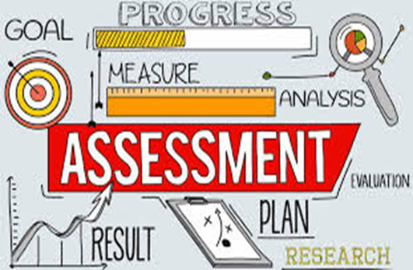
Assessment in project-based learning
Notes:
In this session we will look at the following; the goal of assessment, the importance of product versus process, peer assessment, self-assessment and the integration of various subjects to form one deep assessment.
The goal of the assessment
Ensure you know what the goal of the assessment is:
• Baseline – where are we before we start? Where do we need help?
• Formative – how are we doing after each small step?
• Summative – how did it go after a large chunk of work was completed?
Also: reflect on whether you are assessing the process or the product.
Product versus process
Assessing the product Assessing the process Measuring the quantity and quality of individual work in a group project. Evaluating individual teamwork skills and interaction. Another important consideration when assessing is to reflect on whether you are assessing the process or the product. Often we try to assess too many aspects, both product and process at the same time and very often just the product and the assessment becomes messy and unfair. Assessing process is key to project-based learning. We all understand the assessment of products, example a test, a poster project, a homework assignment. These are second nature to us when assessing. We have been trained to collect marks and often the 21st century skills get left behind. Knowledge and curriculum coverage is not negotiable.
We all agree on that but, a 21st century teacher will pay attention, special attention, to how learners are learning.
4.3 Group work
Group work is an excellent opportunity to measure the quantity of work and the quality of individual work in a group project. An engaged teacher will use the time when learners are working in groups to make notes on individual teamwork skills and how individual learners interact with others. These are the competencies we need to spend more time on developing. These are the processes we need to be observing.
4.4 Peer Assessment
Learners should be given the opportunity to assess each other’s contributions. Consider providing a rubric to foster consistent peer evaluations of participation, quality and quantity of work. Good and solid peer assessment is very powerful and may reveal participation issues that the teacher might not even know about. Learners who know that their peers will evaluate their efforts may contribute more to the group and have a greater stake in the project. Ensure that the rubric you create is easy to understand and fair. Even better, create the rubric with inputs from the class. This is real learning.
4.5 Self-assessment
Give learners opportunities to evaluate their own performance. Help learners reflect on what they have learned and how they have learned it. Consider asking learners to complete a short survey that focuses on their individual contributions to the group, how the group interacted together, and what the individual learner learned from the project.
4.6 Integrate assessment throughout the process
Ensure that groups know how each member is doing by integrating assessment throughout the project: baseline assessment at the beginning to ascertain what they knew before the started. Groups need to know who may be struggling to complete assignments, and members need to know they cannot sit back and let others do all the work.
4.7 Assign specific roles in group work
The roles most often needed for group work include:
a. Facilitator / Team Leader
b. Recorder
c. Presenter
d. Timekeeper
e. Artist / Illustrator
f. Wild card (assumes any role if another role-player is absent
g. Human Resources (keeps the peace)
h. Resource manager (ensures that all members have all the tools and resources they need to complete the project.
When you first introduce roles, provide clear instructions for the responsibilities that come with each project. Filling out a rubric for each member of the group can help teachers assess individual contributions to the group and the individual’s role as a team player. There is an example of a rubric in the teacher’s manual book.
Assessment in PPBL is generally continuous and formative, but in the projects in this programme we are fortunate in that the formal assessments for Term 3 in Grades 4 – 6 Life Skills, Grades 7 – 9 EMS and Grades 10 – 12 Life Orientation are the “project” for assessment. Teachers will have the rubrics they usually use for assessment of the projects in their grades. They are found in the actual project notes. Also, we are hoping that the Life Skills, EMS and Life Orientation teachers will ask other teachers to assist with assessment wherever there is a gain for these teachers as well. We have suggested subjects with which there is possible integration with other subjects. In conclusion, assessment is a key driver of good project-based learning, but each assessment be it peer, individual or group should have a purpose - ultimately to consistently develop learners who are well equipped for the new world after school. This can only be achieved if the process of learning is respected. Product important, process critical!

Slide 32
Supporting deep learning within Project-Based Learning
In this session we look at two key tools for ensuring deeper learning within PBL.
1.
Recognising diversity in the classroom.
2.
The importance of recognising that whatever we teach, we will always be a language teacher first.
Notes:
In this session we look at two key tools for ensuring deeper learning within PBL.
1.Recognising diversity in the classroom.
2.The importance of recognising that whatever we teach, we will always be a language teacher first.
Diversity
In South Africa, the curriculum and education system as a whole generally still have huge challenges to respond, in an adequate way, to the diverse needs of the learner population. Overcoming these challenges will contribute to the reduction of the massive numbers of drop-outs, push-outs and failures (White Paper 6, p8). White Paper 6 (DBE, 2001) is the policy framework that directs the building of a single, inclusive system of education and training, built on the principles of human rights and social justice for all learners. The policy framework states that the education and training system should promote education for all and foster the development of inclusive and supportive centres of learning that would enable all learners to participate actively in the education process so that they could develop and extend their potential and participate as equal members of society. The South African Constitution (Act 208 of 1996) ensures the fundamental right to basic education for all South Africans. Section 29 states that “everyone has the right to a basic education”. This requires the development of a system that accommodates and respects diversity, including departmental, institutional, instructional and curriculum transformation. In order to develop such a system, it is important that all teachers develop knowledge and skills to enable them to enact inclusive practice in the classroom. Part of our responsibility as teachers is to make sure we think of ways to enhance our inclusive practice to ensure all learners in our classes are learning
Scaffolding
A core component of supporting learning by all is to provide effective scaffolding when required by learners. The term “scaffolding” is a metaphor taken from the building industry – where a scaffold is a temporary structure that is taken away when the building can stand alone (English, ESL and more 2006).
Scaffolding must begin from what is near to the learner’s experience and build to what is further from their experience i.e. moving from the known to the unknown. Vygotskian theory shows that learning starts from the concrete and moves through the representational to the abstract (Woolfolk, 1998). Scaffolding starts a learner getting a lot of support while they tackle a task, to teachers slowly removing support as the learner masters the task and can cope independently.
How to scaffold: differentiated Instruction for Project-based LearningA good way to start differentiated instruction is by recognising that every learner is worthy of individual attention and that you should adjust as far as possible, to accommodate individual needs by scaffolding to support each learner.Consider the following steps when planning your differentiated approach to teaching.
Step 1: There are different approaches in lesson delivery. In project-based learning, learners have many chances to understand the content, so capitalise on the opportunity to get to know learners individually. Before you start planning a PBL cycle, have a goal in mind:
• What skills do you want them to practise?
• What do you want them to show in the end?
Plan questions for ‘’low’’ and ‘’high’’ learners before you start Project-basedLearning.
Here are some easy things to incorporate into PPBL to deliver your lesson in different ways:
• Videos
• Reading selections
• Writing assignments
• Building a 3D model
• Discussion
Step 2: Different learning styles
One of the essential elements of PPBL is student choice and voice. Not only do learners have a choice in how to show what they’ve learned in the project they turn in, but they also have several choices throughout the project. Everyone must do a Project in Life Skills, but it can be done with the strategies and tools that work for the individual student. PBL gives learners a chance to learn through technology, text, art, multimedia, and much more.
Step 3: Grouping to differentiate
During PPBL, strategically shuffle groups around often. Not only does it keep it fresh and new for learners, but it allows for the teacher to implement differentiated instruction through
grouping.
• Different groups to try in your classroom:
• Create similar groups and pool a small group of struggling learners.
• Group mixed groups.
• Group learners by interests.
• There are a lot of choices during PBL, so get some learners together that make the same choice!
• Try groups of 2, 3, or 4 people.
• Try partnerships of 1 boy and 1 girl.
• Allow time for learners to work independently but provide a space if they want to work in a “whisper group”.
• Give group members roles, based on their talents and affinities.
Step 4: Using a rubric to differentiate
Create rubrics for each PPBL activity and give them to learners before you even start the activity, so that they know what you expect to see by the end of their project.
Step 5: Enrichment for advanced learners
Create extra challenging activities as part of differentiation. Challenging advanced learners is equally important as is helping those who struggle. Build varying challenges into your project-based learning because it allows you to differentiate for those learners without having to do anything extra during the actual activity.

Slide 33
Language Acquisition Stage | Description of stage | General Support Strategies
Pre-Production | Silent period, Absorbing not speaking | Emphasise listening. Use visuals. Speech slowly, shorter words, gesture.
Early Production | Learner uses short words and sentences, but is still doing more listening then speaking. | Develop new vocabulary. Use visuals. Pair work.
Speech Emergent | Speech more frequent, words and sentences are longer. Context clues. Vocabulary begins to increase. | More academic vocabulary. Visuals and make connections with learners’ background knowledge as much as possible.
Beginning Fluency | Social speech fairly fluent in social situations with minimal errors. Academic language challenging. | Work in pairs and groups to discuss content and process the new language. Ask critical questions. Model academic language. Visual support and vocabulary.
Intermediate Fluency | Commenting in the social language is fluent, but beginning to offer opinion or analyse a problem. | Identify and model key academic vocabulary and phrases. More academic skills’ brainstorming prioritising category summarising, compare and contrast.
Advanced Fluency | Fluent communication in all contexts. Comfortable when exposed to new academic information. | Continue with visual support, building on background knowledge, pre-teaching vocabulary and making connections between content areas. Offer challenging activities to expand vocabulary.
Notes:
Every teacher is a language teacher
In the South African context, you are likely to find many learners in your classroom being taught in a language that is not their home language. This means that it is every teacher’s responsibility to support the language development of learners regardless of whether you are a language teacher or not. Teachers of every subject need to understand that the learners' ability to access subject content is enabled or limited by their language proficiency. Teachers play a critical role in supporting language development. Beyond teaching children to read and write in school, we need to help children learn and use the academic language related to the various school subjects. We need to help them become more aware of how language functions in various modes of communication across the curriculum. As teachers, we need to understand how language works well enough to select materials that will help expand our learner’s language competencies and to plan instructional activities that give learners opportunities to use the new language they have learnt. Teachers need to understand how to design the classroom language environment so as to optimise language and literacy learning and to avoid linguistic obstacles to content area learning (Wong, Fillmore & Snow, 2000, p. 7).
Teachers need to have a basic understanding of the order of language acquisition and how to support each stage. Research has identified stages of language acquisition. Every teacher should be aware of what these are and know some simple strategies for supporting learners in each of these stages. The table below unpacks signs of each stage. This will help you better understand and assist struggling learners.
Teachers need to have a basic understanding of the order of language acquisition and how to support each stage. Research has identified stages of language acquisition. Every teachershould be aware of what these are and know some simple strategies for supporting learners in each of these stages. The table below unpacks signs of each stage. This will help you better understand and assist struggling learners.
A learner with poor language ability in the LOLT may be misunderstood as “slow” or uninterested. It is critical that teachers recognise that learners who are not engaged or participating in class may be experiencing a language barrier or maybe they just need more time. A basic understanding of language acquisition would help teachers understand that if, for example, a new language learner is ‘’silent’’ this is not because s/he is ‘’slow’’, but because s/he is absorbing and listening deeply (i.e. s/he is in the Pre-production Period of Silence and this is normal and actually an extremely important stage.)

Slide 34
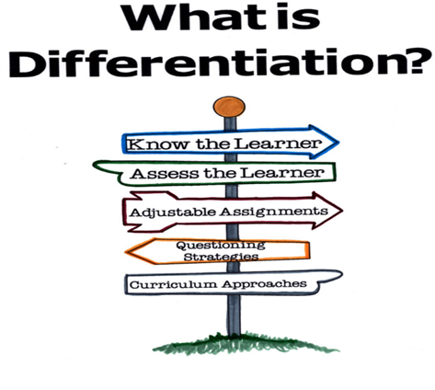
How to scaffold: differentiated Instruction for Project-based Learning
Notes:
A good way to start differentiated instruction is by recognising that every learner is worthy of individual attention and that you should adjust as far as possible, to accommodate individual needs by scaffolding to support each learner. Consider the following steps when planning your differentiated approach to teaching.
Step 1:
There are different approaches in lesson delivery. In project-based learning, learners have many chances to understand the content, so capitalise on the opportunity to get to know learners individually.
Before you start planning a PPBL cycle, have a goal in mind:
• What skills do you want them to practise?
• What do you want them to show in the end?
Plan questions for ‘’low’’ and ‘’high’’ learners before you start Project-basedLearning.
Here are some easy things to incorporate into PBL to deliver your lesson in different ways:
• Videos
• Reading selections
• Writing assignments
• Building a 3D model
• Discussion
Step 2: Different learning styles
One of the essential elements of PBL is student choice and voice. Not only do learners have a choice in how to show what they’ve learned in the project they turn in, but they also have several choices throughout the project. Everyone must do a Project in Life Skills, but it can be done with the strategies and tools that work for the individual student. PBL gives learners a chance to learn through technology, text, art, multimedia, and much more.
Step 3: Grouping to differentiate
During PBL, strategically shuffle groups around often. Not only does it keep it fresh and new for learners, but it allows for the teacher to implement differentiated instruction through grouping.
• Different groups to try in your classroom:
• Create similar groups and pool a small group of struggling learners.
• Group mixed groups.
• Group learners by interests.
• There are a lot of choices during PBL, so get some learners together that make the same choice!
• Try groups of 2, 3, or 4 people.
• Try partnerships of 1 boy and 1 girl.
• Allow time for learners to work independently but provide a space if they want to work in a “whisper group”.
• Give group members roles, based on their talents and affinities.
Step 4: Using a rubric to differentiate
Create rubrics for each PBL activity and give them to learners before you even start the activity, so that they know what you expect to see by the end of their project.
Step 5: Enrichment for advanced learners
Create extra challenging activities as part of differentiation. Challenging advanced learners is equally important as is helping those who struggle. Build varying challenges into your project-based learning because it allows you to differentiate for those learners without having to do anything extra during the actual activity

Slide 35
Supporting deeper learning in PBL: Classroom Management and group work
Keep learners busy
Teacher involvement is critical
Engage struggling learners by selecting suitable tasks which will empower them.
Have a variety of topics for learners to explore
Universal classroom management strategies
Notes:
1: Keep learners busy
If learners are engaged, they are less likely to misbehave. Use project-based learning activities that have printable guides and sheets to help learners organise their work, and have easy access to “Just-in-time” information either from textbooks, the internet or printed out information sheets which you can later collate and use to form a generic toolkit. Textbooks take on a different role in PBL: they are useful for research and no longer drive the LessonTake the time to plan each day of your PPBL with a fresh activity that will have learners asking many questions because this is the beginning of critical thinking. Each day should have a specific task or topic, but different learners might be working towards it in a different fashion, probably very different from your own strategy. Allow them the freedom to explore different ways of solving a problem.
2: Teacher involvement is critical
In the past, some teachers have used projects as a chance to let the learners “get on with it on their own” and would be unavailable to learners. This is not project-based learning! In PBL teachers take on the role of facilitator. Take the time during PPBL to walk around and talk to your individual learners. Because everyone is very busy, this is an excellent opportunity for one-on-one conversations with the learners in your class, especially those who shy away from attention. Don’t wait for the “usual suspects” to raise their hand and ask for help. Engage each learner in discussion and ask them questions about the topic. Groups are a safe space for shy learners to find their voice. This allows you to build relationships with your learners and let them know that you’re nearby paying attention to what they’re doing.
3: Engage struggling learners by selecting suitable tasks which will empower them.
Target the learners that you know struggle in class. Diversify the activities so that every learner is working on something s/he is good at!Plan out the questions you’ll ask these learners and be prepared to listen to what they have to say. Don’t be afraid of silences. Learners sometimes take time to formulate their answers. Give them space and do not give in to the need to fill the silence with your own words. Let them take responsibility for filling that space.
4: Have a variety of topics for learners to explore
During playful project-based learning, we want learners to ask questions and dive deeper into the topic. If possible, have computers, books, and other media available so that no learner has ever really completed the task. Expect more from learners. They should be working against time. This will force the group leader or timekeeper to manage time, encourage creativity and result in high productivity. If learners are really “into” a topic, they won’t stop engaging. They will look for more information on their own. This is a part of learning that needs to be instilled in learners because they aren’t always allowed the freedom to explore a topic.
5: Universal classroom management strategies
• Model ideal behaviour.
• Let learners help establish guidelines.
• Document rules and consequences.
• Avoid punishing the class.
• Encourage initiative.
• Offer praise – catch the positive.
• Use non-verbal communication

Slide 36
Questions and Answers
Raise your hand to ask questions
Or put your questions in the chat box
Or ask your coach after this training session.

Slide 37
www.ecubed-dbe.org

