Slide 1
Playful project-based learning A CHANGING WORLD Topic one
Notes:
Welcome

Slide 2
Programme
TIME | Min | ITEM
E.g. Time | TIME NEEDED | Item
08h00 – 08h20 | 20 min | Welcome and introductions
08h20 – 08h40 | 20 min | Ice-Breaker
08h40 – 09h05 | 25 min | Part One
09h05 – 09h30 | 15 min | BREAK
09h30 – 10h00 | 30 min | Part Two
10h00 – 10h15 | 15 min | Q & A

Slide 3
Icebreaker
Please share what the best thing that has happened to you as a teacher this year
Take 5 mins – you will be called on popcorn style to share.
Notes:
Give the participant 5 minutes to reflect and when you are ready, call on them randomly to share their experiences. Move to slide 4 for this.

Slide 4
Icebreaker feedback
Welcome back
Please share some of your stories in the chat or raise your hand to share your experience.
Notes:
When people come back start an informal discussion. E.g. Hi Paul, Sipho and Sally, welcome back. What were some of your highlights? Wow… that sounds amazing.” Have the nominated person tell the leads what is being read in the chat and comment on that. Give it 5 minutes to talk about what happened. Then pull it together and say, “We want to have more stories like this, and we hope you will see the possibilities for change during the day. For now it is time for us to move on…

Slide 5
PART ONE
A Changing World
In this section we will cover the following
One compelling goal – addressing youth unemployment
Competencies needed for a changing world
Teachers, let’s reassess our technical teaching skills
Teachers, let’s assess our current mindset and appetite for change
Teachers, how can we embrace change?
In this first section we are going to look at a changing world, what learners need to focus on to overcome this crisis of our time. We will also look at the role of the teacher in this journey. One of the most important aspects of the teacher’s role is to have a growth mindset
Notes:
Read what the session with entail.

Slide 6
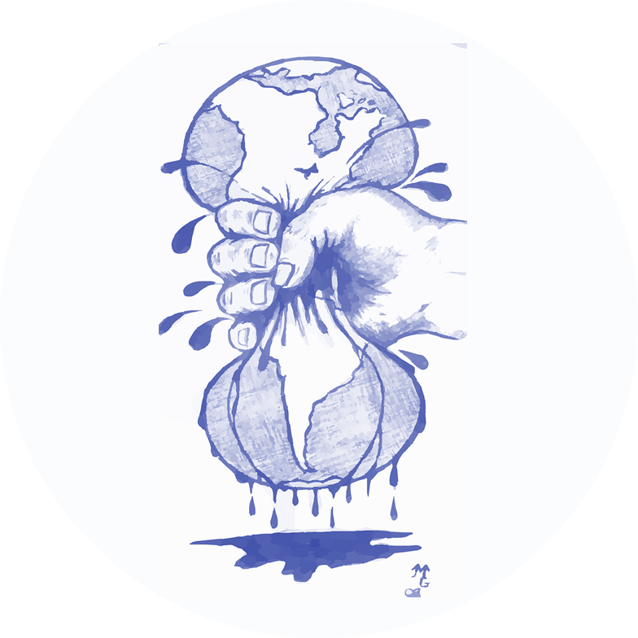
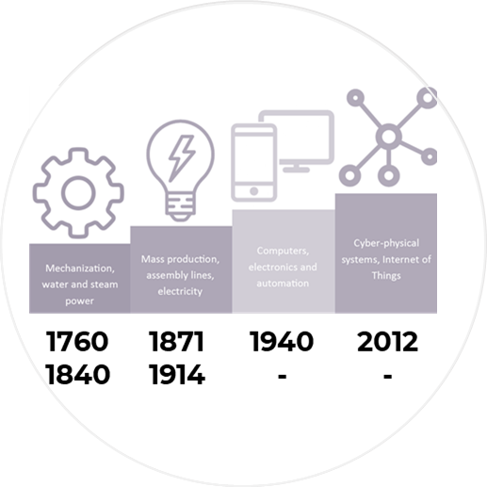
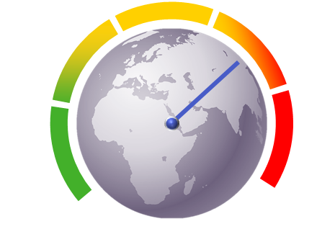
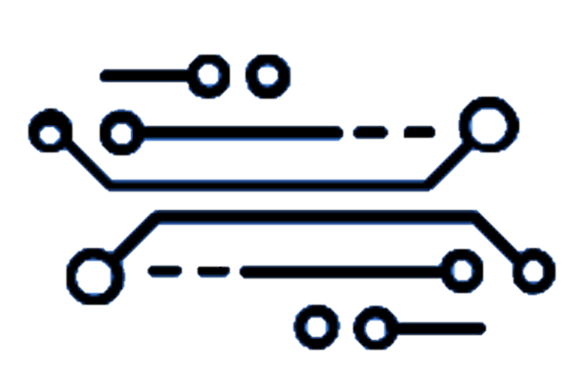
A changing world
Machine learning
What competencies do young people need in order to thrive?
Augmented reality
4IR
Shifting economy
Climate change
Pandemics
What can we do that computers can’t do?
Notes:
The fourth industrial revolution is upon us. From the use of coal to make engines move – instead of having people do the work, to vast factories powered by electricity that made mass production possible, to the information age where data grew to levels beyond our imaginations, we now live in a world very different from the world that existed when we were born – never mind in the 260 years since the first industrial revolution.
Our modern era brings changes all the time. Machines have become tools that we use without thinking. Our own chat service in E³, Teacher Connect, is an example of machine learning. Going on a virtual tour is augmented reality. Digital assistants annoy us with marketing calls almost every day and if you visit a Medicross doctor you can book your own appointments. A machine will create your own music playlist just by learning what music you “swipe left” on spotify or which movies you consistently choose on Netflix. Websites recommend products and movies and songs based on what we bought, watched, or listened to before. Robots vacuum our floors while we do something better with our time. Spam detectors stop unwanted emails from reaching our inboxes. Medical image analysis systems help doctors spot tumors they might have missed. And the first self-driving cars are hitting the road.
We can expect more. As big data keeps getting bigger, as computing becomes more powerful and affordable, and as data scientists keep developing more capable algorithms, machine learning will drive greater and greater efficiency in our personal and work lives.
The big price we pay is that our modern world is changing the global climate and it is predicted that this will lead to an increase in illnesses and things like our current Covid-related impacts. The other is that many of the jobs that we take for granted either no longer exist or are rapidly evaporating. It means that the young people who are in school now will graduate into a job market that keeps changing and our job is help them be prepared for this uncertain future. We can either be distressed or we can be inspired. We are choosing to be inspired. We have the solution.

Slide 7
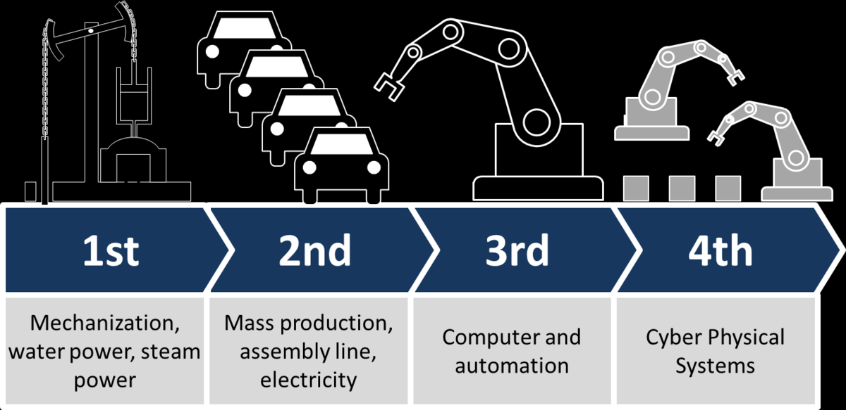
1st
2nd
3rd
4th
Mechanisation, Water Power, Steam Power
Mass production, Assembly line, Electricty
Computer and Automation
Cyber Physical Systems
Notes:
A Changing World
The Fourth Industrial Revolution (4IR), Artificial Intelligence (AI), catastrophic weather conditions resulting from climate change, epidemics and pandemics such as Covid-19, have resulted in our world changing at a quicker pace than ever before. There is much uncertainty in our lives, but what is certain is that our children will enter a post-school world that will be very different from ours. In order to cope in this changing world and find their meaningful place in a shifting economy, they will need a different set of skills and competencies. So, what does the future look like in this changing world of ours?
What we do know is that we are entering, if not already in the Fourth Industrial Revolution. We also know that computers are a huge part of our lives, and that the world as we know it now, in terms of jobs and opportunities - especially for young people - will be changed dramatically by these computers. We know that computers are already being seen as the source of all knowledge (real and fake). We assume that we use a computer to find all that we need to know at the touch of a button. We know that computers will bring digital, physical and other systems together that will change our lives and our jobs forever.

Slide 8
Become really good… at what computers can’t do
Computers can’t imagine
Computers aren’t curious
Computers can’t build relationships
Computers have no empathy
Notes:
Computers will be able to do a lot, but there are things, unique to humans, that computers won’t be able to do. Computers won’t be able to be totally creative - they are not creative beings. They won’t be able to form relationships with people and they can’t perform unstructured tasks. These are the skills that will not be taken over by computers and which will open up huge opportunities for humans and keep us ‘on top of the food chain.
’If we are very conscious of the things that we need and can do that give us the edge over computers, we can stay truly creative. If we can design in a creative manner, we can stay ahead of computers and enhance our creative intelligence.
So, if we are to interact with this new changing world, as humans we need to enhance our creative and communicative intelligence. We need to think of ways of being more and more creative. We need to be able to strengthen our communication skills and our relationship intelligence because this is an area where computers can’t compete. We need to have the skills and agility that don’t necessarily follow structure because we know that computers can only operate in a structured environment. So, it is important that we as teachers start to think about what this means for us personally and professionally. What does it mean to be creative, to strengthen communication skills and to have the skills and agility that do not follow structure?
In order for our learners to excel and succeed in the world of work they will need to become really good at things that computers can’t do. Computers can only do what they are inputted to do. They do not have human traits and it is those very traits that will make all the difference. Computers can’t come up with ideas or ask questions by themselves. Schooling has to stimulate learner imaginations and curiosity and help them build relationships through communication, problem-solving and innovation. In other words, they have to develop competencies. If we don’t, then the problem we have today will continue to grow. We have to do things differently.

Slide 9
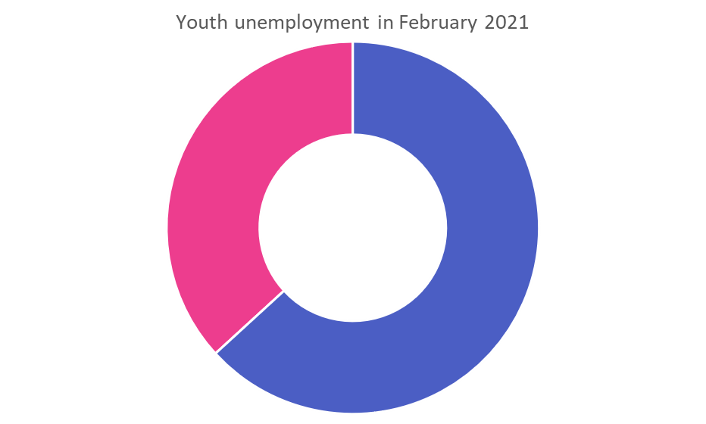
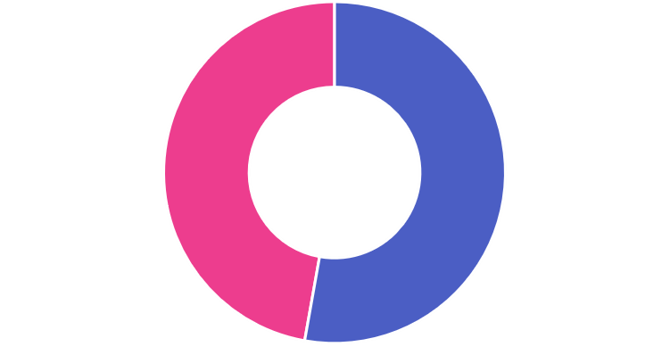
THE UNEMPLOYMENT CRISIS
Youth unemployment pre-COVID19
Youth unemployment post-COVID19
How much has education contributed to this problem?
Notes:
The unemployment crisis
As we know, very depressingly, South Africa has an enormous employment crisis with large numbers of people unemployed, resulting in our country being labelled as the most unequal society in the world. Even more distressing is the fact that youth unemployment currently stands at 52.8% (and during COVID is closer to 60%).
This is a sad prospect for young people’s future in South Africa. Schools have a massive responsibility to ensure that the time learners spend at school is a good investment in future proofing them. Let’s make sure learners spend their time at school in a relevant and productive way so that they can become successful and fulfilled citizens.
It is during these 13 years that learners have the opportunity to develop the competencies and skills that will make them an integral part of the new world, that will give them the edge over computers and enable them to develop the problem-solving skills needed to cope with any challenges that come their way. In light of the youth unemployment crisis, we urgently need to ask if the traditional (let’s call this ‘chalk and talk’) style of teaching is relevant. Is it perhaps obsolete and irrelevant? Will 13 years of traditional schooling provide learners with what they need to be employable, start their own enterprises or continue with their studies? In other words, are we future proofing our learners?

Slide 10
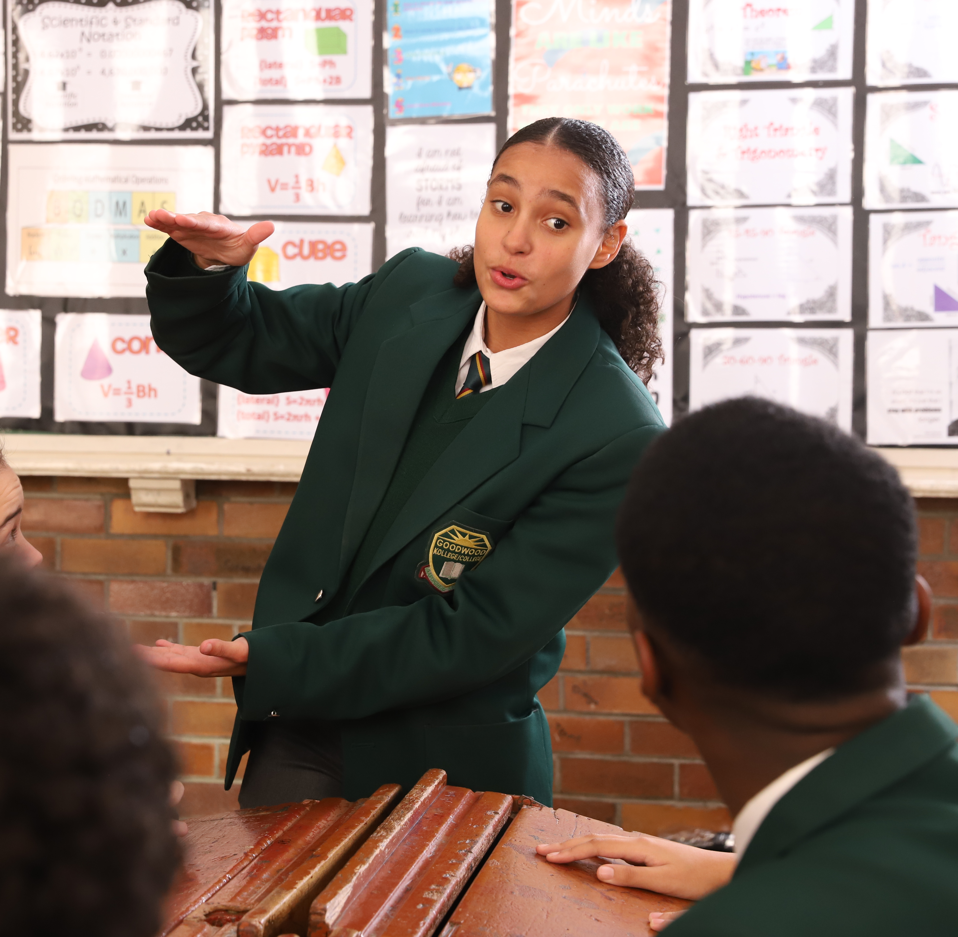
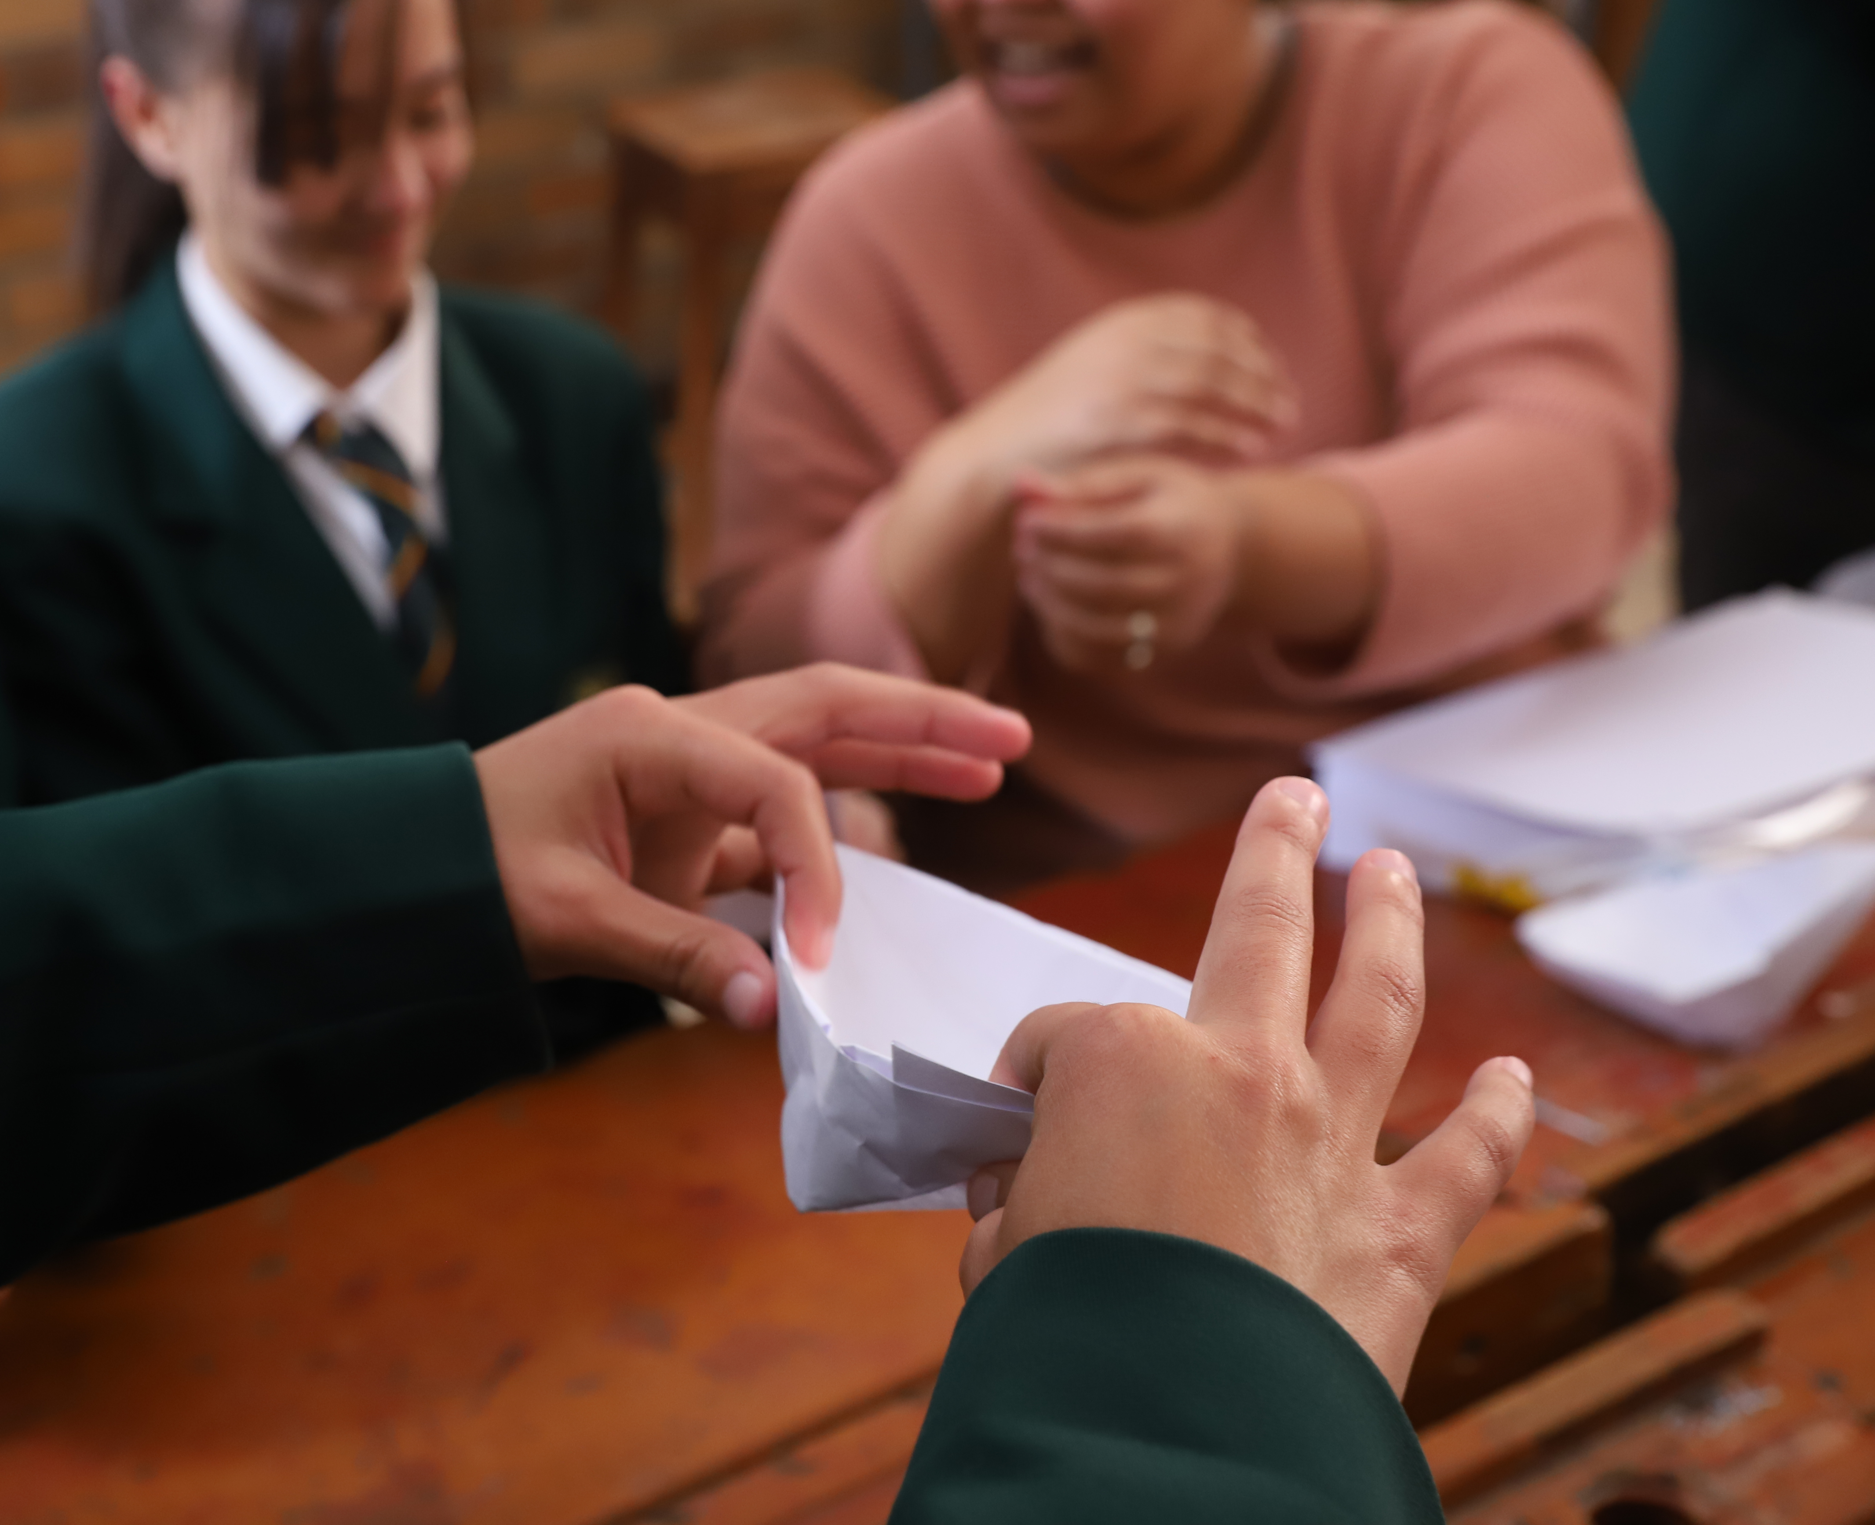
Teachers need to adapt
Notes:
Teachers need to adapt
21st century learners are very different. They have a different way of approaching the world: they are tech savvy, they are impatient, they want to do things. They don’t just want to sit and copy from an outdated textbook. They want to be involved and engaged and they want their classroom to be fun.
As teachers, we have the amazing opportunity to meet the different needs of our 21st century learners, but for this to happen, we need to be ready to embrace a more authentic way of teaching that is results driven, action-based and relevant. Teachers need to be able to reflect on whether they are ready for what it means to prepare learners for our changing world.
It is comfortable to stay in one’s old way of being and it is easy to use one’s old teaching notes, but let’s ask ourselves what we need to do to be ready to adapt to this new classroom. As teachers, we are in an incredibly powerful position to impact the lives of learners in a positive way. It is teachers who learners sit in front of, day after day for 13 years, so it is teachers who need to buy into the fact that they are the most important frontline people to become agents of change in the lives of their learners.
As frontline staff, teachers need to assess their changing role in the 21st century classroom and commit to teaching differently and more effectively. This assessment and commitment may require a shift in mindset and reflection on questions such as:
Am I resilient enough to deal with the new demands of the 21st century classroom?
Can I embrace the 21st century skills and competencies I need to help unlock the potential of every learner and help them thrive and become active members of the modern economy?
We all want to see our learners have the opportunity to become either gainfully employed as entrepreneurs, be employable and find jobs, or pursue an educational journey after school – and as teachers, we are perfectly placed to make this happen.

Slide 11
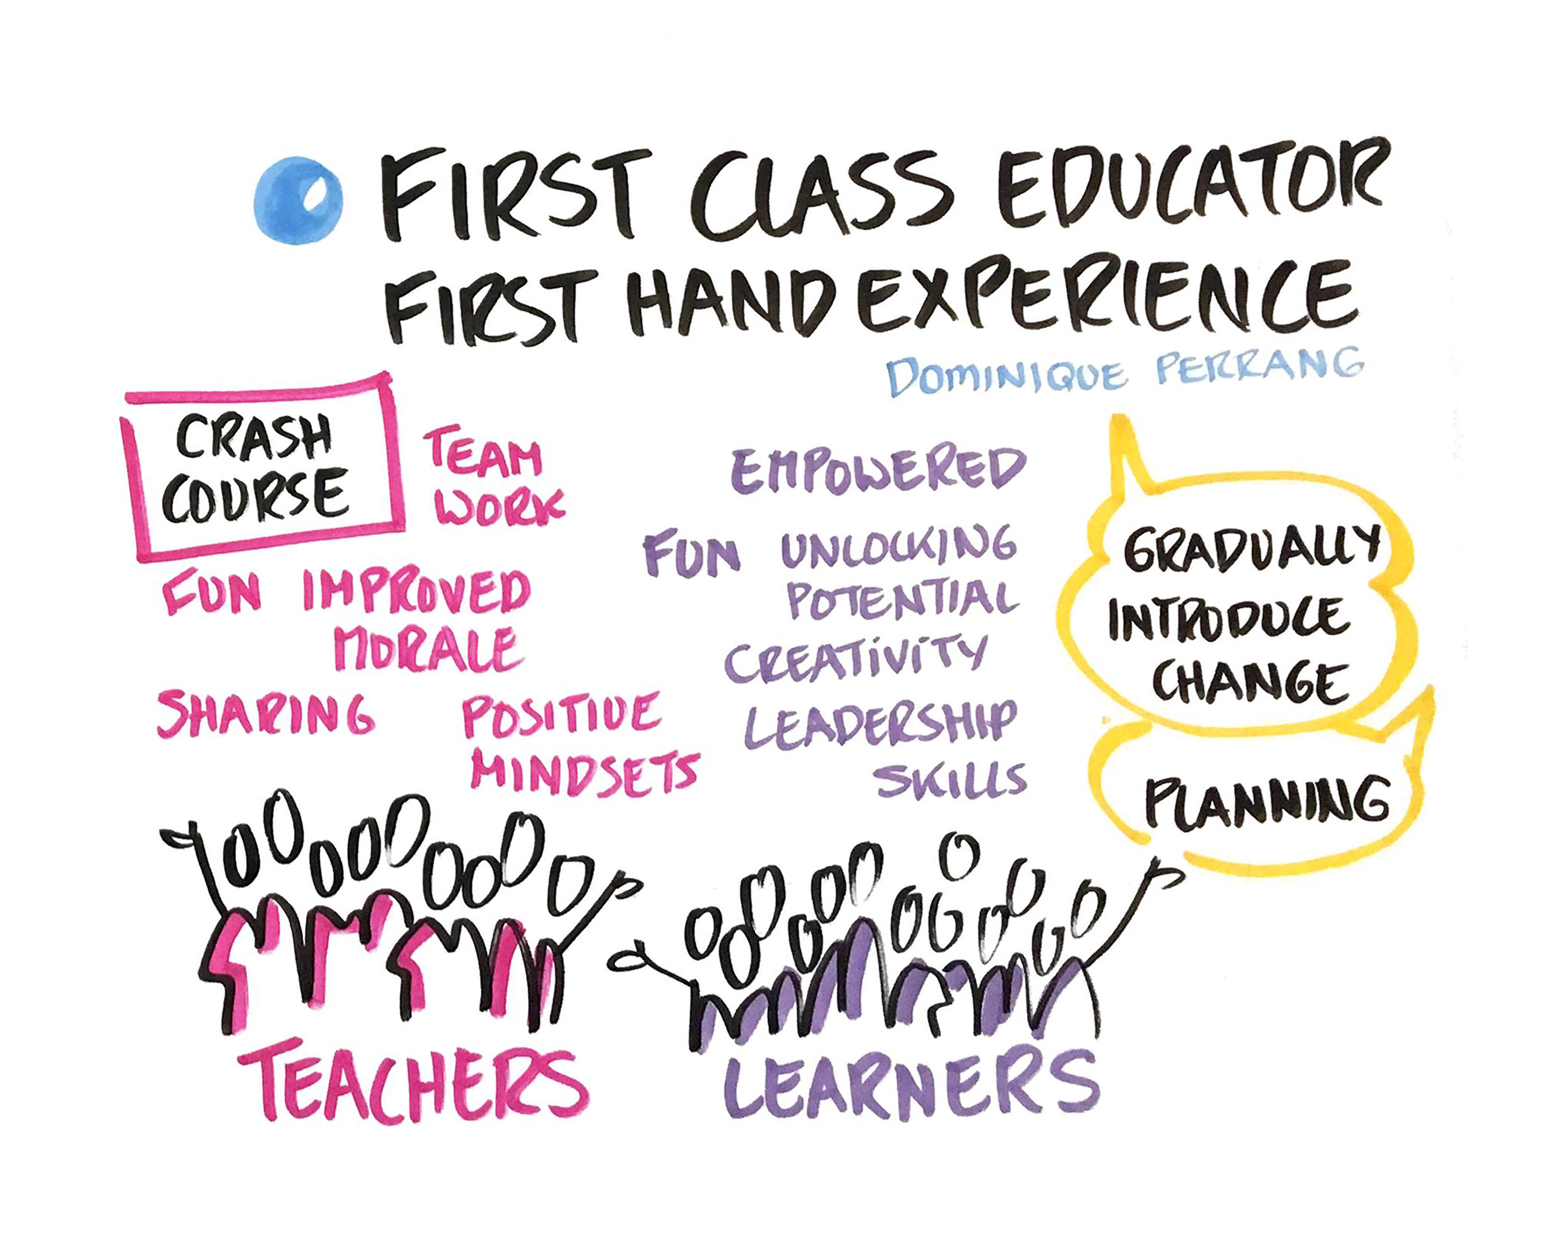
21st Century Competencies (Character, Thinking and Connection)
Notes:
21st century competencies (Character, Thinking and Connection)
The DBE’s CAPS curriculum is intended to prepare learners for the changing world and the modern economy and enable them to participate fully in the modern economy.
E³ is assisting the DBE by helping teachers unlock 21st-century competencies, such as character, thinking and connection, to ensure that learners can become entrepreneurs, are employable, or are able to further their education (the three Es of E³).
This will help to significantly reduce youth unemployment. Teachers are encouraged to use methodologies such as Playful Project-based Learning to help learners during their 13 years of schooling activate and master 21st century competencies. These competencies will become the tools that will enable every young person to become solution-seeking, problem-solving “entrepreneurials.”
There are various models used worldwide that define what these competencies are, and the DBE has been guided by the UNESCO-IBE Competence-based curriculum. The goal is for: “…learners to leave school with the developmental capacity to interactively mobilise and ethically use information, data, knowledge, skills, values, attitudes, and technology; to engage effectively and act across diverse 21st century contexts; and to attain individual, collective, and global good” (UNESCO-IBE).
The DBE established the E³ programme in 2018. This programme uses less traditional and more learner-centred teaching and learning, including projects and games, to deliver the existing CAPS curriculum more efficiently so learners are better prepared for the modern economy.
The goal of E³ is to inspire 100% of learners to complete school and for 100% of these learners start their own enterprises, get a job or study further, i.e. Entrepreneurship, Employability and Education for tertiary and lifelong learning.
E^{3’}s vision is to create a new generation of engaged South African citizens, who are prepared and enabled, through the schooling system, to build the economic engine of the country. By transforming teaching and learning in South African classrooms, the E³ programme seeks to create the building blocks of an entrepreneurial nation, which is capacitated to address socio-economic challenges, including poverty and unemployment.
Be it for employment purposes, employability or for further education purposes, an entrepreneurial mindset (opportunity-seeking and problem-solving) is the answer to the problems looming in the changing world post school

Slide 12
Efficacy and personal agency for teachers and learners
Citizenship
01
CHARACTER
Curiosity
Resilience
Mindset
CONNECTION
Collaboration
02
Communication
Empathy
03
THINKING
Creativity
Critical Thinking
Reasoning
Notes:
Efficacy and personal agency for teachers and learners
Learners who are truly successful after leaving school will be those who have had many opportunities to engage in real-life scenarios in a practical way. As a direct benefit of 13 years of this type of learning, learners will develop confidence (because there is a safety net if mistakes are made) as well as self-efficacy and personal agency to accompany their 21st century competencies. E³ has selected 3 core competencies on which to focus, which will develop and build entrepreneurial 21st-century, solution-seeking mindsets in the South African classroom.
These competencies are:
Click
• Character (Citizenship, Curiosity, Resilience)
Click:
• Connection (Collaboration, Communication, Empathy)
Click:
• Thinking (Creativity, Critical Thinking, Reasoning)
By activating these competencies, E³believes that the following positive elements - as identified by UNESCO - will follow: lifelong learning, self-agency, and the interactive use of diverse resources and multi-literateness.

Slide 13
Need for Deep Understanding
Rather than shallow knowledge
Need to build understanding
Across and among academic subjects
The need to engage learners
With authentic data tools and experts
The need for indicators of progression
To allow multiple measures of mastery PPBL has been identified
Notes:
Addressing the issues using Playful Project-based Learning (PBL)
The DBE understands the changing needs of education in SA as:
Click
• The need for deep understanding rather than shallow knowledge;
Click
• The need to build understanding across and among academic subjects, as well as within 21st century interdisciplinary themes;
Click
• The need to engage learners with authentic real-world problems, data tools, and experts;
Click
• The need for indicators of progression to allow for multiple measures of mastery Playful Project-based Learning (PPBL) has been identified by E³ as the ‘vehicle’ to meet these needs and develop 21st century competencies in learners as this approach provides problem-solving opportunities that stimulate solution-seeking mindsets.
E³ recognises the “Instructional Core”, i.e., the integration of skilled and knowledgeable teachers, engaged and active learners, and rigorous content as pivotal to creating the shifts required to drive educational change at scale. The E³ Playful Project-based Learning programme, champions progressive, constructivist methodologies as a way of doing what Bell Hooks (1994) refers to as, “Interven(ing), alter(ing) and disrupt(ing) the classroom atmosphere” in order to shift core beliefs and attitudes about teaching and learning. Through this programme, E³ also aims to realise the following three programme pillars:
• Equipping learners with 21st-century skills;
• Developing personal agency through unlocking a mindset that produces value and usefulness to others; and
• Developing a belief in self and ability.
In this context, our role as teachers is to create positive learning environments by designing engaging and stimulating learning processes and projects.

Slide 14
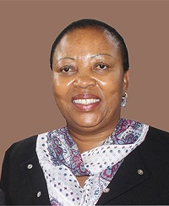
“From a young age, learners will grow their empathy, become caring and develop a continuous problem-solving mindset that is driven by what they care about. It is this process that will establish hope and belief in the new SA of engaged youth.”
Notes:
Through the E³ programme, teachers will be empowered to implement Playful Project-based Learning (PPBL) and Active Learning Pedagogies to unlock the competencies learners need for future success.
(Dr Maboya: Deputy Director General, Curriculum Policy, Support and Monitoring in the Department of Basic Education) said “The E³ value proposition is to provide THE platform for all education initiatives working with DBE schools who are striving to bring 21st-century skills into the pedagogy. Included in this process is the need for all learners to develop curious, enquiring, empathetic minds. They will do this in every subject by being encouraged by the teacher to conceptualise a need, develop a solution and design a project that meets the needs of their environment and that fulfils a purpose within themselves. Teachers will create the opportunity for fun and fascination and provide the direction and guidelines for the three stages of conceptualisation, process and project outcome. From a young age, learners will grow their empathy, become caring and develop a continuous problem-solving mindset that is driven by what they care about. It is this process that will establish hope and belief in the new SA of engaged youth.”
Transmission versus active learning pedagogies - fit for purpose teaching
The world is changing and what happens in classrooms also needs to change to keep up with society. The classroom needs to model society and incorporate activities that are more reflective of the new world so that learners are solving real-world problems that affect them. This authentic engagement with learning will give their lives purpose and meaning. Teacher-centred learning is no longer appropriate as the only pedagogy in 21st-century classrooms. The way we teach should be fit for purpose. If we are trying to develop real-world competencies in our learners, we need to manage the classroom and recreate the activity in such a way that it feels like a real-world activity. How else will learners be able to assess their competency development? Because we are preparing learners for a different world in which to flourish, they need very different knowledge, skills and competencies, and values.

Slide 15
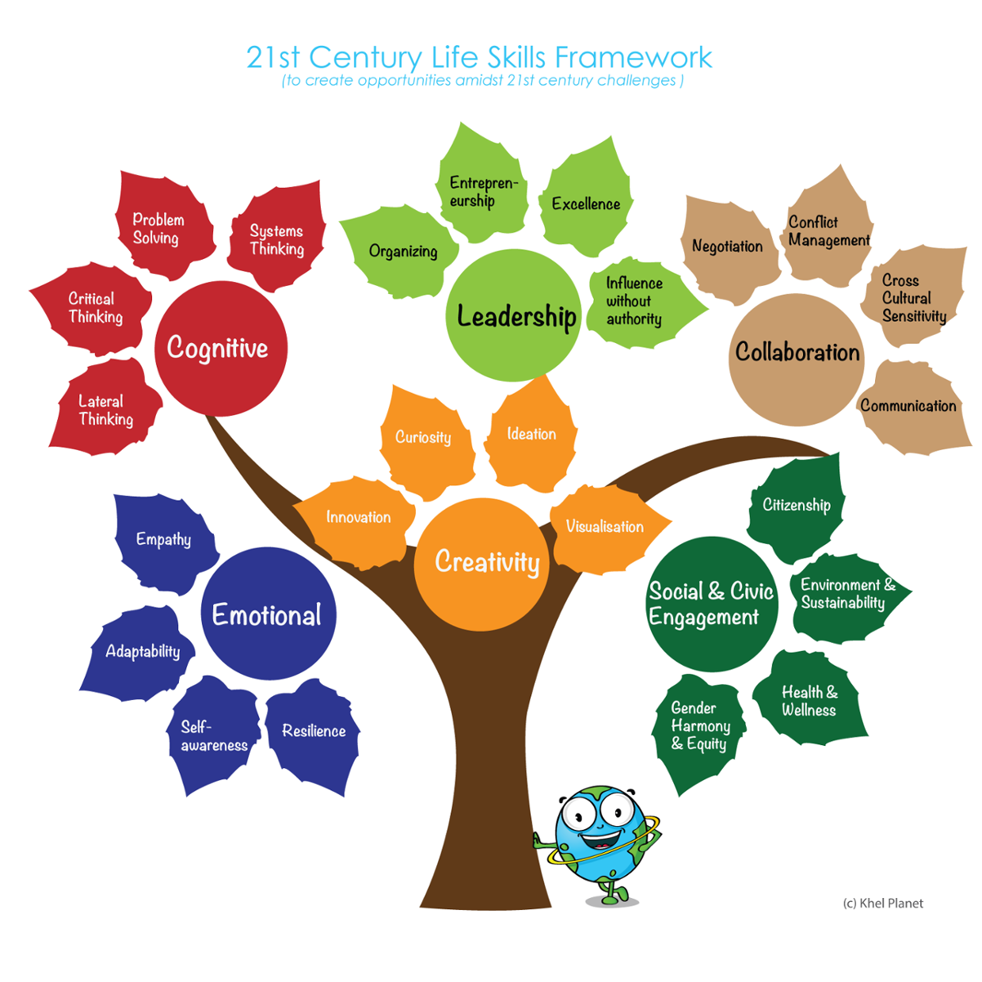
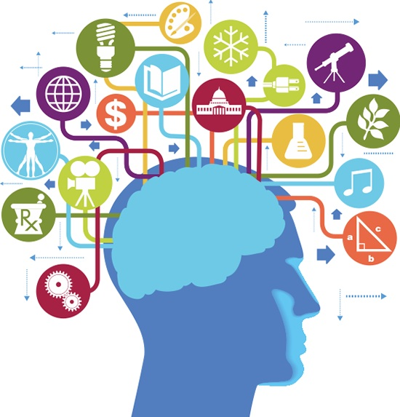
The Importance Interdisciplinary learning
Notes:
The importance of interdisciplinary learning
Knowledge is still important in the 21st Century and traditional subjects like History, Geography and Geometry still have value, but we need to start connecting the subjects. They cannot be stand-alone entities. Inter-disciplinary knowledge is the order of the day in the 21st Century. Linked to traditional subjects, we need to add modern subjects such as entrepreneurship. We also need to connect all these subjects and all the knowledge to global issues like climate change and sustainable development. In terms of skills and competencies, many are needed in order to apply 21st Century knowledge, and while they are embedded in most school subjects, they still need to be unlocked.
Active learning promotes the development of competencies
Traditional teacher-centred teaching has a role, as mentioned above, but this traditional role will diminish as teachers see how successfully they can unlock competencies when learners are doing the work and teachers are taking on the role of facilitator. Millennials and Gen Zs thrive when they are actively involved - when they are doing and not just listening. Research shows that active learning pedagogies (ALPs) are more successful in developing 21st Century learning than traditional teaching. According to well-known educationalist, Michael Fullan (2014), Project-based Learning (PBL), which is an Active Learning approach, is probably more closely associated with 21st Century learning skills than any other form of learning.
How to start the journey to Active Learning – classroom management and group work
An immediate starting point is developing and refining your classroom and group management skills.
Group work delivers a number of 21st Century skills:
• Grouped learners lead the discussion, they are actively engaged.
• Grouped learners develop critical thinking, communication and teamwork skills.
• During group work, it is easier to see each learner as an individual as you visit your small groups.
• It is also easy to identify struggling learners and offer them ‘just-in-time’ learning and scaffolding as needed. This is good activity-based learning which forms part of PPBL.
• Group work also satisfies social reconstructivism - an active learning approach which delivers the skills and competencies we are aiming for.
According to Lev Vygotsky group work is social because the learner is engaged in the process and learners learn from each other. It is reconstructivist because it is learner-centred and thus allows learners to construct their own understanding. Active learning all starts with the learner, not the book. It is the best way to ‘plug into’ Generation Z. Chalk-and-talk can no longer be the only approach. We as teachers need the technical expertise to manage group work and strengthen other technical skills to enhance the learning process

Slide 16
Are we ready for change?
• Do my students have opportunities to be creative?
• Are my students allowed to display their learning in different ways?
• Can my students document and reflect on their learning, exchange ideas and collaborate with others through, for example, blogging?
• Do my students have digital portfolios where they can display their progress and archive their work?
• Do I invite guests into our classroom, either live or virtually, to broaden our knowledge and global perspective?
• Are my students aware of how to be safe online and how to be good digital citizens?
• Do I myself model good digital citizenship by being present online and by connecting with others on social media?
Notes:
Are we ready for change?
We at E³ are motivated by a huge compelling goal – that every young South African must be gainfully employed, active as an entrepreneur and be educated for life after school. And we, as teachers, have an enormous role to play in this compelling goal. As teachers, we need to consider our personal attitude towards change. Do we fear leaving our comfort zone? Or are we just too comfortable? Are we fixed in our ways or are we prepared to grow and adapt? And so, the question is: Do you have a fixed mindset or a growth mindset? You are in an enormously powerful position to influence the future of learners if you are just willing to embrace change: change in the world around you and change in your own classroom. So here is a quick checklist for you.
Ask yourself the following:
• Do my students have opportunities to be creative?
• Are my students allowed to display their learning in different ways?
• Can my students document and reflect on their learning, exchange ideas and collaborate with others through, for example, blogging?
• Do my students have digital portfolios where they can display their progress and archive their work?
• Do I invite guests into our classroom, either live or virtually, to broaden our knowledge and global perspective?
• Are my students aware of how to be safe online and how to be good digital citizens?
• Do I myself model good digital citizenship by being present online and by connecting with others on social media?
• Do I make an effort to connect face-to-face or online with other educators at conferences?
• Do I model a growth mindset by stepping out of my comfort zone and trying new things?
• Do I believe that I would enjoy being a student in my own class?

Slide 17
Tea Time
Please be back in fifteen minutes, ready to play a game.
Notes:
Leave this up for tea time

Slide 18
PART TWO
A Changing World
In this section we will cover the following
A fixed versus a growth mindset
Growth mindset quiz
The Circle of Influence versus the Circle of Concern
How can teachers embrace change?
Teachers, how can we embrace change?
In this first section we are going to look at a one of the most important aspects of the teacher’s role which is to have a growth mindset
Notes:
Read what the session with entail.

Slide 19
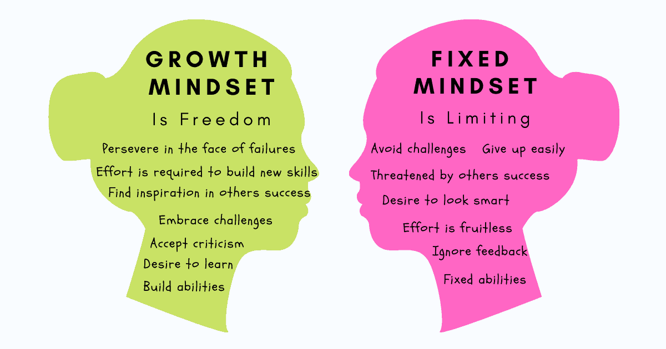
A fixed versus a growth mindset
Notes:
A fixed versus a growth mindset
Why do some of us succeed and others not? Carol Dweck did a study to show that there are two mindsets which direct our lives: a fixed mindset or a growth mindset.
Fixed mindset
Many of us spend our lives trying to prove ourselves. In everything we do, we look for acknowledgement and confirmation: Am I OK? Will people think I am stupid? Am I a loser? Are the talents I have been handed sufficient for success? The world is changing every day. The days of being an expert because you were “handed” certain talents or specialised in a specific field, e.g., teaching, are over. If you are not prepared to accept occasional failure and change with every setback, and thus learn from your mistakes, you will not be open to growth. Your mindset is fixed. “A fixed mindset assumes a static stance towards intelligence, character and creative abilities – people with fixed mindsets believe their talents and intelligence are fixed at birth and therefore cannot be improved upon.” As a teacher, you are at the start of a new professional journey. There will be hurdles but, see them as tools for developing professional muscle and personal resilience. You need to keep on growing so that your learners will thrive – success is a personal choice. “If it’s going to be, it’s up to me!”
Growth mindset
The other choice (and it is in your hands!) is to accept the following:
• Although I have certain talents, they are merely the starting point of who I can become.
• I believe that I can learn and be an expert at anything if I put in the effort.
• I appreciate feedback and know that making mistakes is part of growth.
“The growth mindset argues that talent and intelligence can be developed over time and with effort. Those with growth mindsets tend to thrive on challenges and embrace failure as a mechanism for learning and development.”

Slide 20
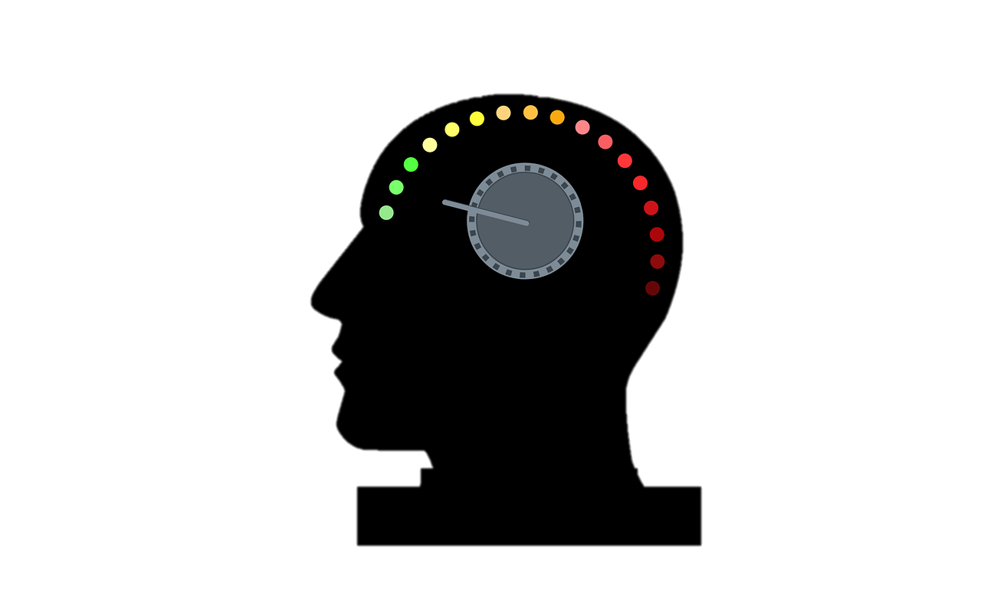
Growth mindset quiz
In the chat you will find the link to an online quiz.
You can do it on your phone or computer.
We will call you back in ten minutes.
Notes:
Add the link to the chat and ask people to go to the chat to click on the link. We are going to have a short growth mindset assessment to see where you are right now. We will call you back in ten minutes.
Interactive Quiz: Fixed vs Growth Mindsets | London Academy of IT

Slide 21
My growth mindset
How do you feel about your score?
Please share your thoughts in the chat.
What have you learnt about yourself?
Notes:
When people come back start an informal discussion. E.g. Hi Paul, Sipho and Sally, welcome back. Is there anything you would like to share about what you learned about yourself? Or the quiz itself? Wow… that sounds amazing.” Have the nominated person tell the leads what is being read in the chat and comment on that. Give it 5 minutes to talk about what happened. Then pull it together and say, “Growth mindset is something that can be learned. We hope this is a new beginning for you. Right now it is time for us to move on to preparing us for the next step.

Slide 22
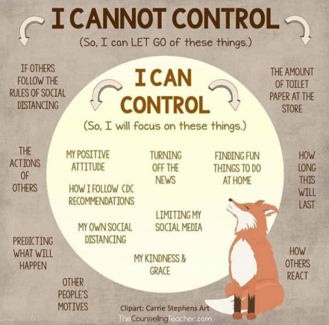
The Circle of Influence versus the Circle of Concern
Notes:
The Circle of Influence versus the Circle of Concern
Not only mindset, but also the manner in which you deal with your day-to-day frustrations can affect successful teaching in the 21st century classroom. Some problems can be managed, but others are beyond the control of teachers. What about focusing on the things you can control and “parking” the situations you cannot control? Why waste time and energy on areas which you cannot influence? According to Steven Covey, every one of us operates in two circles, the Circle of Influence and the Circle of Concern. These circles represent the two areas in which you focus your time and energy. The inside circle represents situations in which you can influence or control, while the outer circle represents situations over which you have no, or very little, control.
Most people waste a great deal of energy and time being concerned about issues that they cannot change. In other words, they spend too much time in their Circle of Concern. Steven Covey believes that successful ,people think and do things within their Circle of Influence and do not waste time on issues that they like to complain about but over which they have no control.
To make a real difference, rather focus on things you can influence. Make a difference, but by focusing your energy on being effective and changing unhappy situations. By doing so, you will be entering a cycle of success: by doing more and more things that you have control over, you are increasing your Circle of Influence and are entering a positive cycle of earning more respect and power. Where do you spend most of your time and energy? Whenever you're getting worked up over something, ask yourself, “What can I do to change this situation for the better?” Figure out some good ideas and act on them. If you really can't think of anything, realize that you're wasting valuable time and energy worrying about the issue. Let it go and redirect your resources to an area where you can actually make a difference.
Some tips:
• Stop worrying about other people. Stay within your Circle of Influence.
• Stop worrying about something that has happened or will happen that
• you cannot control. Worrying paralyses you.
• Plan your actions. Be organised to avoid situations that will land you in your Circle of Concern.
• Practice staying in your Circle of Influence so that it grows bigger. As it grows bigger, the Circle of Concern grows smaller. You will feel more in control. You will be less stressed and become happier.
New knowledge and mindset are the gateway to change But, without considering new knowledge about how we react to change, we may never open ourselves up to new beliefs, and maybe our behaviour will never change. And so, a growth mindset is one whereby talent and intelligence can be developed over time and with effort. With a growth mindset one thrives, challenges and embraces failure as a mechanism for development. People with a growth mindset listen to new information. They are willing to change beliefs and assumptions and to start behaving differently. "My effort and attitude determine everything. And so, If it’s going to be, it’s up to me. It is up to me and my growth mindset to change the world and to be part of E³’s compelling goal."

Slide 23
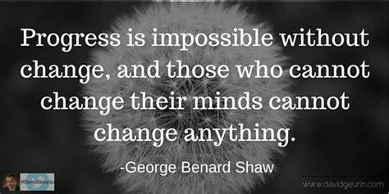
How can teachers embrace change?
Growth Mindset
Collaborate
Dig Deep and face your fears
Have fun with your learners
Embrace diversity
Embrace happiness
Notes:
As we consider the last session for the Topic: A changing world, we have come to realise that we all need to change and to adapt to the changes around us. How can teachers embrace change? Consider these six skills as you reimagine the way in which you teach.
Skill 1 – A growth mindset to start with will mean that you are not afraid to try out any of the skills that follow. You are a risk-taker because you want to learn and you are not afraid of making mistakes.
Skill 2 – Collaborate, pair, share. You are not alone. Your colleagues, technology and your learners are now partners on an exciting new learning journey. Knowledge is constantly changing, so the textbook which is quickly outdated can no longer be the driver. We truly need one another. Pooling knowledge and skills is more productive than going at it alone. 21st Century teachers can no longer be lone wolves.
Skill 3 - Our ability to dig deep, face our fears and try out new things in the classroom. With your growth mindset, you will no longer be afraid of taking risks and making mistakes. The 21st Century needs more real-life problem-solving, solution-seeking teachers and learners who see so-called failure as a launchpad to new learning.
Skill 4 - Laughter and enjoyment. Have fun with your learners. Make this choice and you will build bridges to your learners. Laughter will also create an enabling environment for your learners to try out new things without any fear of losing face because of failure. Accept mistakes and forgive yourself for making them.
Skill 5 - Embrace diversity in your classroom. Diversity comes in all shapes and sizes, not only in your classroom, but globally. Classrooms are diverse in terms of race, creed, colour, but also in language and the different ways in which learners learn and make sense of the world around them. Teaching has to become more personalized. Start working in small groups and see each individual learner in the group as a person. Watch your learners grow as you acknowledge them and their uniqueness. Watch yourself grow as they acknowledge you. You will know that you are doing well when you really understand Skill 5.
Skill 6 – Embrace happiness. This sixth skill is really an outcome of the above skills. If you develop a growth mindset, are prepared to collaborate, boldly try out new things, laugh and enjoy the journey with your learners because you see each one as unique and special, you will eventually reach Skill 6: Embracing Happiness. Happiness is a choice, but it is also the result of events in your journey as a teacher.
Event 1 – become a valued member of the teaching community.
Event 2 – you yourself value that community.
Event 3 – that community starts being valued by others. It’s all about mindset and accepting that it is OK not to know, but it is not OK to do nothing about it.
Embrace change, become a change leader and watch as your learners follow you. E³ is here to help and support you on this often, scary journey. Accept the challenge and change your school. Make it an exciting place where your learners are faced with exciting challenges every day. Make it a place of laughter and happiness, where these problems are solved, and successes celebrated.
We have reached the end of Topic 1: The world is changing. We acknowledge our challenges, both those of youth unemployment and the new world of work. We know that we have to adapt our teaching in terms of technical skills and mindset changes. We know that happiness is a choice and that we alone are responsible for the change we want to see. "If it’s going to be, it’s up to me."

Slide 24
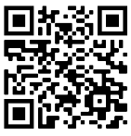
Get connected
Find out what you need for this journey by adding TeacherConnect as a contact on WhatsApp with the number 060 060 33 33 and send the world BELT to start with training on our zero-rated platform, or use the TeacherConnect QR code below:
The Teachers’ Lounge
https://www.teacherconnect.co.za/share/49Q5oaJa85GQmb9C?utm_source=manual
Notes:
Before we end, please feel free to link up with the E³ journey on TeacherConnect and in the Teachers’ Lounge.

Slide 25
www.ecubed-dbe.org
Thank you – see you soon

